Slide 1
Pregnancy termination trajectories in Zambia
Dr Ernestina Coast (London School of Economics)
Dr Susan F Murray (King’s College London)
International Seminar on Decision-making regarding abortion—determinants and consequences
Nanyuki, Kenya, 3-5 June 2014

Slide 2
Background
The Termination of Pregnancy Act (1972, amended 1994) legalises induced abortion in wide range of circumstances
  “account may be taken of the pregnant woman’s actual or reasonably foreseeable environment or of her age”
The Penal Code criminalises unsafe and illegal terminations

Slide 3
To try to understand…
Why public sector investment in safe abortion services in Zambia is not fully used.

Slide 4
Comparative research design
ToP at a hospital
vs.
Abortion-related care at a hospital
Notes:
4

Slide 5
Methodology
Facility-based recruitment
  Attempts to include severe morbidities
Novel dual interviewer approach for simultaneous mixed data collection
Women interviewed immediately following discharge after ToP or PAC
  n=112, refusal rate=13%
Extraction and analysis of medical notes
Framework analysis used to facilitate within and across case explanatory analysis

Slide 6
Methodological failure
Qualitative longitudinal (QL) component
  3/112 achieved
  Despite 90%+ agreement for follow-up
  But you have to try….

Slide 7
Results and discussion

Slide 8
Facility-based design aims to capture some of the safe/unsafe dichotomy
Safe
Unsafe
Hospital TOP
Hospital PAC

Slide 9
Safe/unsafe dichotomy
Not all TOP initiated outside study hospital is equally unsafe
Safe
Unsafe
Continuum of safe
Hospital ToP
Hospital PAC
Hospital PAC

Slide 10
3 typologies identified
Developed 3 typologies of the trajectories for women receiving care in public sector hospital
Typologies:
  Give better purchase on the data and help explain difference
  Help identify points of intervention

Slide 11
Typology 1
Hospital ToP sought
Referral clinic
Barriers at or before hospital not overcome
Arrives at hospital for ToP
MA
MA & MVA
MVA
Presence or absence of complications

Slide 12
Typology 2
‘Clinical’ ToP sought from unregulated setting
Typology 3
MVA performed or MA commenced with clinical input (e.g. pharmacist)
ToP completed without complications
Complications from successful or unsuccessful ToP treated outside hospital
Death
TOP unsuccessful without complications
Referral clinic
Arrives at hospital for abortion-related care
Review, antibiotics
2nd dose MA
MVA
Presence or absence of complications

Slide 13
Typology 3
Non-clinical ToP sought
Typology 2
Non-clinical ToP performed
TOP completed without complications
Complications from successful or unsuccessful TOP treated outside hospital
Death
TOP unsuccessful without complications
Referral clinic
Arrives at hospital for abortion-related care
Review, antibiotics, other treatment (e.g. blood transfusion)
MA
MVA
Presence or absence of complications

Slide 14
Study participants’ complex trajectories
First attempt
14 (34%) attempt TOP with non-hospital clinical methods | 24 (59%) attempt TOP with non-clinical methods
4 (11%) seek an alternative method
41(37%) visit different providers
No information about 3 (7%)
22 (65%) receive referral
Second attempt
2 (50%) attempt TOP with non-hospital clinical methods | 2 (50%) attempt TOP with non-clinical methods
112 women
34 (89%) go to hospital
11 (15%) receive referral
1 attempts third non-clinical TOP
71 (63%) report going straight to hospital
Government hospital
Includes 2 ambiguous cases
2 (50%) receive referral

Slide 15

Study participants’ complex trajectories
First attempt
14 (34%) attempt TOP with non-hospital clinical methods | 24 (59%) attempt TOP with non-clinical methods
4 (11%) seek an alternative method
41(37%) visit different providers
No information about 3 (7%)
Visit to the doctor’s home for ToP
MA pills from a pharmacist
MA pills from a friend
22 (65%) receive referral
Second attempt
2 (50%) attempt TOP with non-hospital clinical methods | 2 (50%) attempt TOP with non-clinical methods
112 women
34 (89%) go to hospital
11 (15%) receive referral
1 attempts third non-clinical TOP
71 (63%) report going straight to hospital
Government hospital
Includes 2 ambiguous cases
2 (50%) receive referral

Slide 16
Study participants’ complex trajectories
First attempt
14 (34%) attempt TOP with non-hospital clinical methods | 24 (59%) attempt TOP with non-clinical methods
4 (11%) seek an alternative method
41(37%) visit different providers
No information about 3 (7%)
Overdose of combined oral contraceptive pill Microgynon
Overdose of paracetamol
Unknown pills from a partner
Insertion of foreign object e.g.:
cassava stick from a herbalist
22 (65%) receive referral
Second attempt
2 (50%) attempt TOP with non-hospital clinical methods | 2 (50%) attempt TOP with non-clinical methods
112 women
34 (89%) go to hospital
11 (15%) receive referral
1 attempts third non-clinical TOP
71 (63%) report going straight to hospital
Government hospital
Includes 2 ambiguous cases
2 (50%) receive referral

Slide 17
Study participants’ complex trajectories
First attempt
14 (34%) attempt TOP with non-hospital clinical methods | 24 (59%) attempt TOP with non-clinical methods
4 (11%) seek an alternative method
T1
41(37%) visit different providers
No information about 3 (7%)
22 (65%) receive referral
Second attempt
2 (50%) attempt TOP with non-hospital clinical methods | 2 (50%) attempt TOP with non-clinical methods
112 women
34 (89%) go to hospital
11 (15%) receive referral
1 attempts third non-clinical TOP
71 (63%) report going straight to hospital
Government hospital
Includes 2 ambiguous cases
2 (50%) receive referral

Slide 18
Study participants’ complex trajectories
T2
First attempt
14 (34%) attempt TOP with non-hospital clinical methods | 24 (59%) attempt TOP with non-clinical methods
4 (11%) seek an alternative method
41(37%) visit different providers
No information about 3 (7%)
22 (65%) receive referral
Second attempt
2 (50%) attempt TOP with non-hospital clinical methods | 2 (50%) attempt TOP with non-clinical methods
112 women
34 (89%) go to hospital
11 (15%) receive referral
1 attempts third non-clinical TOP
71 (63%) report going straight to hospital
Government hospital
Includes 2 ambiguous cases
2 (50%) receive referral

Slide 19
Study participants’ complex trajectories
T3
First attempt
14 (34%) attempt TOP with non-hospital clinical methods | 24 (59%) attempt TOP with non-clinical methods
4 (11%) seek an alternative method
41(37%) visit different providers
No information about 3 (7%)
22 (65%) receive referral
Second attempt
2 (50%) attempt TOP with non-hospital clinical methods | 2 (50%) attempt TOP with non-clinical methods
112 women
34 (89%) go to hospital
11 (15%) receive referral
1 attempts third non-clinical TOP
71 (63%) report going straight to hospital
Government hospital
Includes 2 ambiguous cases
2 (50%) receive referral

Slide 20
Four themes
The influence of advice
Perceptions of risk
Delays in care seeking and receipt
The economic costs
All influence trajectory
direction
(typology)
complexity
timing

Slide 21
Four themes
The influence of advice
Perceptions of risk
Delays in care seeking and receipt
The economic costs
All influence trajectory
direction
(typology)
complexity
timing
Vignettes + Quotes
Notes:
21

Slide 22
The influence of advice
Advice sought and received, or did not seek, played significant role in shaping their trajectories
Respondents’ relationships with significant others influenced who was told about their pregnancy, the decision to terminate it, how and where it was terminated and whether PAC at hospital was sought, and when
Others’ knowledge of different service providers shaped how women of typologies 1 & 2 navigated care seeking

Slide 23
The influence of advice: typology 1
33 years old and married. She has two children aged under 3 and lives in a township with her husband. They both run small businesses and just get by. Her pregnancy was unplanned and unexpected – they had been using condoms.
“I called a friend, I explained my situation. // And she gave me a [study hospital] doctor’s number and who I called.”

Slide 24
The influence of advice: typology 2
17 years old and works as a housemaid. She went for a pregnancy test at the local clinic with her sister. The pregnancy was unplanned but her partner wanted to continue with the pregnancy while she reports getting mixed messages from “other people”. Ultimately she didn’t feel ready for a child. She attempts to terminate her pregnancy with tablets from a friend before attending a local clinic and then on her mother’s advice, the study hospital for PAC.
“It was my friend, I had told her… She is my friend and I have known her for a long time now. I told her and I asked her if she knows medicine for aborting… She said there is someone I know but these things are dangerous you may die together with the child and I told her to just get for me…One was for drinking and the others 4 for inserting… [I] started paining around 23 hours… [I] went to [local] clinic. They referred me here. // I told mum at home [that I had taken the medicine], yes that’s when she told me that we go to the clinic and she told me that I should have told her.”

Slide 25
The influence of advice: typology 3
28 years old, married and one child. She kept both her pregnancy and subsequent actions secret from her husband
I: So when you knew that you were pregnant did you do anything to try and terminate it?
R: I only had some Panadol… I only took two
She reports continuing to take her contraceptive pills, possibly hoping to precipitate a miscarriage. When the pregnancy continued, she escalated her attempts and went to a herbalist
“I was given something to insert… I was given medicine, a stick… They inserted it themselves”
Subsequently, her husband brought her to the hospital at night, as an emergency admission, after telling her husband that she had high blood pressure. She seems to have had no knowledge of the possibility of a safe(r) ToP.

Slide 26
Perceptions of risk
Respondents reported that they and those they confided in considered risks of various ToP methods
Government providers (clinics and hospitals) were widely trusted and considered safe
Avoidance or reduction of risk influenced women’s selection of provider and methods (Typology 2 + 3)
However for some respondents the risks of harm were outweighed by the desire for a ToP

Slide 27
Importance of risk: typology 2
She lives with her parents and brothers. She did not tell her family, but asked her friends for advice on how to terminate her pregnancy.
“They told me to try herbs from people. I told them I can’t because I don’t trust them, you can die”.
On the advice of a different friend she looks for MA drugs, at first in her local drug store and then in the town.
“So I had gone to a drug store near where I stay but they said that they don’t do that. So my friend told me a friend of hers had done it with a certain medicine in a white box they are 5 in it, that’s how she wrote for me on a paper and I went to buy in town.”
When the MA causes her pain she tells her mother who took her to the local government clinic, then referral to hospital.

Slide 28
Importance of risk: typology 3
She is young, at school and lives with her mother. Having decided to terminate her pregnancy, she found her friends discussing various non-clinical methods and selected the one she thought was safest.
“I went home and decided to try whatever they were saying. That Cafemol really drugged me, felt like I was dying… I took twenty Cafemol tablets.// They said a lot of things that people take to terminate the pregnancy… I heard that you can drink Coca-Cola with some tablets, some were saying you drink Jerico [hair gel], some said you should drink Cafemol. A lot was said even for using sticks.
I: So of all the stuff said, you chose to use Cafemol?
R: Yes, felt that it is safer.”

Slide 29
Delays in care seeking and receipt
Delays in care seeking common, particularly among typologies 2 and 3.
Some delays connected to the healthcare system – long queues, forgotten appointments and economic costs (official and informal)
Lengthier delays appear to be linked to
  denial of pregnancy, or
  non-disclosure of ToP attempts to clinicians associated with stigma of unplanned pregnancy and induced abortion, especially for younger women of typology 3

Slide 30
Delays associated with non-disclosure: typology 3
When the Cafemol overdose is followed heavy bleeding, discharge and pain, she starts a lengthy process of care seeking:
“I was just feeling okay until after two weeks when I started wondering if I was rotting... That started worrying me a lot //
[I] went to [local clinic]. I explained to them something else because I was scared to tell them that I did something. They gave me prescriptions there but I did not buy the medicine because I knew that it was the wrong medicine. I went home and my mother asked me if I was given any medicine and I said yes. I tried to hide from my mother for few days but I [then] decided to tell her what was happening //
I: So from the clinic, you went home and what happened next?
R: I got sick that I could not move out of bed because of the pains... I then decided to tell my mother about what happened… She was very annoyed with me... I stayed for three days, very sick... On the third day, she called me from work and told me to meet her at some station so that she can take me to [a local clinic]
She was referred to the study hospital for sepsis.

Slide 31
Economic costs / barriers
Financial costs of seeking a ToP influence the timing and complexity of trajectories
The hospital served a large area and finding money for transport was a first hurdle. Study not able to capture women who could not overcome it.
Economic “incentive” to access district clinics first: a referral from a satellite health centre reduces registration fee at a hospital from K80 to K10.
  For poorer women, knowledge of how to navigate the public sector health system made care affordable but also added an additional step in their trajectory to the hospital

Slide 32
Clandestine payment to doctors: typology 1
For some women, the clandestine cost of a ToP within the hospital is significant, and introduce further delays
20 years old, from a poor family and stays with her mother’s friend (‘aunty’) as a maid. She told her aunty who called a hospital doctor for a ToP and they came to the hospital. However they were charged more than they expected and had to leave to find the outstanding balance. Only when returning several weeks later was she given a medical abortion.
I thought that… when we got here, everything would happen. That I would be admitted and given some medicine, but than that did not happen there and then, two weeks passed and I was told to come back… Yes, I had come before, almost a month ago… About the money. We did not manage the money that we were told was not enough… We thought that maybe we would be charged 100, so that is the money we come with. So we gave him a 100 and had a balance of 200 [still to pay]. So that is how we went back….We paid 200 [today], but it is not enough yet, we still have a balance.

Slide 33
Clandestine payment to doctors: typology 3
Married with three young children. When she found out she was pregnant, she continued to take her family planning pills, including taking all of the “red pills in the Microgynon packet”, hoping that it would help her miscarry. When this did not work she took some other (unspecified) tablets. When she started bleeding heavily, however, she did not feel that she could afford not to open her market stall, so she delayed seeking care. When she eventually went to the study hospital, she is at first sent away and told to return the following day when a clandestine fee was charged.
I: OK so what happened with the doctor [when you came yesterday]?
R: Well, he was difficult, he told me that it’s not allowed by the Government
I: OK, what else did the doctor say to you?
R: He told me that he would help me, and that this should not happen again
The respondent subsequently revealed, after extensive probing, that the doctor had charged her K200 for treatment. She was very reluctant to reveal what she had paid: “Won’t I be taken to the police?”

Slide 34
CONCLUSIONS AND IMPLICATIONS

Slide 35
Knowledge of safe ToP
Care-seeking trajectories of women who knew that safe ToP services were available from physicians were relatively straightforward
For women unaware of these services, the process to achieving a TOP is more complex:
  the nature of their trajectory influenced by advice from others and evaluation of risks;
  the pace of their trajectory influenced by the costs of services and the process of disclosure

Slide 36
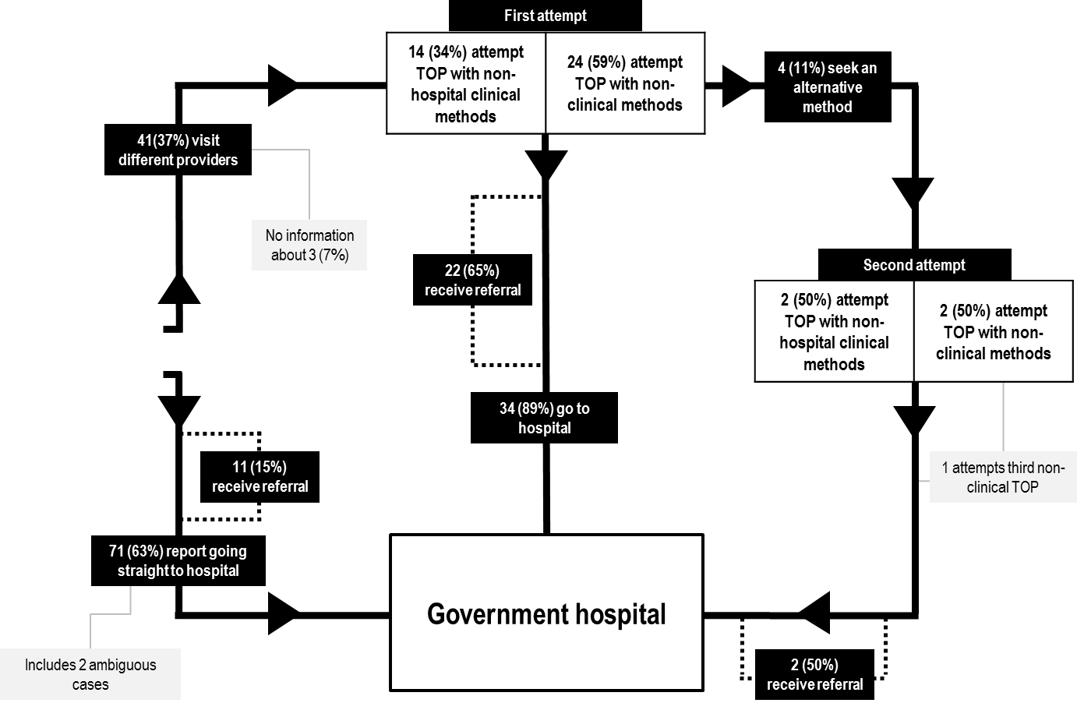
Influences on trajectory
Advice
Risk assessment
Advice
Risk assessment
Non-disclosure
Advice
Risk assessment
Non-disclosure
Cost
Advice
112 women
Advice
Risk assessment
Risk assessment
Cost
Problems with service delivery
Non-disclosure
Cost
Influence nature of trajectory
Cost
Influence pace
of trajectory

Slide 37
Implications
The false perception that ToP is prohibited contributed to steering women towards clandestine methods or clandestine payments for safe and legal treatment
A group of women who had received medical abortion (MA) from non-physicians
  Although Zambia ToP Act only permits ToP by physicians, MA bought from a pharmacist and self-administered may be expected to be safer and more effective than other methods, such as inserting a foreign object.
Notes:
37

Slide 38

And finally…
One small part of a wider project
http://personal.lse.ac.uk/coast/ZambiaTOP.htm
  Research instruments included
Also comparative (ToP vs. PAC) analyses of
  Health system costs
  Individual costs
  Household costs
Research impact and uptake phase (started 1st June 2014)
e.coast@lse.ac.uk

