Slide 1
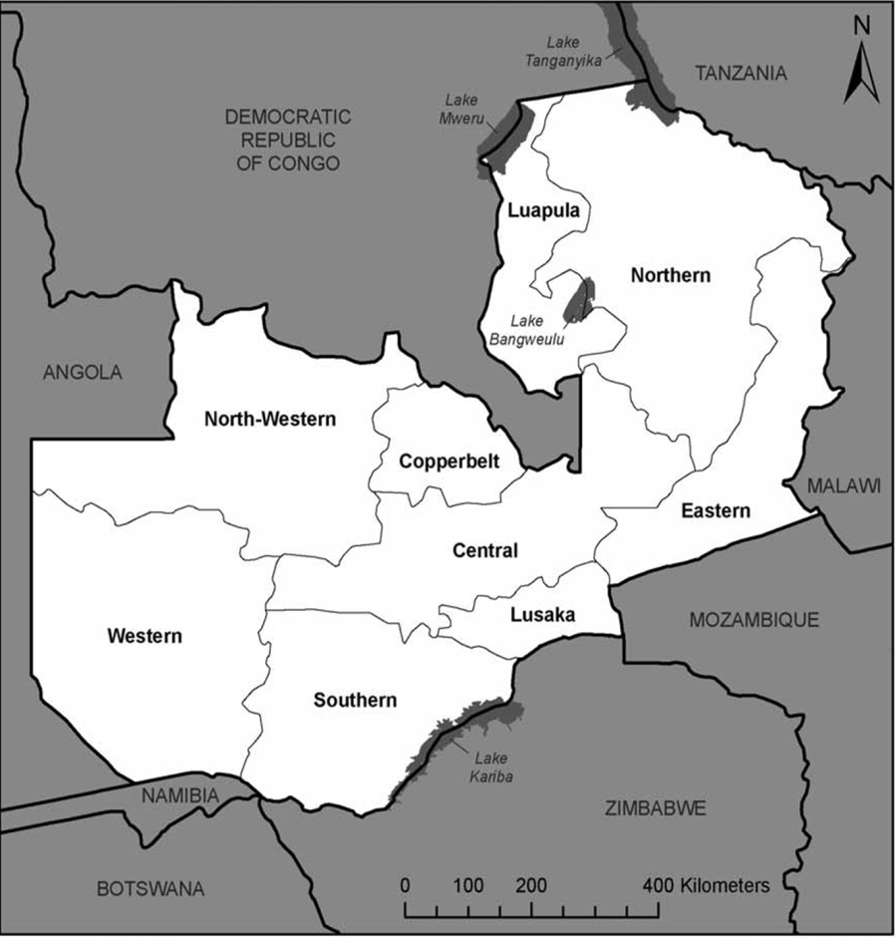



Pregnancy Termination Trajectories in Zambia: the socio-economic costs
AIM: To establish how investment in abortion services impacts on the socio-economic conditions of women and their households, and the implications for policy-making and service provision in Zambia.
OBJECTIVES
To understand the role that socio-economic circumstances play in the seeking of abortion and abortion -related services in Zambia
To estimate and compare the socio-economic implications of safe abortion and post abortion care for women and their households
To understand how and why safe abortion services are not used more fully
To disseminate our findings to a wide range of audiences
FIELDSITE
Lusaka University Teaching Hospital
PARTICIPANTS
Women admitted to hospital for:
Post Abortion Care n100
Safe Abortion
n 100
ZAMBIA
Source: Zambia DHS 2007
METHODOLOGY
Stage Two: Quantitative survey
Stage 3: In-depth qualitative interviews (QL1)
Stage 4: Follow up in-depth qualitative interviews (QL2)
Stage 5: Policymaker interviews and feedback
Stage 1: Pilot Study
RESEARCH QUESTIONS
What are the indirect and direct socio-economic costs of safe abortion compared to hospital-based PAC following an unsafe abortion for women and their households?
What role does poverty play in termination of pregnancy trajectories?
What are the social benefits and costs of using formal safe abortion services compared to informal unsafe abortion methods?
Why is the investment in safe abortion services in Zambia not fully used by women seeking to terminate a pregnancy?
RESEARCH TEAM
Dr Ernestina Coast Dr Tiziana Leone
Dr Susan F Murray Dr Bellington Vwalika
Dr Divya Parmar Dr Bornwell Sikateyo
Contact: e.coast@lse.ac.uk

