Slide 1
Accommodating Awareness Growth
Anna Mahtani, LSE

Slide 2
Introduction to awareness growth
Problems for Reverse Bayesianism
The first-pass version
The restricted version
There is no awareness growth
The explanation gap
The ‘flatness’ of the Bayesian Framework
How complicated should our models be?
New Concepts
Decision Theory

Slide 3
Landlord (L)
Mia (M)

Slide 5
Landlord (L)
Mia (M)
P(L) = 0.5 | P(M) = 0.5

Slide 6
Landlord (L)
Mia (M)
P(L) = 0.5 | P(M) = 0.5
P⁺(L&D) = | P⁺(M&D) =
P⁺(L&A) = | P⁺(M&A) =

Slide 7
Landlord (L)
Mia (M)
P(L) = 0.5 | P(M) = 0.5
What constraints are there on these numbers?
P⁺(L&D) = 0.25 | P⁺(M&D) = 0.4
P⁺(L&A) = 0.25 | P⁺(M&A) = 0.1

Slide 8
Accounting for awareness growth
“The domain of an agent’s attitudes can expand as a result of a refinement of the possibilities that she entertains. In this case … she should not revise her attitudes on the coarser domain” (Bradley, DMHF p257)

Slide 9
Landlord (L)
Mia (M)
P(L) = 0.5 | P(M) = 0.5
What constraints are there on these numbers?
P⁺(L&D) = 0.25 | P⁺(M&D) = 0.4
P⁺(L&A) = 0.25 | P⁺(M&A) = 0.1

Slide 10
Reverse Bayesianism (first pass):
$$\frac{P(A)}{P\left(B\right)}= \frac{P^{+}(A)}{P^{+}(B)}$$

Slide 11
Landlord (L)
Mia (M)
P(L) = 0.5 | P(M) = 0.5
What constraints are there on these numbers?
P⁺(L&D) = 0.25 | P⁺(M&D) = 0.4
P⁺(L&A) = 0.25 | P⁺(M&A) = 0.1

Slide 12
Accounting for awareness growth
“The domain of an agent’s attitudes can expand as a result of a refinement of the possibilities that she entertains. In this case … she should not revise her attitudes on the coarser domain” (Bradley, DMHF p257)
“The domain of awareness can expand because the agent entertains one or more possibilities disjoint from those she entertained initially” (Bradley, DMHF, p257)

Slide 13
Landlord (L)
Mia (M)
P(L) = 0.5 | P(M) = 0.5

Slide 14
Landlord (L)
Mia (M)
Other (O)
P(L) = 0.5 | P(M) = 0.5

Slide 15
Landlord (L)
Mia (M)
Other (O)
P(L) = 0.5 | P(M) = 0.5
P⁺(L) = | P⁺(M) = | P⁺(O) =

Slide 16
Landlord (L)
Mia (M)
Other (O)
What constraints are there on these numbers?
P(L) = 0.5 | P(M) = 0.5
P⁺(L) = 0.4 | P(M) = 0.4 | P⁺(O) = 0.2

Slide 17
Accounting for awareness growth
“The domain of an agent’s attitudes can expand as a result of a refinement of the possibilities that she entertains. In this case … she should not revise her attitudes on the coarser domain” (Bradley, DMHF p257)
“The domain of awareness can expand because the agent entertains one or more possibilities disjoint from those she entertained initially” (Bradley, DMHF, p257)

Slide 18
Accounting for awareness growth
“The domain of an agent’s attitudes can expand as a result of a refinement of the possibilities that she entertains. In this case … she should not revise her attitudes on the coarser domain” (Bradley, DMHF p257)
“The domain of awareness can expand because the agent entertains one or more possibilities disjoint from those she entertained initially” (Bradley, DMHF, p257)
“we should extend our relational attitudes to the new set in such a way as to conserve all prior relational beliefs and preferences” (Bradley, DMHF, p257)

Slide 19
Landlord (L)
Mia (M)
Other (O)
What constraints are there on these numbers?
P(L) = 0.5 | P(M) = 0.5
P⁺(L) = 0.4 | P(M) = 0.4 | P⁺(O) = 0.2

Slide 20
Reverse Bayesianism (first pass):
$$\frac{P(A)}{P\left(B\right)}= \frac{P^{+}(A)}{P^{+}(B)}$$

Slide 21
Introduction to awareness growth
Problems for Reverse Bayesianism
The first-pass version
The restricted version
There is no awareness growth
The explanation gap
The ‘flatness’ of the Bayesian Framework
How complicated should our models be?
New Concepts
Decision Theory

Slide 22
Landlord (L)
Mia (M)
P(L) = 0.5 | P(M) = 0.5

Slide 23
Tenant (T)
Landlord (L)
Mia (M)
P(L) = 0.5 | P(M) = 0.5
P(T) = 0.5

Slide 24
Tenant (T)
Landlord (L)
Mia (M)
Other (O)
P(L) = 0.5 | P(M) = 0.5
P(T) = 0.5

Slide 25
Tenant (T)
Landlord (L)
Mia (M)
Other (O)
P(L) = 0.5 | P(M) = 0.5
P(T) = 0.5

Slide 26
Tenant (T)
Landlord (L)
Mia (M)
Other (O)
P(L) = 0.5 | P(M) = 0.5
 | P(T) = 0.5
P⁺(L) = | P⁺(M) = | P⁺(O) =
P⁺(T) =

Slide 27
Tenant (T)
Landlord (L)
Mia (M)
Other (O)
P(L) = 0.5 | P(M) = 0.5
 | P(T) = 0.5
P⁺(L) = | P⁺(M) = | P⁺(O) =
P⁺(T) =
Reverse Bayesianism (first pass):
$$\frac{P(A)}{P\left(B\right)}= \frac{P^{+}(A)}{P^{+}(B)}$$

Slide 28
Tenant (T)
Landlord (L)
Mia (M)
Other (O)
P(L) = 0.5 | P(M) = 0.5
 | P(T) = 0.5
P⁺(L) = | P⁺(M) = | P⁺(O) =
P⁺(T) =
Reverse Bayesianism (first pass):
$$\frac{P(A)}{P\left(B\right)}= \frac{P^{+}(A)}{P^{+}(B)}$$
$$\frac{P(M)}{P\left(T\right)}=1= \frac{P^{+}(M)}{P^{+}(T)}$$

Slide 29
Tenant (T)
Landlord (L)
Mia (M)
Other (O)
P(L) = 0.5 | P(M) = 0.5
 | P(T) = 0.5
P⁺(L) = | P⁺(M) = | P⁺(O) = 0
P⁺(T) =
Reverse Bayesianism (first pass):
$$\frac{P(A)}{P\left(B\right)}= \frac{P^{+}(A)}{P^{+}(B)}$$
$$\frac{P(M)}{P\left(T\right)}=1= \frac{P^{+}(M)}{P^{+}(T)}$$

Slide 30
Tenant (T)
Landlord (L)
Mia (M)
Other (O)
P(L) = 0.5 | P(M) = 0.5
 | P(T) = 0.5
P⁺(L) = | P⁺(M) = | P⁺(O) =
P⁺(T) =
Reverse Bayesianism (first pass):
$$\frac{P(A)}{P\left(B\right)}= \frac{P^{+}(A)}{P^{+}(B)}$$

Slide 31
Tenant (T)
Landlord (L)
Mia (M)
Other (O)
P(L) = 0.5 | P(M) = 0.5
 | P(T) = 0.5
P⁺(L) = | P⁺(M) = | P⁺(O) =
P⁺(T) =
Reverse Bayesianism (restricted):
$$\frac{P(A)}{P\left(B\right)}= \frac{P^{+}(A)}{P^{+}(B)}$$
Either $P^{+}(A/{X_{j})=0=P^{+}(B/{X_{j}) }}$
Or
IFF
$$\frac{P^{+}(A/{X_{j})}}{P^{+}(B/{X_{j})}}=\frac{P(A)}{P(B)}$$

Slide 32
Tenant (T)
Landlord (L)
Mia (M)
Other (O)
P(L) = 0.5 | P(M) = 0.5
 | P(T) = 0.5
P⁺(L) = | P⁺(M) = | P⁺(O) =
P⁺(T) =
Reverse Bayesianism (restricted):
$$\frac{P(A)}{P\left(B\right)}= \frac{P^{+}(A)}{P^{+}(B)}$$
Either $P^{+}(A/{X_{j})=0=P^{+}(B/{X_{j}) }}$
Or
IFF
$X_{j}$: Other (O)
$$\frac{P^{+}(A/{X_{j})}}{P^{+}(B/{X_{j})}}=\frac{P(A)}{P(B)}$$

Slide 33
Tenant (T)
Landlord (L)
Mia (M)
Other (O)
P(L) = 0.5 | P(M) = 0.5
 | P(T) = 0.5
P⁺(L) = | P⁺(M) = | P⁺(O) =
P⁺(T) =
Reverse Bayesianism (restricted):
$$\frac{P(A)}{P\left(B\right)}= \frac{P^{+}(A)}{P^{+}(B)}$$
Either $P^{+}(A/{X_{j})=0=P^{+}(B/{X_{j}) }}$
Or
IFF

$X_{j}$: Other (O)
$$\frac{P^{+}(A/{X_{j})}}{P^{+}(B/{X_{j})}}=\frac{P(A)}{P(B)}$$

A: Mia (M)
B: Tenant (T)

Slide 34
Tenant (T)
Landlord (L)
Mia (M)
Other (O)
P(L) = 0.5 | P(M) = 0.5
 | P(T) = 0.5
P⁺(L) = | P⁺(M) = | P⁺(O) =
P⁺(T) =
Reverse Bayesianism (restricted):
$$\frac{P(A)}{P\left(B\right)}= \frac{P^{+}(A)}{P^{+}(B)}$$
Either $P^{+}(A/{X_{j})=0=P^{+}(B/{X_{j}) }}$
Or
IFF
$X_{j}$: Other (O)
$$\frac{P^{+}(A/{X_{j})}}{P^{+}(B/{X_{j})}}=\frac{P(A)}{P(B)}$$

Slide 35
Tenant (T)
Landlord (L)
Mia (M)
Other (O)
P(L) = 0.5 | P(M) = 0.5
 | P(T) = 0.5
P⁺(L) = | P⁺(M) = | P⁺(O) =
P⁺(T) =
Reverse Bayesianism (restricted):
$$\frac{P(A)}{P\left(B\right)}= \frac{P^{+}(A)}{P^{+}(B)}$$
Either $P^{+}(A/{X_{j})=0=P^{+}(B/{X_{j}) }}$
Or
IFF
$X_{j}$: Other (O)
$$\frac{P^{+}(A/{X_{j})}}{P^{+}(B/{X_{j})}}=\frac{P(A)}{P(B)}$$
A: Landlord (L)
B: Mia (M)

Slide 36
Tenant (T)
Landlord (L)
Mia (M)
Other (O)
P(L) = 0.5 | P(M) = 0.5
 | P(T) = 0.5
P⁺(L) = | P⁺(M) = | P⁺(O) =
P⁺(T) =
Reverse Bayesianism (restricted):
$$\frac{P(A)}{P\left(B\right)}= \frac{P^{+}(A)}{P^{+}(B)}$$
Either $P^{+}(A/{X_{j})=0=P^{+}(B/{X_{j}) }}$
Or
IFF

$X_{j}$: Other (O)
$$\frac{P^{+}(A/{X_{j})}}{P^{+}(B/{X_{j})}}=\frac{P(A)}{P(B)}$$
A: Landlord (L)
B: Mia (M)

Slide 37
Tenant (T)
Landlord (L)
Mia (M)
Other (O)
P(L) = 0.5 | P(M) = 0.5
 | P(T) = 0.5
P⁺(L) = 0.4 | P⁺(M) = 0.4 | P⁺(O) = 0.2
P⁺(T) = 0.6
Reverse Bayesianism (restricted):
$$\frac{P(A)}{P\left(B\right)}= \frac{P^{+}(A)}{P^{+}(B)}$$
Either $P^{+}(A/{X_{j})=0=P^{+}(B/{X_{j}) }}$
Or
IFF

$X_{j}$: Other (O)
$$\frac{P^{+}(A/{X_{j})}}{P^{+}(B/{X_{j})}}=\frac{P(A)}{P(B)}$$
A: Landlord (L)
B: Mia (M)

Slide 38
Introduction to awareness growth
Problems for Reverse Bayesianism
The first-pass version
The restricted version
There is no awareness growth
The explanation gap
The ‘flatness’ of the Bayesian Framework
How complicated should our models be?
New Concepts
Decision Theory

Slide 39
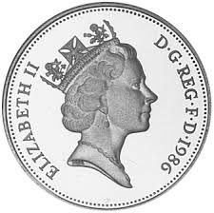
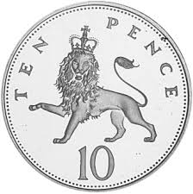
Tails (T)
Heads (H)
Lion (L)
P(H) = 0.5 | P(L) = 0.5
P(T) = 0.5

Slide 40
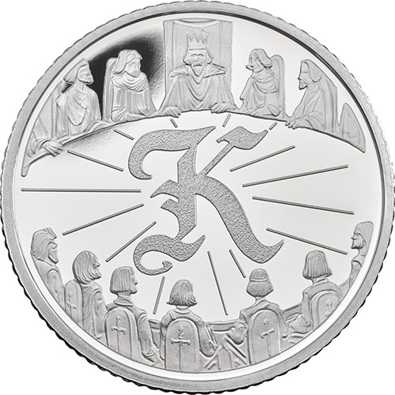
Tails (T)
Heads (H)
Lion (L)
King (K)
P(H) = 0.5 | P(L) = 0.5
P(T) = 0.5

Slide 41
Tails (T)
Heads (H)
Lion (L)
King (K)
P(H) = 0.5 | P(L) = 0.5
 | P(T) = 0.5
P⁺(H) = | P⁺(L) = | P⁺(K) =
P⁺(T) =

Slide 42
Tails (T)
Heads (H)
Lion (L)
King (K)
P(H) = 0.5 | P(L) = 0.5
 | P(T) = 0.5
P⁺(H) = | P⁺(L) = | P⁺(K) =
P⁺(T) =
Reverse Bayesianism (restricted):
$$\frac{P(A)}{P\left(B\right)}= \frac{P^{+}(A)}{P^{+}(B)}$$
Either $P^{+}(A/{X_{j})=0=P^{+}(B/{X_{j}) }}$
Or
IFF
$$\frac{P^{+}(A/{X_{j})}}{P^{+}(B/{X_{j})}}=\frac{P(A)}{P(B)}$$

Slide 43
Tails (T)
Heads (H)
Lion (L)
King (K)
P(H) = 0.5 | P(L) = 0.5
 | P(T) = 0.5
P⁺(H) = | P⁺(L) = | P⁺(K) =
P⁺(T) =
Reverse Bayesianism (restricted):
$$\frac{P(A)}{P\left(B\right)}= \frac{P^{+}(A)}{P^{+}(B)}$$
Either $P^{+}(A/{X_{j})=0=P^{+}(B/{X_{j}) }}$
Or
$X_{j}$: King (K)
IFF
$$\frac{P^{+}(A/{X_{j})}}{P^{+}(B/{X_{j})}}=\frac{P(A)}{P(B)}$$

Slide 44
Tails (T)
Heads (H)
Lion (L)
King (K)
P(H) = 0.5 | P(L) = 0.5
 | P(T) = 0.5
P⁺(H) = | P⁺(L) = | P⁺(K) =
P⁺(T) =
Reverse Bayesianism (restricted):
$$\frac{P(A)}{P\left(B\right)}= \frac{P^{+}(A)}{P^{+}(B)}$$
Either $P^{+}(A/{X_{j})=0=P^{+}(B/{X_{j}) }}$
Or
$X_{j}$: King (K)
IFF
A: HEADS (H)
B: LION (L)
$$\frac{P^{+}(A/{X_{j})}}{P^{+}(B/{X_{j})}}=\frac{P(A)}{P(B)}$$

Slide 45
Tails (T)
Heads (H)
Lion (L)
King (K)
P(H) = 0.5 | P(L) = 0.5
 | P(T) = 0.5
P⁺(H) = | P⁺(L) = | P⁺(K) =
P⁺(T) =
Reverse Bayesianism (restricted):
$$\frac{P(A)}{P\left(B\right)}= \frac{P^{+}(A)}{P^{+}(B)}$$
Either $P^{+}(A/{X_{j})=0=P^{+}(B/{X_{j}) }}$
Or
$X_{j}$: King (K)
IFF

A: HEADS (H)
B: LION (L)
$$\frac{P^{+}(A/{X_{j})}}{P^{+}(B/{X_{j})}}=\frac{P(A)}{P(B)}$$

Slide 46
Tails (T)
Heads (H)
Lion (L)
King (K)
P(H) = 0.5 | P(L) = 0.5
 | P(T) = 0.5
P⁺(H) = 0.4 | P⁺(L) = 0.4 | P⁺(K) = 0.2
P⁺(T) = 0.6
Reverse Bayesianism (restricted):
$$\frac{P(A)}{P\left(B\right)}= \frac{P^{+}(A)}{P^{+}(B)}$$
Either $P^{+}(A/{X_{j})=0=P^{+}(B/{X_{j}) }}$
Or
$X_{j}$: King (K)
IFF

A: HEADS (H)
B: LION (L)
$$\frac{P^{+}(A/{X_{j})}}{P^{+}(B/{X_{j})}}=\frac{P(A)}{P(B)}$$

Slide 47
Tails (T)
Heads (H)
Lion (L)
King (K)
P(H) = 0.5 | P(L) = 0.5
 | P(T) = 0.5
P⁺(H) = 0.4 | P⁺(L) = 0.4 | P⁺(K) = 0.2
P⁺(T) = 0.6
Reverse Bayesianism (restricted):
$$\frac{P(A)}{P\left(B\right)}= \frac{P^{+}(A)}{P^{+}(B)}$$
Either $P^{+}(A/{X_{j})=0=P^{+}(B/{X_{j}) }}$
Or
$X_{j}$: King (K)
IFF

A: HEADS (H)
B: LION (L)
$$\frac{P^{+}(A/{X_{j})}}{P^{+}(B/{X_{j})}}=\frac{P(A)}{P(B)}$$

Slide 48
Tails (T)
Heads (H)
Lion (M)
King (K)
Tenant (T)
Landlord (L)
Mia (M)
Other (O)

Slide 49
Introduction to awareness growth
Problems for Reverse Bayesianism
The first-pass version
The restricted version
There is no awareness growth
The explanation gap
The ‘flatness’ of the Bayesian Framework
How complicated should our models be?
New Concepts
Decision Theory

Slide 50
What is unawareness?

Slide 51
What is unawareness?
In cases of unawareness… “certain contingencies or prospects are not available to the agent’s consciousness at the time at which she is deliberating on some question” (Bradley DMHF, p253)

Slide 52
What is unawareness?
In cases of unawareness… “certain contingencies or prospects are not available to the agent’s consciousness at the time at which she is deliberating on some question” (Bradley DMHF, p253)
“An agent can form attitudes only towards prospects that she is aware of” (Bradley, DMHF, p254)

Slide 53
Landlord (L)
Mia (M)
Other (O)
P(L) = 0.5 | P(M) = 0.5
P⁺(L) = | P⁺(M) = | P⁺(O) =

Slide 54
What is unawareness?
In cases of unawareness… “certain contingencies or prospects are not available to the agent’s consciousness at the time at which she is deliberating on some question” (Bradley DMHF, p253)
“An agent can form attitudes only towards prospects that she is aware of” (Bradley, DMHF, p254)
Is this right?

Slide 55
Landlord (L)
Mia (M)
Other (O)
P(L) = 0.5 | P(M) = 0.5
P⁺(L) = | P⁺(M) = | P⁺(O) =

Slide 56
Landlord (L)
Mia (M)
Other (O)
P(L) = 0.5 | P(M) = 0.5
P⁺(L) = | P⁺(M) = | P⁺(O) = 1

Slide 57
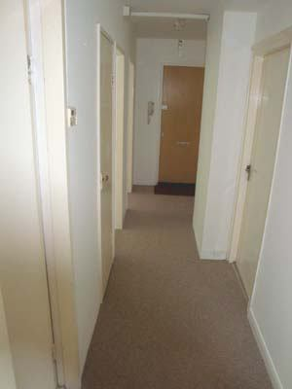

Slide 58
Landlord (L)
Mia (M)
Other (O)
P(L) = 0.5 | P(M) = 0.5
P⁺(L) = | P⁺(M) = | P⁺(O) = 1

Slide 59
Cr₀(L) = 0.49 Cr₀(M) = 0.49 Cr₀(O) = 0.01
Cr₀(L) = 0.4 Cr₀(M) = 0.4 Cr₀(O) = 0.2

Slide 60
Introduction to awareness growth
Problems for Reverse Bayesianism
The first-pass version
The restricted version
There is no awareness growth
The explanation gap
The ‘flatness’ of the Bayesian Framework
How complicated should our models be?
New Concepts
Decision Theory

Slide 61
Introduction to awareness growth
Problems for Reverse Bayesianism
The first-pass version
The restricted version
There is no awareness growth
The explanation gap
The ‘flatness’ of the Bayesian Framework
How complicated should our models be?
New Concepts
Decision Theory

Slide 62
0
0
How sure are you that P?
1

Slide 63
1
How present is P to your consciousness?
0
0
How sure are you that P?
1

Slide 64
0
0
How sure are you that P?
1

Slide 65
Introduction to awareness growth
Problems for Reverse Bayesianism
The first-pass version
The restricted version
There is no awareness growth
The explanation gap
The ‘flatness’ of the Bayesian Framework
How complicated should our models be?
New Concepts
Decision Theory

Slide 66
Landlord (L)
Mia (M)
P(L) = 0.5 | P(M) = 0.5

Slide 67
Landlord (L)
Mia (M)
Other (O)
P(L) = 0.49 | P(M) = 0.49 | P(O) = 0.02
P(L/V) = 0.4
P⁺(L) = 0.4 | P⁺(M) = 0.4 | P⁺(O) = 0.2

Slide 68
Landlord (L)
Mia (M)
Other (O)
P(L) = 0.49 | P(M) = 0.49 | P(O) = 0.02
P(L/V) = 0.4
P⁺(L) = 0.4 | P⁺(M) = 0.4 | P⁺(O) = 0.2
Heads (H)
Lion (L)
King (K)
P(H) = 0.5 | P(L) = 0.48
P(K) = 0.02
P(H/V) = 0.5
P(H) = 0.5 | P(L) = 0.4
P(K) = 0.1

Slide 69
Introduction to awareness growth
Problems for Reverse Bayesianism
The first-pass version
The restricted version
There is no awareness growth
The explanation gap
The ‘flatness’ of the Bayesian Framework
How complicated should our models be?
New Concepts
Decision Theory

Slide 70
Hi, I’m Noreen

Slide 71
Landlord (L)
Mia (M)
P(L) = 0.5 | P(M) = 0.5
P(N) = ??
P⁺(L) = 0.3 | P⁺(M) = 0.3
P⁺(N) = 0.4

Slide 72
A big question about the objects of credence
What are propositions: how fine-grained are they?
Can there be multiple ways (involving different concepts) of grasping the same proposition?
Bob is a bachelor
Bob is an unmarried man
Noreen is singing in the shower
Someone called ‘Noreen’ is singing in the shower

Slide 73
Introduction to awareness growth
Problems for Reverse Bayesianism
The first-pass version
The restricted version
There is no awareness growth
The explanation gap
The ‘flatness’ of the Bayesian Framework
How complicated should our models be?
New Concepts
Decision Theory

Slide 74
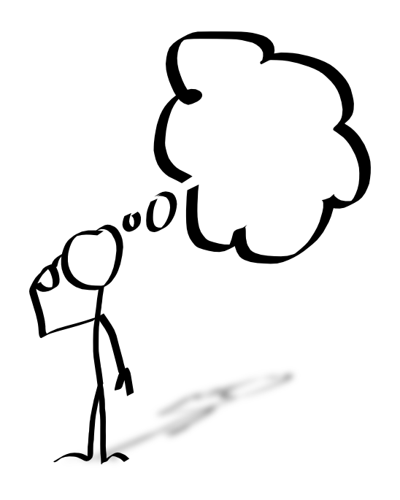
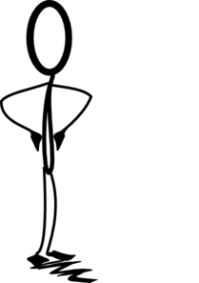
X modelling Y
Y
X

Slide 75
X modelling X
X

Slide 76
In cases of unawareness… “certain contingencies or prospects are not available to the agent’s consciousness at the time at which she is deliberating on some question” (Bradley DMHF, p253)
“An agent can form attitudes only towards prospects that she is aware of” (Bradley, DMHF, p254)
This doesn’t hold (on my view) as a claim about the agent being modelled.

Slide 77
In cases of unawareness… “certain contingencies or prospects are not available to the agent’s consciousness at the time at which she is deliberating on some question” (Bradley DMHF, p253)
“An agent can form attitudes only towards prospects that she is aware of” (Bradley, DMHF, p254)
A related claim holds about what the modeller is capable of.

Slide 78
X modelling Y
The models that are created do not depend just on what is present to Y’s consciousness, but they do depend on what is present to X’s consciousness.
Y
X

Slide 79
X modelling X
The models X produces are limited by what is present to X’s consciousness, but because of X’s role as attributer, not as subject.
X can produce models of himself that are inadequate for the purpose at hand.
X

Slide 80
When we discover that we’ve produced an inadequate model of some phenomena (because we’ve left something important out), what should we do?

Slide 81
When we discover that we’ve produced an inadequate model of some phenomena (because we’ve left something important out), what should we do?
Start afresh?

Slide 82
When we discover that we’ve produced an inadequate model of some phenomena (because we’ve left something important out), what should we do?
Start afresh?
Or can we find a way to interpret the model that we have already created?

Slide 83
When we discover that we’ve produced an inadequate model of some phenomena (because we’ve left something important out), what should we do?
Start afresh?
Or can we find a way to interpret the model that we have already created?
The model that we’ve already created is a simplification – and not the simplification that we need. To answer the question, perhaps we need an account of the different ways that things can be simplified, so that we can figure out how we can move between them?

Slide 84
Introduction to awareness growth
Problems for Reverse Bayesianism
The first-pass version
The restricted version
There is no awareness growth
The explanation gap
The ‘flatness’ of the Bayesian Framework
How complicated should our models be?
New Concepts
Decision Theory

