Slide 1
Arguments for Probabilism
Anna Mahtani, LSE
Possibilities
Opaque Contexts
Dutch Book Arguments
Accuracy Arguments

Slide 2
What are credences?
You
Cr_{you}(HEADS)=0.5
Cr_{you}(RAIN)=0.6
Cr_{you}(P)=v (where 0≤v≤1)

Slide 3
The ‘Probability Axioms’
A consequence:
If Cr_{you}(P)=v, then Cr_{you}(not P)=1-v

Slide 4
An example of a Dutch Book Argument
 | Paris is big | Not (Paris is big)
Bet 1 | -£0.90+£1 | -£0.90
Bet 2 | -£0.50 | -£0.50+£1
Total | -£0.40 | -£0.40
Alan
Dutch Booked
Cr_{Alan} (Paris is big) = 0.9
Cr_{Alan}(It’s not the case that Paris is big) = 0.5
Possibilitie
Opaque Contexts
Dutch Book Arguments
Accuracy Arguments

Slide 5

Question: What does the agent is guaranteed to lose money mean, in the Dutch Book Argument?
Answer: The agent loses money when the bets are assessed against what is true, in every possible world in which the agent would accept those bets as fair.
the traditional reading
Peter Milne 1991, and others!
Opaque Contexts
Dutch Book Arguments
Accuracy Arguments

Slide 6
 | Paris is big | Not (Paris is big)
Bet 1 | -£0.90+£1 | -£0.90
 | Cr_{Bob} (Paris is big)≥0.9 | Not (Cr_{Bob}(Paris is big)≥0.9)
Bet 2 | £5-£10 | £5
Bob
Cr_{Bob}(Paris is big) = 0.9
Cr_{Bob}(Cr_{Bob} (Paris is big) ≥ 0.9) = 0.5
Introduction
Opaque Contexts
Dutch Book Arguments
Accuracy Arguments

Slide 7
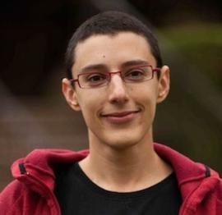
Question: What does the agent is guaranteed to lose money mean, in the Dutch Book Argument?
Answer: The agent loses money when the bets are assessed against what is true, in every possible world in which the agent would accept those bets as fair.
Rachel Briggs’ Reading
Opaque Contexts
Dutch Book Arguments
Accuracy Arguments

Slide 8
 | Paris is big | Not (Paris is big)
Bet 1 | -£0.90+£1 | -£0.90
 | Cr_{Bob} (Paris is big)≥0.9 | Not (Cr_{Bob} (Paris is big)≥0.9)
Bet 2 | £5-£10 | £5
Bob
Cr_{Bob}(Paris is big) = 0.9
Cr_{Bob}(Cr_{Bob} (Paris is big) ≥ 0.9) = 0.5
Introduction
Opaque Contexts
Dutch Book Arguments
Accuracy Arguments

Slide 9
 | George Orwell is Eric Blair | Not (George Orwell is Eric Blair)
Bet 1 | -£0.50 | -£0.50 + £1
Chris
Dutch Booked
Cr_{Chris}(George Orwell is not Eric Blair) = 0.5
Introduction
Opaque Contexts
Dutch Book Arguments
Accuracy Arguments

Slide 10
Can’t be Dutch-Booked
Can be Dutch-Booked
Bob
Alan
Chris
Bob

Slide 11
Question: Which of these readings of the key move in the Dutch Book Argument give the right results?
Can’t be Dutch-Booked
Can be Dutch-Booked
Rational
Irrational

Slide 12
Some ways of categorizing sets of outright beliefs
Metaphysically impossible
Epistemic blindspot
Logically inconsistent
Conceptually impossible (Chalmers’ style).

Slide 13
Some ways of categorizing credence functions
Metaphysically impossible C
Epistemic blindspot C
Logically inconsistent C
Conceptually impossible (Chalmers’ style) C

Slide 14
Question: What does the agent is guaranteed to lose money mean, in the Dutch Book Argument?
Answer: The agent loses money when the bets are assessed against what is true, in every possible world in which the agent would accept those bets as fair.
Rachel Briggs’ Reading
Opaque Contexts
Dutch Book Arguments
Accuracy Arguments

Slide 15
Possible credence functions
Violates the probability axioms
Metaphysically Possible C
Credence of less than 1 in metaphysical necessities, such as that George Orwell is Eric Blair
Everything else
Metaphysically Impossible C

Slide 16
Some ways of categorizing credence functions
Metaphysically impossible C
Epistemic blindspot C
Logically inconsistent C
Conceptually impossible (Chalmers’ style) C

Slide 17
Epistemic Blindspot
It’s raining but I don’t believe that it’s raining.

Slide 18
Question: What does the agent is guaranteed to lose money mean, in the Dutch Book Argument?
Answer: The agent loses money when the bets are assessed against what is true, in every possible world in which the agent would accept those bets as fair.
the traditional reading
Peter Milne 1991, and others!
Opaque Contexts
Dutch Book Arguments
Accuracy Arguments

Slide 19
Possible credence functions
Violates the probability axioms
Not an Epistemic Blindspot C
Credence of less than 1 in metaphysical necessities, such as that George Orwell is Eric Blair
Everything else
Credences that reveal imperfect self-knowledge
Credences that violate the (synchronic) Reflection Principle
Epistemic Blindspot C

Slide 20
Some ways of categorizing credence functions
Metaphysically impossible C
Epistemic blindspot C
Logically inconsistent C
Conceptually impossible (Chalmers’ style) C

Slide 21
Logically possible/consistent: true at some interpretation
Some fish sing
F
T
“fish” means fish
“sing” means sing
“fish” means people
Possibilities
Opaque Contexts
Dutch Book Arguments
Accuracy Arguments

Slide 22
Logically possible/consistent: true at some interpretation
Some fish sing and it’s not the case that some fish sing
F
“fish” means people
∃x(Px & Qx) ∧ ¬ ∃x(Px & Qx)
Possibilities
Opaque Contexts
Dutch Book Arguments
Accuracy Arguments

Slide 23
Logically possible/consistent: true at some interpretation
It’s not the case that George Orwell is Eric Blair
T
F
“Eric Blair” means Nick Clegg
¬a=b
Possibilities
Opaque Contexts
Dutch Book Arguments
Accuracy Arguments

Slide 24
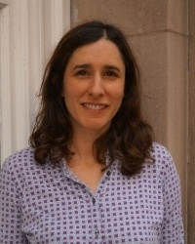
A credence function is ‘logically inconsistent C’
iff
It endorses a set of bets which result in a loss at every interpretation, when assessed against what is true at the actual world.

Slide 25
 | The coin came up heads | Not (The coin came up heads)
Bet 1 | -£0.50+£1 | -£0.50
You
Cr_{you}(The coin came up heads) = 0.5
“heads” means tails
Opaque Contexts
Dutch Book Arguments
Accuracy Arguments
Possibilitie

Slide 26
 | Paris is big | Not (Paris is big)
Bet 1 | -£0.90+£1 | -£0.90
Bet 2 | -£0.50 | -£0.50+£1
Total | -£0.40 | -£0.40
Alan
Dutch Booked
Cr_{Alan} (Paris is big) = 0.9
Cr_{Alan}(It’s not the case that Paris is big) = 0.5
“big” means small
Accuracy Arguments
Opaque Contexts
Dutch Book Arguments
Possibilitie

Slide 27
 | Paris is big | Not (Paris is big)
Bet 1 | -£0.90+£1 | -£0.90
 | Cr_{Bob} (Paris is big)≥0.9 | Not (Cr_{Bob} (Paris is big)≥0.9)
Bet 2 | £5-£10 | £5
Bob
Cr_{Bob}(Paris is big) = 0.9
Cr_{Bob}(Cr_{Bob} (Paris is big) ≥ 0.9) = 0.5
“Cr_{Bob}” means Cr_{Dave}
Opaque Contexts
Dutch Book Arguments
Accuracy Arguments
Introduction

Slide 28
 | George Orwell is Eric Blair | Not (George Orwell is Eric Blair)
Bet 1 | -£0.50 | -£0.50 + £1
“Eric Blair” means Nick Clegg
Bob
Cr_{Chris}(George Orwell is not Eric Blair) = 0.5
Introduction
Opaque Contexts
Dutch Book Arguments
Accuracy Arguments

Slide 29
Possible credence functions
Logically Consistent C
Violates the probability axioms
Credence of less than 1 in metaphysical necessities, such as that George Orwell is Eric Blair
Credences that reveal imperfect self-knowledge
Credences that violate the (synchronic) Reflection Principle
Logically Inconsistent C

Slide 30
Some ways of categorizing credence functions
Metaphysically impossible C
Epistemic blindspot C
Logically inconsistent C
Conceptually impossible (Chalmers’ style) C

Slide 31
A claim is conceptually impossible (you can know a priori that it is false)
iff
It is not verified at any scenario
George Orwell is not Eric Blair
false in all possible worlds
… but verified at some scenario

Slide 32
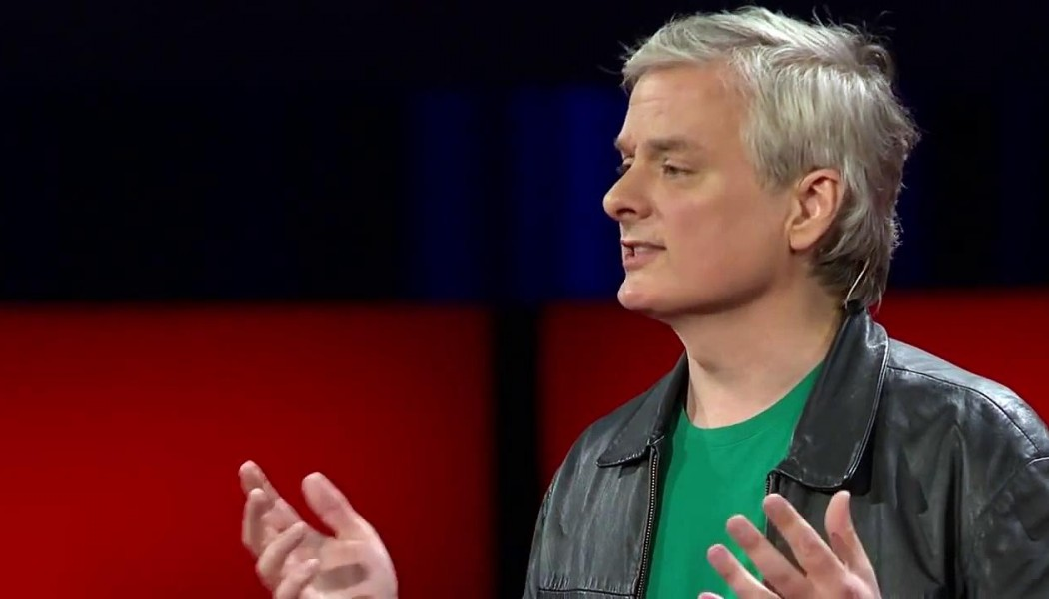
A credence function is ‘conceptually impossible’
iff
It endorses a set of bets which result in a loss at every scenario, when assessed against what is verified at that scenario.

Slide 33
 | George Orwell is Eric Blair | Not (George Orwell is Eric Blair)
Bet 1 | -£0.50 | -£0.50 + £1
Chris
Cr_{Chris}(George Orwell is not Eric Blair) = 0.5
Introduction
Opaque Contexts
Dutch Book Arguments
Accuracy Arguments

Slide 34
Possible credence functions
Violates the probability axioms
Conceptually Possible C
Credence of more than 0 in any claims that are a priori false - e.g. that my scarf is scarlet but not red
Credence of less than 1 in metaphysical necessities, such as that George Orwell is Eric Blair
Credences that reveal imperfect self-knowledge
Credences that violate the (synchronic) Reflection Principle
Conceptually Impossible C

Slide 35
Some ways of categorizing credence functions
Metaphysically impossible C
Epistemic blindspot C
Logically inconsistent C
Conceptually impossible (Chalmers’ style) C

Slide 36
An example of an Accuracy Argument
Alan
Accuracy Dominated
Cr_{Alan} (Paris is big) = 0.9
Cr_{Alan} (It’s not the case that Paris is big) = 0.5
Opaque Contexts
Dutch Book Arguments
Accuracy Arguments

Slide 37
Question: What does it mean to say that one credence function Cr* ‘accuracy dominates’ another credence function Cr?
It means that Cr* is guaranteed to be more accurate than Cr, but what does ‘guaranteed’ mean here?
Answer: Cr* is more accurate than Cr when assessed against what is true in every possible world.
at every interpretation.
Possibilities
Opaque Contexts
Dutch Book Arguments
Accuracy Arguments

Slide 38
Question: What does it mean to say that one credence function Cr* ‘accuracy dominates’ another credence function Cr?
It means that Cr* is guaranteed to be more accurate than Cr, but what does ‘guaranteed’ mean here?
Answer: Cr* is more accurate than Cr when assessed against what is true in every possible world.
verified
scenario
Opaque Contexts
Dutch Book Arguments
Accuracy Arguments

Slide 39
Some ways of categorizing credence functions
Metaphysically impossible C
Epistemic blindspot C
Logically inconsistent C
Conceptually impossible (Chalmers’ style) C
Do any of these categories fit with:
Irrationality (in the everyday sense)?
Irrationality (in some technical sense)?
No!

Slide 40
Possible credence functions
Logically Consistent C
Violates the probability axioms
Credence of less than 1 in metaphysical necessities, such as that George Orwell is Eric Blair
Credence of less than 1 in complex logical tautology.
Credences that reveal imperfect self-knowledge
Credences that violate the (synchronic) Reflection Principle
Logically Inconsistent C

Slide 41
Some ways of categorizing credence functions
Metaphysically impossible C
Epistemic blindspot C
Logically inconsistent C
Conceptually impossible (Chalmers’ style) C
Do any of these categories fit with:
Irrationality (in the everyday sense)?
Irrationality (in some technical sense)?
No!

Slide 42
Analogues of Probabilism
An agent whose credences functions violate the probability axioms has a credence function that is:
  Metaphysically impossible
  An epistemic blindspot
  Logically Inconsistent
  Conceptually impossible

Slide 43
What are the Objects of Credence?
Propositions – corresponding to sets of possible worlds?
Sentences – corresponding to sets of interpretations?
Primary intensions – corresponding to sets of scenarios?
Which epistemic relation(s) will make it into decision theory?

