Slide 1
Philosophy of language for Decision Theory
The objects of credence, and intensionality
Indexicals, and centred worlds
Vagueness
Implicature

Slide 2
w
Cr(P) = v
What sort of thing is P?

Slide 3

P is an event/proposition, which corresponds to a set of states – and by states we mean possible worlds
Dice lands 1
P: dice lands on an even number
Dice lands 2
Dice lands 3
Dice lands 4
Dice lands 6
Dice lands 5

Slide 4
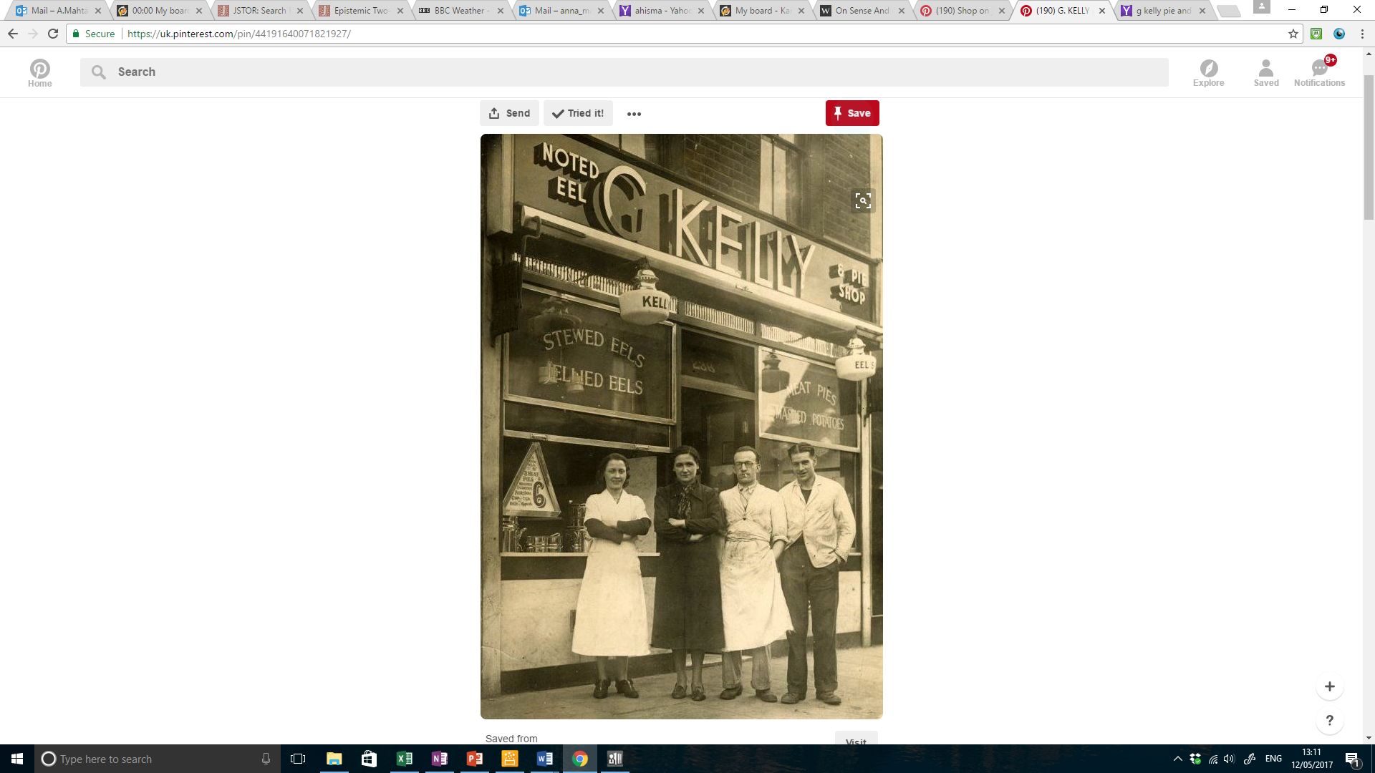
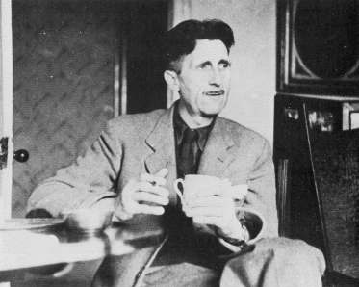
w
Cr(EB is a waiter) = 0.9
Cr(GO is a waiter) = 0.2
Mrs Kelly
Eric Blair AKA George Orwell

Slide 5
P is an event/proposition, which corresponds to a set of states – and by states we mean possible worlds
EB is a waiter
EB is not a waiter
GO is a waiter
EB is a waiter
EB is not a waiter
EB is a waiter
EB is a waiter
EB is not a waiter

Slide 6
P is an event/proposition, which corresponds to a set of states – and by states we mean possible worlds
EB is a waiter
GO is not a waiter
GO is a waiter
GO is a waiter
GO is not a waiter
GO is a waiter
GO is a waiter
GO is not a waiter

Slide 7
P is an event/proposition, which corresponds to a set of states – and by states we mean possible worlds

EB is a waiter
GO is not a waiter
GO is a waiter
GO is a waiter
GO is not a waiter
GO is a waiter
GO is a waiter
GO is not a waiter

Slide 8
w
Cr(EB is a waiter) = 0.9
Cr(GO is a waiter) ≠ 0.9
Cr(GO is a waiter) = 0.2
Mrs Kelly

Slide 9
w
Believes that EB is a waiter
Doesn’t believe that GO is a waiter
Believes that GO is not a waiter
Mrs Kelly

Slide 10
Somerset Maugham : I love Mrs Kelly’s pie shop. I go there a lot with the other authors, because we like going somewhere we can be anonymous. She doesn’t have a clue who we all are. She thinks that I’m a postman, and she thinks George Orwell is a waiter!

Referentialism: If you believe that some object X is P, then you believe that X is P under every name that refers to X
(Salmon, Soames)

Slide 11
w
Believes that EB is a waiter
Doesn’t believe that GO is a waiter
Believes that GO is not a waiter
Mrs Kelly

Slide 12
w
Believes that EB is a waiter
Believes that GO is a waiter
Believes that GO is not a waiter
Mrs Kelly

Slide 13
w
Cr(EB is a waiter) = 0.9
Cr(GO is a waiter) ≠ 0.9
Cr(GO is a waiter) = 0.2
Cr(GO is not a waiter) = 0.8
Mrs Kelly

Slide 14
w
Cr(EB is a waiter) = 0.9
Cr(GO is a waiter) = 0.9
Cr(GO is a waiter) = 0.2
Cr(GO is not a waiter) = 0.8
Mrs Kelly

Slide 15
w
Cr(EB is a waiter) = 0.9
Cr(GO is a waiter) = 0.9
Cr(GO is a waiter) = 0.2
Cr(GO is not a waiter) = 0.8
Mrs Tunnock no longer has a credence function.
Mrs Kelly

Slide 16
Perhaps referentialism is right.
If you believe that EB is a waiter, then you believe that GO is a waiter.
And if you have a high credence that EB is a waiter, then you have a high credence that GO is a waiter.
But this just shows that credences/beliefs are not the things that we are interested in. They are not the things that can help us explain and predict behaviour.
We are interested in the function that (for Mrs Kelly) assigns a high value (and no other value) to “EB is a waiter”, and a low value (and no other value) to “GO is a waiter”.
w
Cr(EB is a waiter) = 0.9
Cr(GO is a waiter) = 0.2
Mrs Kelly

Slide 17
P is an event/proposition, which corresponds to a set of states – and by states we mean possible worlds

EB is a waiter
EB is not a waiter
GO is a waiter
EB is a waiter
EB is not a waiter
EB is a waiter
EB is a waiter
EB is not a waiter

Slide 18
P is an event/proposition, which corresponds to a set of states – and by states we mean impossible worlds
EB is a waiter
EB is not a waiter
GO is a waiter
EB is a waiter
EB is not a waiter
EB is a waiter
EB is a waiter
EB is not a waiter

Slide 19
P is an event/proposition, which corresponds to a set of states – and by states we mean impossible worlds
EB is a waiter
EB is not a waiter
GO is a waiter
EB is a waiter
EB is not a waiter
EB is a waiter
EB is a waiter
EB is not a waiter

Slide 20
P is an event/proposition, which corresponds to a set of states – and by states we mean impossible worlds
EB is a waiter
GO is not a waiter
GO is a waiter
GO is not a waiter
GO is a waiter
GO is a waiter
GO is a waiter
GO is not a waiter

Slide 21
P is an event/proposition, which corresponds to a set of states – and by states we mean impossible worlds
EB is a waiter
GO is not a waiter
but EB is
GO is a waiter
GO is not a waiter
GO is a waiter
GO is a waiter
but EB is not
GO is a waiter
GO is not a waiter

Slide 22
P is an event/proposition, which corresponds to a set of states – and by states we mean impossible worlds
EB is a waiter
GO is not a waiter
but EB is
GO is a waiter
GO is not a waiter
GO is a waiter
GO is a waiter
but EB is not
GO is a waiter
GO is not a waiter
But what will these impossible worlds be like? (Jackson)

Slide 23
Descriptivism
“George Orwell” is shorthand for “the person who wrote Animal Farm and 1984”
“Eric Blair” is shorthand for “the person who comes into the café on Tuesdays wearing a blue jumper”
EB is a waiter
EB is not a waiter
EB is a waiter but GO is not
EB is not a waiter but GO is
EB is a waiter
EB is a waiter
EB is not a waiter

Slide 24
Descriptivism
“George Orwell” is shorthand for “the person who wrote Animal Farm and 1984”
“Eric Blair” is shorthand for “the person who comes into the café on Tuesdays wearing a blue jumper”
EB is a waiter
EB is not a waiter
GO is a waiter
EB is a waiter but GO is not
EB is not a waiter but GO is
EB is a waiter
EB is a waiter
EB is not a waiter

Slide 25
Descriptivism
“George Orwell” is shorthand for “the person who wrote Animal Farm and 1984”
“Eric Blair” is shorthand for “the person who comes into the café on Tuesdays wearing a blue jumper”
These must be necessary: there must be no world at which George Orwell did not write Animal Farm
We can “rigidify” the description – but then we lose our solution

Slide 26
Descriptivism
“George Orwell” is shorthand for “the person who actually wrote Animal Farm and 1984”
“Eric Blair” is shorthand for “the person who actually comes into the café on Tuesdays wearing a blue jumper”
These must be necessary: there must be no world at which George Orwell did not write Animal Farm
We can “rigidify” the description – but then we lose our solution

Slide 27
Descriptivism
“George Orwell” is shorthand for “the person who actually wrote Animal Farm and 1984”
“Eric Blair” is shorthand for “the person who actually comes into the café on Tuesdays wearing a blue jumper”
EB is not a waiter
EB is a waiter but GO is not
EB is not a waiter but GO is
EB is a waiter
α
EB is a waiter
EB is not a waiter

Slide 28
Descriptivism
“George Orwell” is shorthand for “the person who wrote Animal Farm and 1984”
“Eric Blair” is shorthand for “the person who comes into the café on Tuesdays wearing a blue jumper”
These must be certain: there must be no world at which George Orwell did not write Animal Farm
We can “rigidify” the description – but then we lose our solution
Are there descriptions which are metaphysically necessary?

Slide 29
Chalmers two-dimensionalism
Statements have a primary and secondary intension
The secondary intension is the set of possible worlds at which the statement is true
The primary intension is the set of “scenarios” at which the statement is “verified”

Slide 30
The person who was born in 1903 and christened “Eric Blair” never wrote any books. Someone else took the pen name “George Orwell” and wrote 1984.

Slide 31
Chalmers two-dimensionalism
Statements have a primary and secondary intension
The secondary intension is the set of possible worlds at which the statement is true
The primary intension is the set of “scenarios” at which the statement is “verified”
“The primary intension of S is [verified] at a scenario w iff D epistemically necessitates S, where D is a canonical specification of w” (Chalmers, “Epistemic Two-Dimensional Semantics” p180)
“… if one wants a set of possibilities of some sort to play the role of objects of credences, then primary intensions appear to be natural candidates” (Chalmers 2011, p618)

Slide 32
The primary intension is the set of scenarios in which the claim is verified
Cr(EB is a waiter) = 0.9
Cr(GO is a waiter) = 0.2
It is verified that EB is a waiter
but it is verified that GO is not a waiter
Mrs Kelly

Slide 33
The primary intension is the set of scenarios in which the claim is verified
Cr(EB is a waiter) = 0.9
Cr(GO is a waiter) = 0.2
It is verified that EB is a waiter
but it is verified that GO is not a waiter
Mrs Kelly

Slide 34
Chalmers two-dimensionalism
Statements have a primary and secondary intension
The secondary intension is the set of possible worlds at which the statement is true
The primary intension is the set of “scenarios” at which the statement is “verified”
“The primary intension of S is [verified] at a scenario w iff D epistemically necessitates S, where D is a canonical specification of w” (Chalmers, “Epistemic Two-Dimensional Semantics” p180)
“… if one wants a set of possibilities of some sort to play the role of objects of credences, then primary intensions appear to be natural candidates” (Chalmers 2011, p618)

Slide 35
The man who was born in 1903 and was christened “Eric Blair” is a waiter.

Slide 36
The man who came into the pie shop last Tuesday in the grey suit, who calls himself “Eric Blair”, is a waiter.

Slide 37
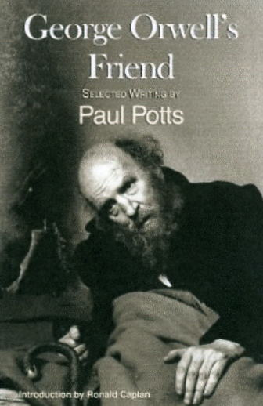
Mrs Kelly
Paul Potts
Eric Blair is the man who came into the pie shop last Tuesday in the grey suit
Eric Blair is the author who drinks bitter at the Carpenters’ Arms

Slide 38
The author that drinks in the Carpenter’s Arms is not a waiter
GO is not a waiter
The man who comes into the pie shop is a waiter
GO is not a waiter
GO is a waiter
GO is a waiter
GO is not a waiter

Slide 39
“On the account I have given, it is clear that the epistemic intension of a name can vary between speakers … This suggests that for a general account, epistemic intensions cannot be assigned to expression types but rather must be assigned to expression tokens (or perhaps to expression types in contexts of use)”
Chalmers 2002, “On Sense and Intension”, p174

Slide 40
I bet you that Eric Blair came into my shop last Tuesday
You’re on!
Mrs Kelly
Paul Potts
Eric Blair is the man who came into the pie shop last Tuesday in the grey suit
Eric Blair is the author who I met up with yesterday.

Slide 41
w
Cr(P) = v
What sort of thing is P?
P is a sentence.

Slide 42
w
Cr(EB is a waiter) = 0.9
Cr(GO is a waiter) = 0.2
Mrs Kelly
Eric Blair AKA George Orwell

Slide 43
w
Cr(P) = v
What sort of thing is P?
P is a sentence.
A sentence type?

Slide 44
w
Cr(P) = v
What sort of thing is P?
P is a sentence.
A sentence token?

Slide 45
I bet you that Eric Blair came into my shop last Tuesday
You’re on!
Mrs Kelly
Paul Potts

Slide 46
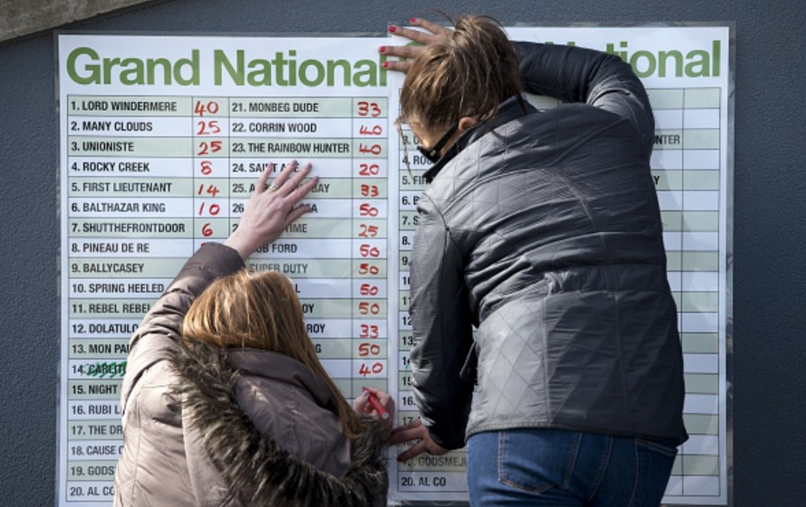

Slide 47
 | Many Clouds wins | Rocky Creek wins | …
Bet on Many Clouds | £££ | 0 | …
Bet on Rocky Creek | 0 | £££
…

Slide 48
P is an event/proposition, which corresponds to a set of states – and by states we mean possible worlds
Dice lands 1
P: dice lands on an even number
Dice lands 2
Dice lands 3
Dice lands 4
Dice lands 6
Dice lands 5

Slide 49
“Eric Blair” designates Teresa May
“… is a waiter” picks out the set of people who are retail assistants
P is a sentence, which corresponds to a set of interpretations
“Eric Blair” designates Eric Blair
“… is a waiter” picks out the set of people who are waiters
P: Eric Blair is a waiter

Slide 50
 | State 1 | State 2 | …
Action 1 | Outcome A | Outcome B | …
Action 2 | …
…

Slide 51
 | State 1 Cr(State 1) = p | State 2 Cr(State 2) = p’ | …
Action 1 | Outcome A V(Outcome A) = v | Outcome B V(Outcome B) = v’ | …
Action 2 | …
…

Slide 52
“Eric Blair” designates Teresa May
“… is a waiter” picks out the set of people who are retail assistants
P is a sentence, which corresponds to a set of interpretations
“Eric Blair” designates Eric Blair
“… is a waiter” picks out the set of people who are waiters
P: Eric Blair is a waiter

Slide 53
 | Interpretation 1 Cr(Interpretation 1) = p | Interpretation 2 Cr(Interpretation 2) = p’ | …
Action 1 | Outcome A V(Outcome A) = v | Outcome B V(Outcome B) = v’ | …
Action 2 | …
…

Slide 54
“Eric Blair” designates Teresa May
“… is a waiter” picks out the set of people who are retail assistants
P is a sentence, which corresponds to a set of interpretations
“Eric Blair” designates Eric Blair
“… is a waiter” picks out the set of people who are waiters

Slide 55
 | Interpretation 1 Cr(Interpretation 1) = p | Interpretation 2 Cr(Interpretation 2) = p’ | …
Action 1 | Outcome A V(Outcome A) = v | Outcome B V(Outcome B) = v’ | …
Action 2 | …
…

Slide 56
P is a sentence, which corresponds to a set of interpretations
“Eric Blair” designates Eric Blair
“… is a waiter” picks out the set of people who are waiters (namely Master Kelly…)
“Eric Blair” designates Eric Blair
“… is a waiter” picks out the set of people who are waiters (namely Miss Kelly…)

Slide 57
 | Interpretation 1 Cr(Interpretation 1) = p | Interpretation 2 Cr(Interpretation 2) = p’ | …
Action 1 | Outcome A V(Outcome A) = v | Outcome B V(Outcome B) = v’ | …
Action 2 | …
…

Slide 58
What the objects of credence cannot be
Propositions – sets of metaphysically possible worlds
Propositions’ – sets of impossible worlds
Epistemic intensions - sets of “scenarios”
Sentence tokens – sets of interpretations

