Slide 1

Communication Efficient Stochastic Gradient Descent
Milan Vojnović Department of Statistics
Joint work with Dan Alistarh, Jerry Li and Ryota Tomioka
Huawei: Innovative Algorithmic and Mathematic Workshop for NG Network Technology, Paris, November 7th, 2016

Slide 2
To Probe Further
QSGD: Randomized Quantization for Communication-Optimal Stochastic Gradient Descent, D. Alistarh, J. Li, R. Tomioka, M. Vojnovic https://arxiv.org/abs/1610.02132
Workshop OPTIM 2016, co-located with NIPS 2016, Barcelona, December 10, 2016
Work performed in part while all authors worked at Microsoft Research

Slide 3
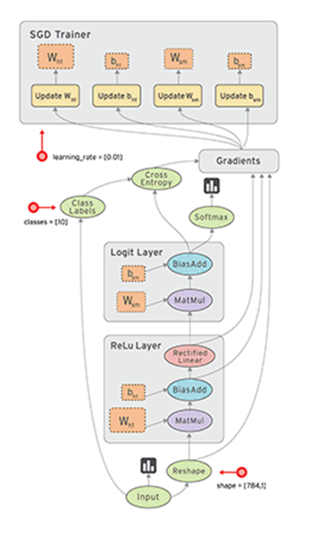



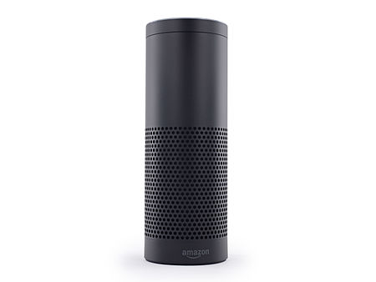
Motivating Applications
Amazon’s Alexa

Slide 4
Big data & big models
Vision
ImageNet: 1.6 million images
ResNet-152: 60 million parameters [He et al, Deep Residual Learning for Image Recognition, 2015]
Speech
NIST 2000 Switchboard dataset: 2,000 hours
LACEA: 65 million parameters (w/o language model) [Yu et al, Deep Convolutional Neural Networks with Layer-wise Context Expansion and Attention, 2016]

Slide 5
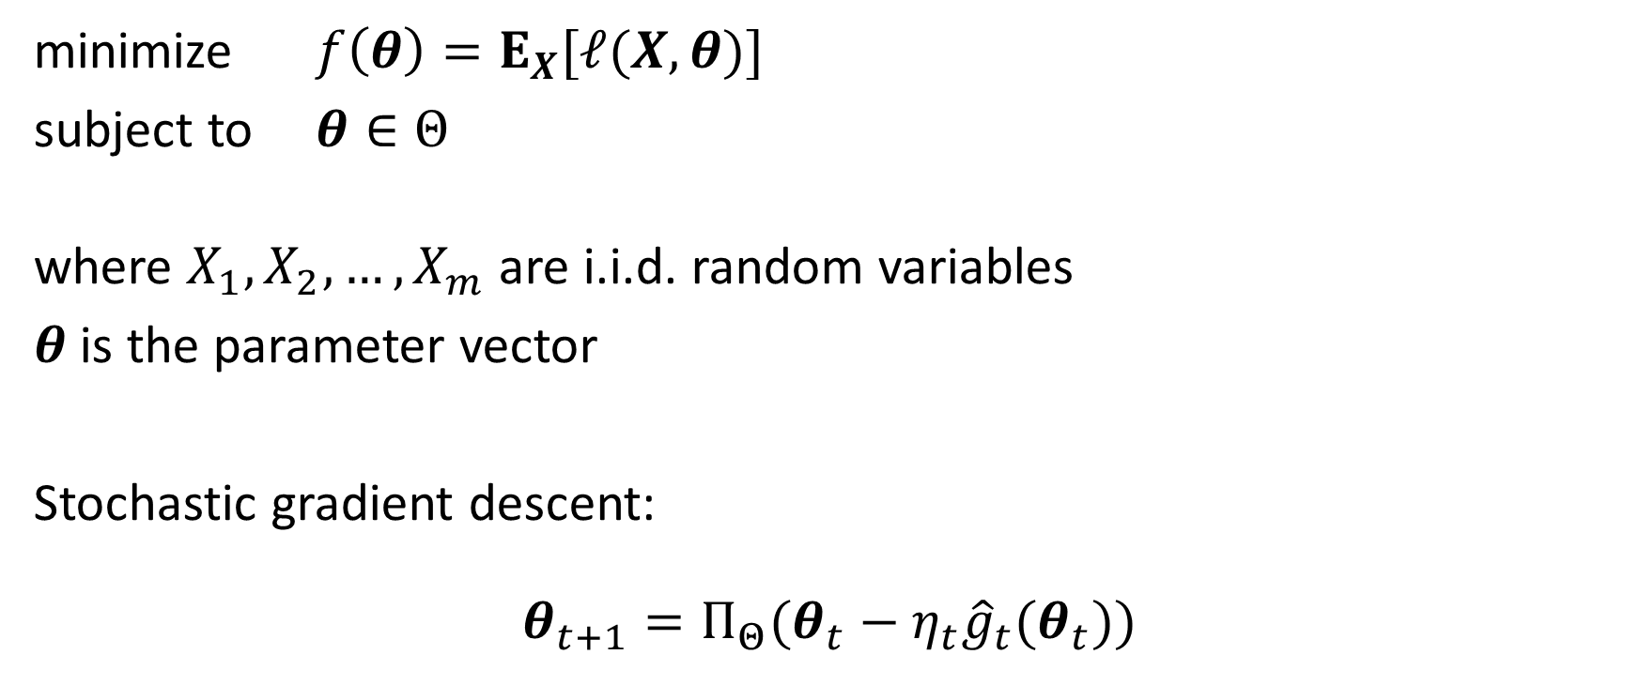
Stochastic Gradient Descent (SGD)
minimize $f\left(θ\right)=E_{X}[ℓ(X,θ)]$
subject to $θ∈Θ$
where $X_{1},X_{2},…, X_{m}$ are i.i.d. random variables
$θ$ is the parameter vector
Stochastic gradient descent:
$$θ_{t+1}={Π_{Θ}(θ}_{t}−η_{t}{\hat{g}}_{t}(θ_{t}))$$
projection
step size
stochastic gradient vector

Slide 6




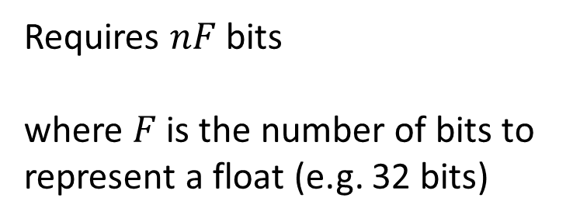
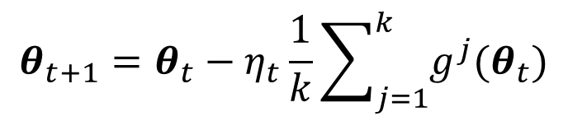


Scaling Up SGD: Data-Parallel Computing
$$g^{1}(θ_{t})$$
Gradient updates communicated to all nodes
1
$$g^{2}(θ_{t})$$
2
$$θ_{t+1}=θ_{t}−η_{t}\frac{1}{k}\sum_{j=1}^{k}{g^{j}(θ_{t})}$$
$$⋮$$
$$⋮$$
k
Requires $nF$ bits where $F$ is the number of bits to represent a float (e.g. 32 bits)
$$g^{k}(θ_{t})$$

Slide 7
Data Parallel SGD
Compute
gradient
Exchange
gradient
Update params
Mini-batch 1
Mini-batch 2

Slide 8
With compressed gradients…
Compress
gradient
Exchange
gradient
Decompress
gradient
Compute
gradient
Update params
Mini-batch 1
Mini-batch 2

Slide 9
Two Examples of Lossy Gradient Compressions …

Slide 10

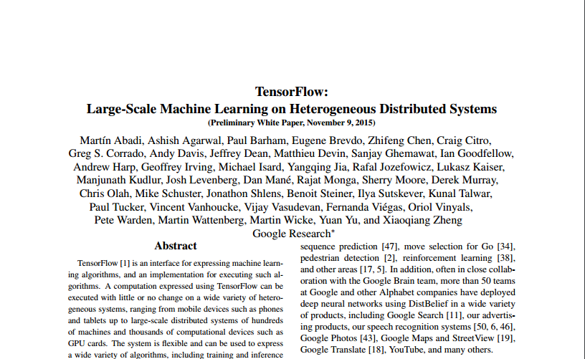
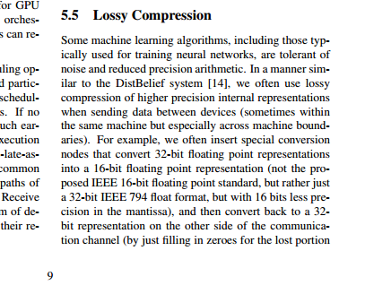

Slide 11

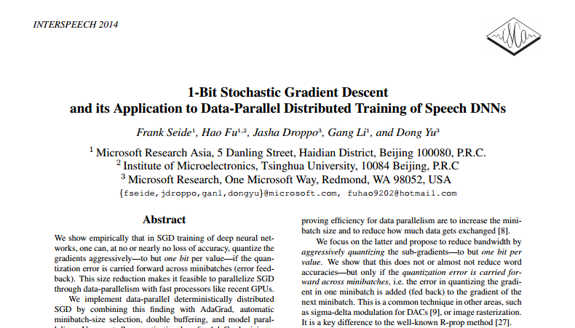

Slide 12

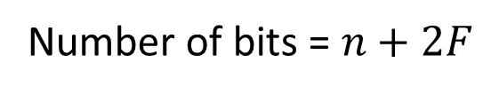
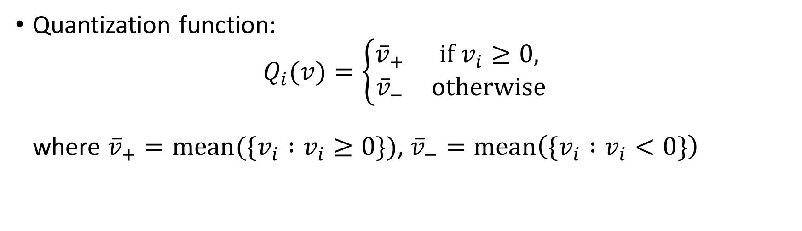
1-bit SGD [Seide et al 2014]
Quantization function: $Q_{i}(v)=\left\{\begin{matrix}{\overline{v}}_{+} & \text{if} v_{i}≥0, \\ {\overline{v}}_{−} & \text{otherwise}\end{matrix}\right.$ where ${\overline{v}}_{+}=\text{mean}(\{v_{i} :v_{i}≥0\})$, ${\overline{v}}_{−}=\text{mean}\left(\{v_{i} :v_{i}<0\}\right)$
float
float
float
float
float
v1
v2
v3
v4
$$⋯$$
vn
float
float
n bits
vp
vn
sign
Number of bits = $n+2F$
Biased stochastic gradient updates, no theoretical guarantees

Slide 13
Questions
Can we compress the stochastic gradient updates to fewer bits while still having a convergence guarantee ?
Can this be achieved with a sublinear number of bits with respect to the parameter vector dimension ?

Slide 14
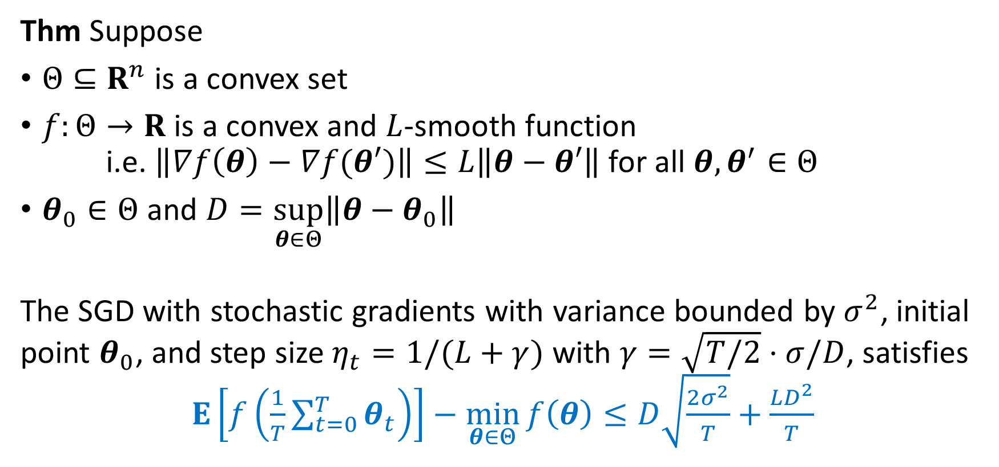
A Gadget
Thm Suppose
$Θ⊆R^{n}$ is a convex set
$f:Θ→R$ is a convex and $L$-smooth function i.e. $\left\|∇f\left(θ\right)−∇f(θ′)\right\|≤L\left\|θ−θ′\right\|$ for all $θ, θ^{′}∈Θ$
$θ_{0}∈Θ$ and $D=\sup_{θ∈Θ}\left\|θ−θ_{0}\right\|$
The SGD with stochastic gradients with variance bounded by $σ^{2}$, initial point $θ_{0}$, and step size $η_{t}=1/(L+γ)$ with $γ=\sqrt{T/2}⋅σ/D$, satisfies $E\left[f\left(\frac{1}{T}\sum_{t=0}^{T}{θ_{t}}\right)\right]−\min_{θ∈Θ}{f\left(θ\right)}≤D\sqrt{\frac{2σ^{2}}{T}}+\frac{LD^{2}}{T}$

Slide 15

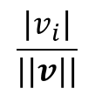
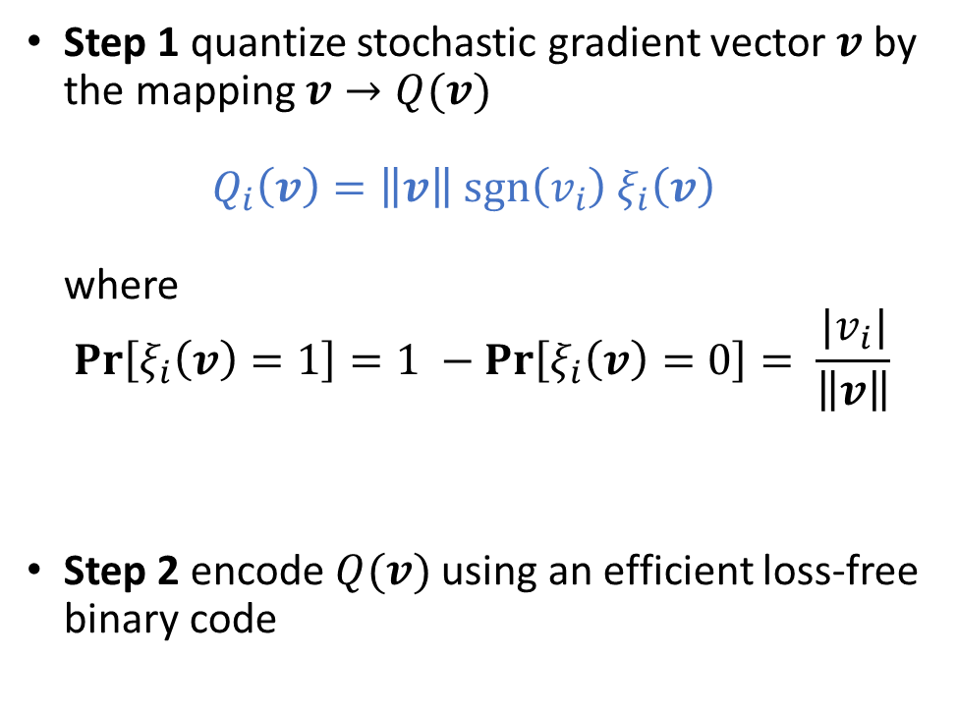



Our Quantized SGD Scheme: Simple Version
Step 1 quantize stochastic gradient vector $v$ by the mapping $v→Q(v)$ $Q_{i}\left(v\right)=\left\|v\right\| sgn\left(v_{i}\right){ ξ}_{i}\left(v\right)$ where
$$\operatorname{Pr}\left[ξ_{i}\left(v\right)=1\right]=1 −\operatorname{Pr}\left[ξ_{i}\left(v\right)=0\right]= \frac{|v_{i}|}{\left\|v\right\|}$$
Step 2 encode $Q(v)$ using an efficient loss-free binary code
$$Pr⁡[ξ_{i}\left(v\right)=x]$$
$$x$$
$$0$$
$$1$$
$$\frac{|v_{i}|}{||v||}$$

Slide 16
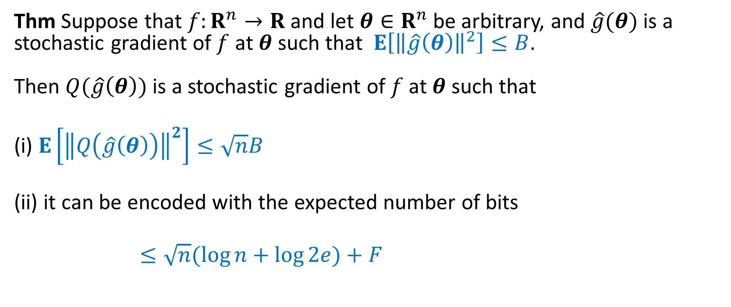
Simple Quantized SGD Scheme (Cont’d)
Thm Suppose that $f:R^{n}→R$ and let $θ∈R^{n}$ be arbitrary, and $\hat{g}(θ)$ is a stochastic gradient of $f$ at $θ$ such that $E\left[{\left\|\hat{g}\left(θ\right)\right\|}^{2}\right]≤B$. Then $Q(\hat{g}\left(θ\right))$ is a stochastic gradient of $f$ at $θ$ such that
(i) $E\left[{\left\|Q\left(\hat{g}\left(θ\right)\right)\right\|}^{2}\right]≤\sqrt{n}B$
(ii) it can be encoded with the expected number of bits
$≤\sqrt{n}(\log{n+\log{2e)+F}}$

Slide 17

Proof Sketch
For every $v∈R^{n}$
$E\left[{\left\|Q\left(v\right)\right\|}^{2}\right]=\sum_{i=1}^{n}{{\left\|v\right\|}^{2}E[ξ_{i}{\left(v\right)}^{2}]}$
$=\sum_{i=1}^{n}{{\left\|v\right\|}^{2}\frac{|v_{i}|}{\left\|v\right\|}}$
$=\left\|v\right\|\sum_{i=1}^{n}{|v_{i}|}$
$≤\sqrt{n}{\left\|v\right\|}^{2}$
$Q(v)$ can be encoded with: ${\left\|v\right\|}^{2}$ $F$ bits $sgn(v_{i})$ $1$ bit
$ξ_{i}(v)$ $1$ bit $ξ(v)$ is sparse: $E\left[|\{i:ξ_{i}\left(v\right)>0\}|\right]≤\sqrt{n}$

Slide 18
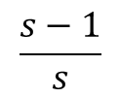
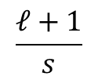
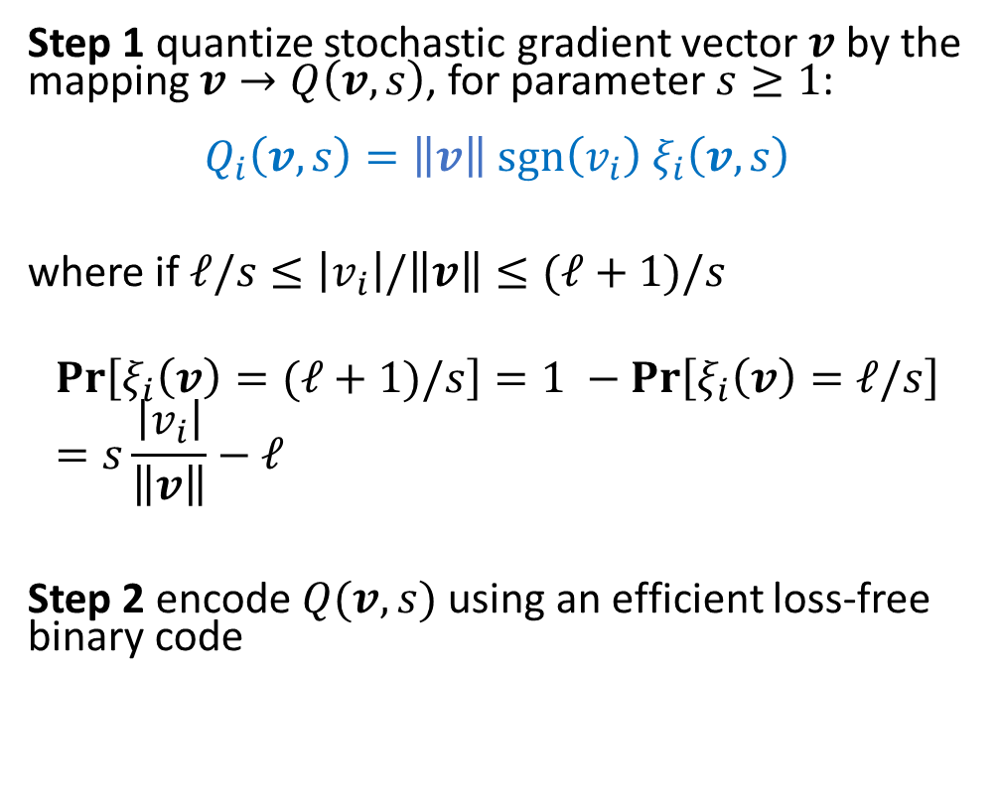





Our Quantized SGD Scheme: Full Version
Step 1 quantize stochastic gradient vector $v$ by the mapping $v→Q\left(v,s\right)$, for parameter $s≥1$: $$Q_{i}\left(v,s\right)=\left\|v\right\| sgn\left(v_{i}\right){ ξ}_{i}\left(v,s\right)$$ where if $ℓ/s≤\left|v_{i}\right|/\left\|v\right\|≤(ℓ+1)/s$
$$\operatorname{Pr}\left[ξ_{i}\left(v\right)=(ℓ+1)/s\right]=1 −\operatorname{Pr}\left[ξ_{i}\left(v\right)=ℓ/s\right]=s\frac{\left|v_{i}\right|}{\left\|v\right\|}−ℓ$$
Step 2 encode $Q(v,s)$ using an efficient loss-free binary code
$$Pr⁡[ξ_{i}\left(v,s\right)=x]$$
$$x$$
$$\frac{1}{s}$$
$$⋯$$
$$\frac{ℓ}{s}$$
$$\frac{ℓ+1}{s}$$
$$\frac{s−1}{s}$$
$$0$$
$$⋯$$
$$1$$
$$\frac{|v_{i}|}{||v||}$$

Slide 19
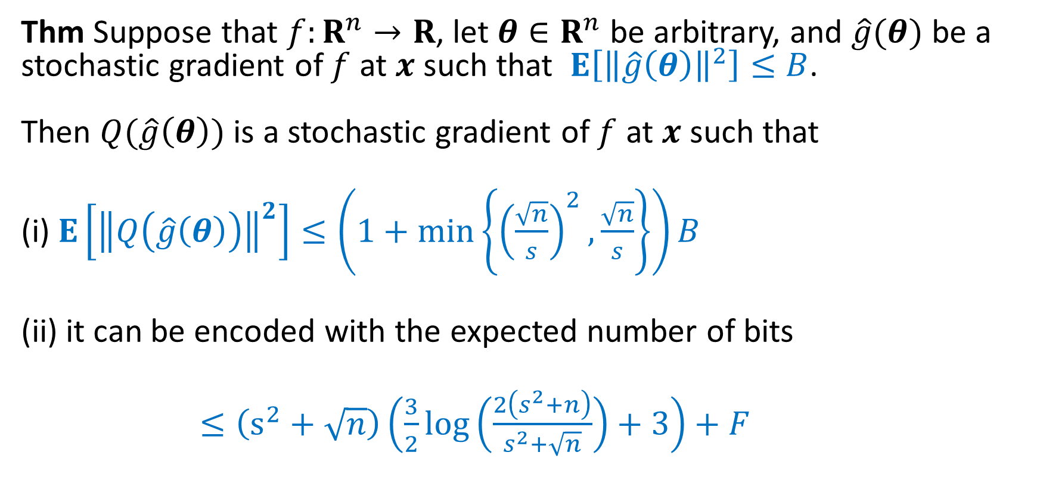
Generalized Quantized SGD Scheme (Cont’d)
Thm Suppose that $f:R^{n}→R$, let $θ∈R^{n}$ be arbitrary, and $\hat{g}(θ)$ be a stochastic gradient of $f$ at $x$ such that $E\left[{\left\|\hat{g}\left(θ\right)\right\|}^{2}\right]≤B$. Then $Q(\hat{g}\left(θ\right))$ is a stochastic gradient of $f$ at $x$ such that
(i) $E\left[{\left\|Q\left(\hat{g}\left(θ\right)\right)\right\|}^{2}\right]≤\left(1+\min\left\{{\left(\frac{\sqrt{n}}{s}\right)}^{2},\frac{\sqrt{n}}{s}\right\}\right)B$
(ii) it can be encoded with the expected number of bits
$≤\left(s^{2}+\sqrt{n}\right)\left(\frac{3}{2}\log\left(\frac{2\left(s^{2}+n\right)}{s^{2}+\sqrt{n}}\right)+3\right)+F$

Slide 20










Smooth Trade-off Curve
iterations
bits per iteration
$$n$$
$$\sqrt{n}$$
$$1$$
$$\sqrt{n}$$
$$1$$
$$\sqrt{n}$$
$$1$$
$$\sqrt{n}$$
$$s$$
$$s$$

Slide 21
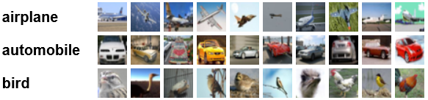
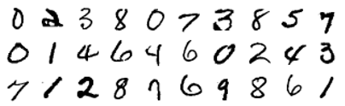
Experimental Results
MNIST: handwritten digits
Training set: 60,000 28 x 28 single digit images, test set: 10,000
Model: two-layer perceptron
Mini-batch size 256, Step size 0.1
Number of parameters = 3.3M
CIFAR-10: object classification
Training set: 50,000 32 x 32 colour images; 1.8M images by translating, cropping and horizontal flipping
Model: 9 2D convolution layers and 3 fully connected layer
Mini-batch size 256, Step size 0.1
Number of parameters = 22M

Slide 22

MNIST
$d$ := bucket size

Slide 23
CIFAR-10

Slide 24
Multiple GPU Nodes

Slide 25
Thanks

