Slide 1

Scalable Inference for Statistical Models of Ranking Data
Milan Vojnovic
Department of Statistics
Joint work with Se-Young Yun and Kaifang Zhou
Keynote talk, Workshop on Challenges for Categorical Data Analysis, RWTH Aachen University, October 22-23, 2018

Slide 2
This talk: statistical ranking models
Statistical ranking outcomes
paired comparisons, full rankings, choice, rankings with ties
Applications:
Learning to rank
Web search results ranking
Information retrieval
Rating skills of online gamers
Microsoft TrueSkill
Rating reinforcement learning algorithms
DeepMind (NeurIPS 2018)

Slide 3


Statistical ranking models
A ground set of items: $N=\{1,2,…,n\}$
Independent ranking observations with probability distribution: $Pr\left[Y=y \right| S=s] = p_{θ}(y;s)$, for every $s⊆N$
Ranking output:
e.g. full ranking of items,
choice of one item,
ranking with ties, …
Parametric distribution
of a ranking output for
parameter $θ∈Θ$

Slide 4
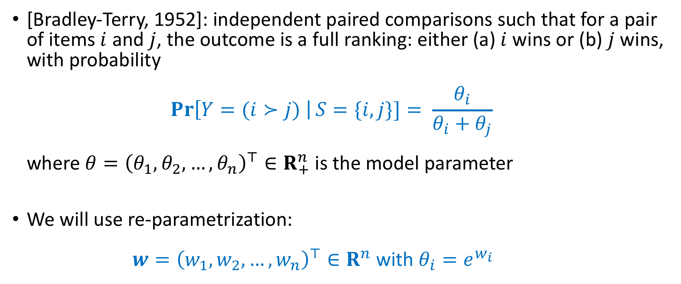
Bradley-Terry model of paired comparisons
[Bradley-Terry, 1952]: independent paired comparisons such that for a pair of items $i$ and $j$, the outcome is a full ranking: either (a) $i$ wins or (b) $j$ wins, with probability $\operatorname{Pr}\left[Y=(i≻j) \right|S=\{i,j\}]= \frac{θ_{i}}{θ_{i}+θ_{j}}$ where $θ={\left(θ_{1},θ_{2},…, θ_{n}\right)}^{⊤}∈R_{+}^{n}$ is the model parameter
We will use re-parametrization: $w={\left(w_{1},w_{2},…, w_{n}\right)}^{⊤}∈R^{n}$ with $θ_{i}=e^{w_{i}}$
Note: the model first proposed by Zermelo (1929)

Slide 5
Generalized Bradley-Terry models
Rao-Kupper model (1967)
Paired comparisons with tie outcomes
Luce’s choice model (1959)
One item selection from a comparison set of two or more items
Plackett-Luce ranking model (1975)
A full ranking (permutation) for a comparison set of two or more items

Slide 6
Some related work
MM algorithm [Ford 1957, Hunter 2004, Caron and Doucet 2012]
Rank centrality [Negahban, Oh and Shah 2017]
Rank breaking [Khetan and Oh 2016]
Sampling complexity [Hajek 2014, V. and Yun 2017]

Slide 7
This talk
Characterization of the convergence rate of first-order iterative optimization methods for generalized Bradley-Terry model:
Gradient descent (GD) algorithm
Minimize-majorize (MM) algorithm
Objectives under consideration:
Maximum likelihood estimation (MLE)
Maximum a-posteriori probability (MAP)
New accelerated iterative optimization method for MAP

Slide 8
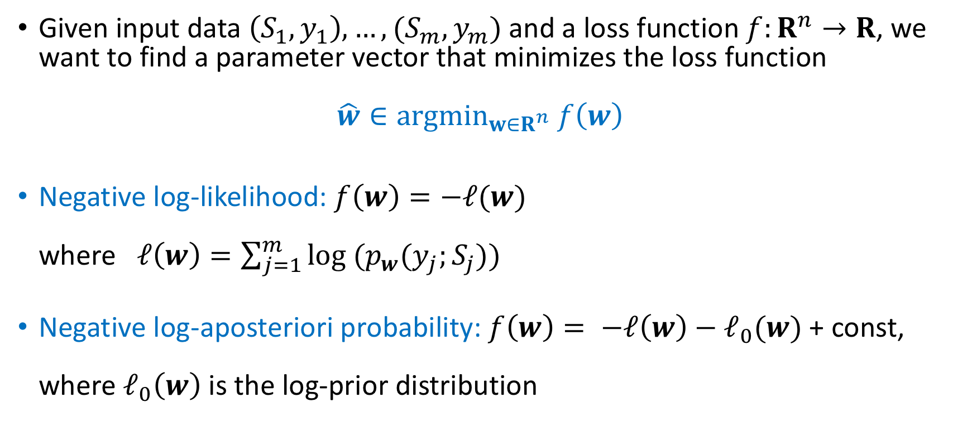
Model fitting by a loss function minimization
Given input data $\left(S_{1},y_{1}\right),…, (S_{m},y_{m})$ and a loss function $f:R^{n}→R$, we want to find a parameter vector that minimizes the loss function $\hat{w}∈{argmin}_{w∈R^{n}} f\left(w\right)$
Negative log-likelihood: $f\left(w\right)=−ℓ(w)$ where $ℓ\left(w\right)=\sum_{j=1}^{m}{log (p_{w}(y_{j};S_{j}))}$
Negative log-aposteriori probability: $f\left(w\right)= −ℓ\left(w\right)−ℓ_{0}(w)$ + const, where $ℓ_{0}\left(w\right)$ is the log-prior distribution

Slide 9
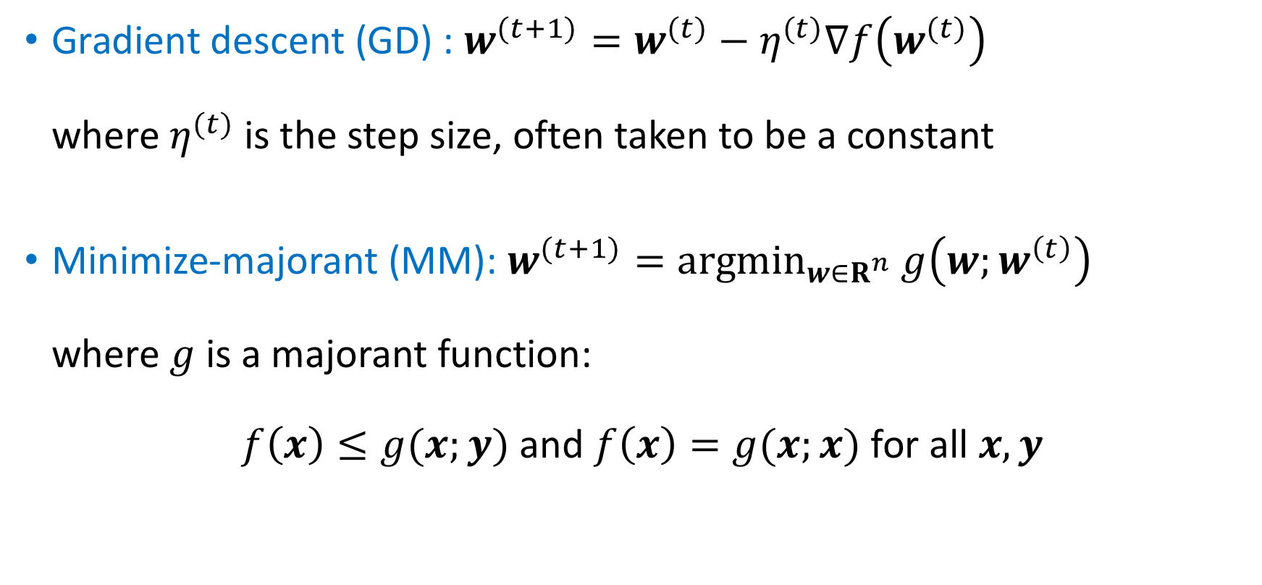
First-order iterative optimization algorithms
Gradient descent (GD) : $w^{(t+1)}=w^{(t)}−η^{(t)}∇f\left(w^{(t)}\right)$ where $η^{(t)}$ is the step size, often taken to be a constant
Minimize-majorant (MM): $w^{(t+1)}=argmin_{w∈R^{n}} g\left(w;w^{\left(t\right)}\right)$ where $g$ is a majorant function: $f\left(x\right)≤g(x;y)$ and $f\left(x\right)=g(x;x)$ for all $x,y$

Slide 10

MM algorithm for Bradley-Terry model
The MM iteration update: $θ_{i}^{(t+1)}=\left(\sum_{j≠i}{w_{i,j}}\right){\left(\sum_{j≠i}{\frac{m_{i,j}}{θ_{i}^{(t)}+θ_{j}^{(t)}}}\right)}^{−1}$, $i=1,2,…, n$
Similar MM iteration updates are known also for the Rao-Kupper, Luce, and Plackett-Luce model [Hunter 2004]
$w_{i,j}$ := number of paired comparisons in which $i$ won against $j$
$m_{i,j}$ := number of paired comparisons of items $i$ and $j$

Slide 11

MM algorithm by Caron and Doucet (2012)
Bayesian inference framework with a prior distribution of product-form with $e^{w_{i}}∼$ Gamma ($α, β$), $α≥1$ and $β>0$
The MM iteration update: $θ_{i}^{(t+1)}=\left(α−1+\sum_{j≠i}{w_{i,j}}\right){\left(β+ \sum_{j≠i}{\frac{m_{i,j}}{θ_{i}^{(t)}+θ_{j}^{(t)}}}\right)}^{−1}$, $i=1,2,…, n$
Corresponds to standard (MLE) MM iteration when $α=1$ and $β↓0$

Slide 12

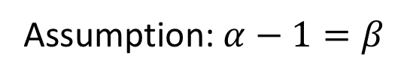
Small $β$ limit: non-informative prior
Assumption: $α−1=β$

Slide 13
Software packages
BradleyTerry2 [Heather Turner and David Firth] https://cran.r-project.org/web/packages/BradleyTerry2/index.html
BradleyTerryScallable [Ella Kaye and David Firth] https://cran.r-project.org/web/packages/BradleyTerryScalable/index.html
Choix [Lucas Maystre] (Python) https://github.com/lucasmaystre/choix

Slide 14
This talk: research questions
How fast do first-order iterative methods converge?
How does the convergence time depend on the properties of the input data? Which properties of the input data matter?
Is there a gap between convergence times for different iterative methods, and/or different ranking models?
Can we design faster first-order iterative methods?

Slide 15

Illustrative numerical example
Mapping the emotional language of gifs
http://gifgif.media.mit.edu/

Slide 16

1,048,576 observations
17 metrics

Slide 17
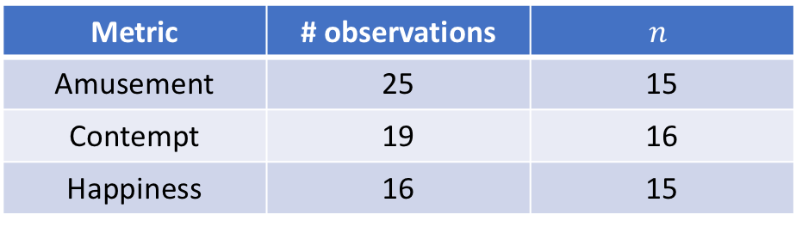
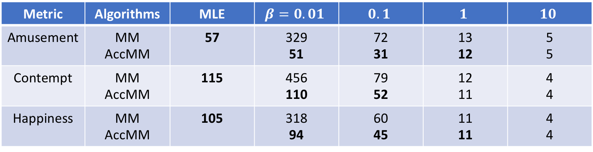
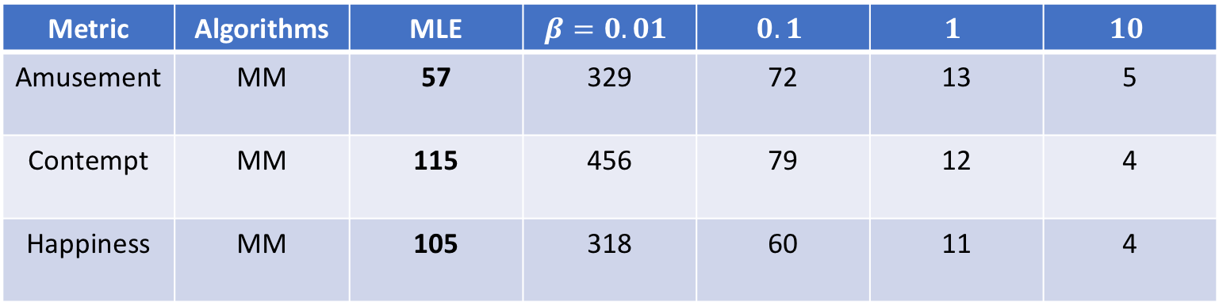
Convergence times: subsample of items
Metric | # observations | $$n$$
Amusement | 25 | 15
Contempt | 19 | 16
Happiness | 16 | 15
Metric | Algorithms | MLE | $$β=0.01$$ | $$0.1$$ | $$1$$ | $$10$$
Amusement | MM | 57 | 329 | 72 | 13 | 5
Contempt | MM | 115 | 456 | 79 | 12 | 4
Happiness | MM | 105 | 318 | 60 | 11 | 4
Metric | Algorithms | MLE | $$β=0.01$$ | $$0.1$$ | $$1$$ | $$10$$
Amusement | MM AccMM | 57 | 329 51 | 72 31 | 13 12 | 5 5
Contempt | MM AccMM | 115 | 456 110 | 79 52 | 12 11 | 4 4
Happiness | MM AccMM | 105 | 318 94 | 60 45 | 11 11 | 4 4
Convergence time: number of iterations until the change
of the estimated parameter vector is within a given error tolerance

Slide 18

Convergence time for MLE
Thm Suppose $w^{∗}$ is the MLE such that ${\left\|w^{∗}\right\|}_{∞}≤ω.$ For both GD and MM, the number of iterations $T$ such that $f\left(w^{\left(T\right)}\right)−f\left(w^{∗}\right)≤ε$ satisfies $T=O\left(\frac{d(M)}{a(M)}log⁡(1/ε)\right)$ where $d(M)$ maximum number of comparisons of an item $a(M)$ algebraic connectivity of matrix $M$ $M$ matrix of the co-occurrence counts of pairs of items

Slide 19



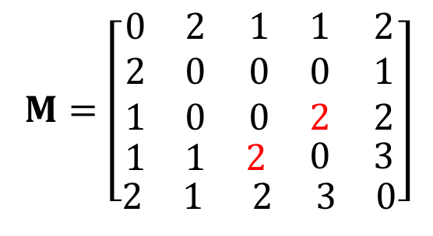



Matrix of paired comparison counts
4
1
1
3
Comparison sets:
4
2
4
5
2
1
3
5
5
5
$$M=\left[\begin{aligned}\begin{aligned}\begin{matrix}0 & 2 \\ 2 & 0 \\ 1 & 0\end{matrix} \begin{matrix}1 & 1 \\ 0 & 0 \\ 0 & 2\end{matrix} \begin{matrix}2 \\ 1 \\ 2\end{matrix} \\ \begin{matrix}1 & 1 & 2\end{matrix} 0 3\end{aligned} \\ \begin{matrix}2 & 1 & 2\end{matrix} \begin{matrix} 3 & 0\end{matrix}\end{aligned}\right]$$
$$d_{1}\left(M\right)=6$$
$$d_{2}\left(M\right)=3$$
$$d_{3}(M)=5$$
$$d\left(M\right)=\max_{i}{d_{i}(M)}= 8$$
$$d_{4}\left(M\right)=7$$
$$d_{5}\left(M\right)=8$$

Slide 20
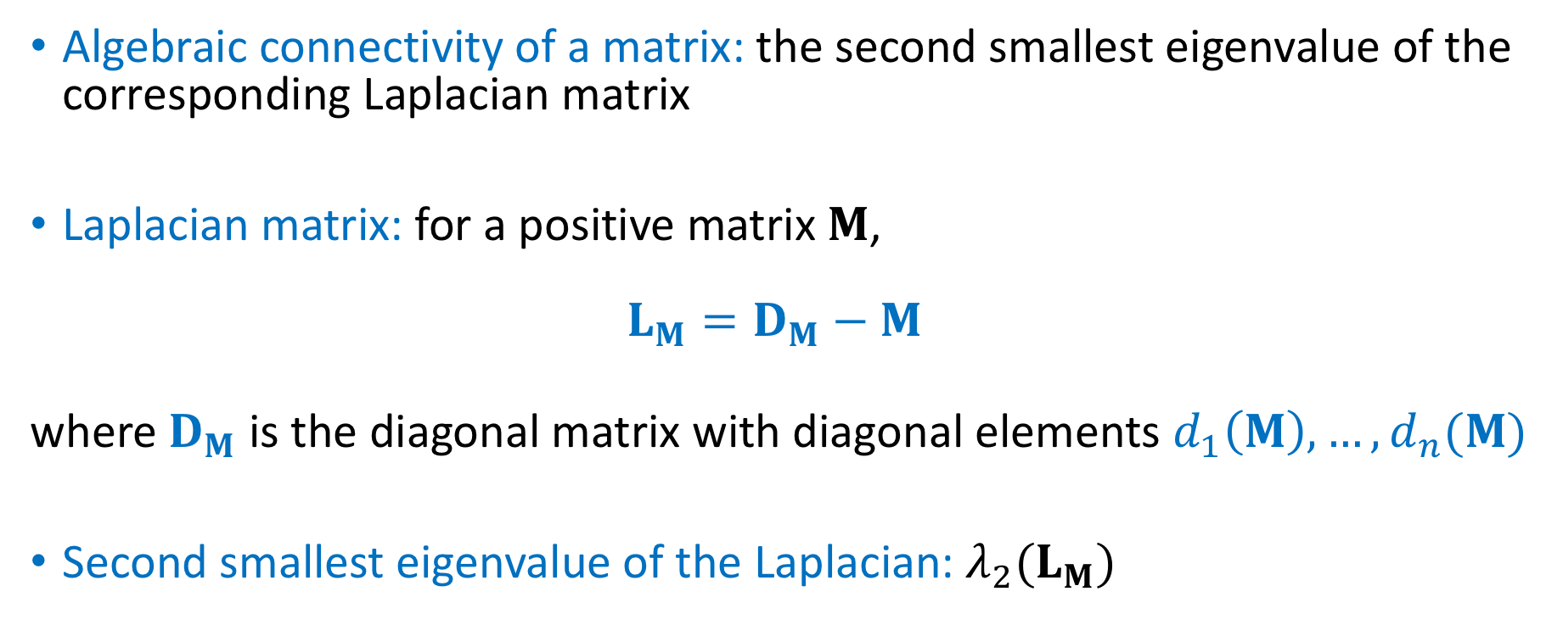
Algebraic connectivity of a matrix
Algebraic connectivity of a matrix: the second smallest eigenvalue of the corresponding Laplacian matrix
Laplacian matrix: for a positive matrix $M$, $L_{M}=D_{M}−M$
where $D_{M}$ is the diagonal matrix with diagonal elements $d_{1}\left(M\right), …, d_{n}(M)$
Second smallest eigenvalue of the Laplacian: $λ_{2}(L_{M})$
Def. the eigenvalues of a matrix $A$ in $R^{n×n}$ are denoted as $λ_{1}\left(A\right)≤λ_{2}\left(A\right)≤⋯≤λ_{n}(A)$

Slide 21
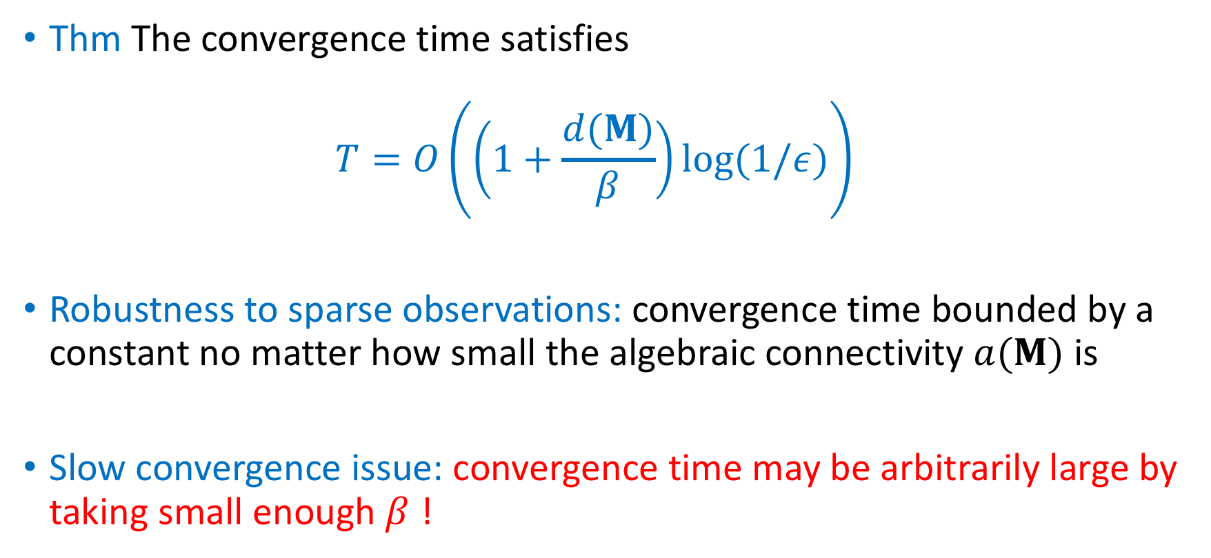
Convergence time for MAP
Thm The convergence time satisfies $T=O\left(\left(1+\frac{d(M)}{β}\right)\log{(1/ε)}\right)$
Robustness to sparse observations: convergence time bounded by a constant no matter how small the algebraic connectivity $a(M)$ is
Slow convergence issue: convergence time may be arbitrarily large by taking small enough $β$ !

Slide 22


Tight example: two items compared $m$ times
Convergence rate for the MAP objective: $\lim_{t→∞}{\frac{f\left(w^{\left(t+1\right)}\right)−f(w^{∗})}{f\left(w^{\left(t\right)}\right)−f(w^{∗})}}={\left(1+\frac{2(α−1)}{m}\right)}^{−2}$ $≈1−\frac{4(α−1)}{m}$ for small $α−1$
Can be arbitrarily slow by taking $α−1=β$ for small enough $β$

Slide 23

Accelerated iterative methods
Thm For the accelerated version of gradient descent and MM iterative algorithms, the convergence time satisfies $T=O\left(\min\left\{\frac{d(M)}{a(M)},\frac{d(M)}{β}\right\}\log{(1/ε)}\right)$
The slow convergence issue resolved: the convergence time of the same order as for MLE when $a\left(M\right)>0$ and $β<a(M)$
Note: accelerated method to be defined later

Slide 24
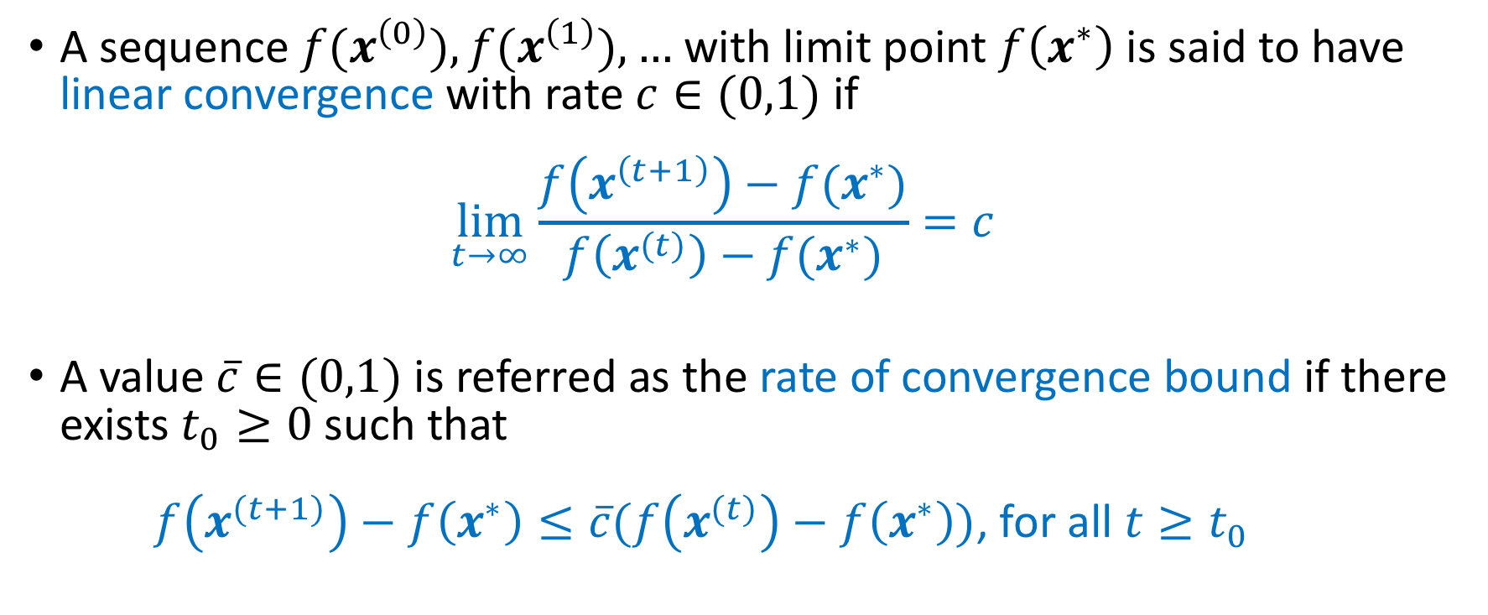
Background: linear convergence rate
A sequence $f(x^{\left(0\right)}),{f(x}^{\left(1\right)}), …$ with limit point $f\left(x^{∗}\right)$ is said to have linear convergence with rate $c∈(0,1)$ if $\lim_{t→∞}{\frac{f\left(x^{\left(t+1\right)}\right)−f(x^{∗})}{f\left(x^{(t)}\right)−f(x^{∗})}=c}$
A value $\overline{c}∈(0,1)$ is referred as the rate of convergence bound if there exists $t_{0}≥0$ such that $f\left(x^{(t+1)}\right)−f\left(x^{∗}\right)≤\overline{c}(f\left(x^{(t)}\right)−f\left(x^{∗}\right))$, for all $t≥t_{0}$

Slide 25

Background: convex functions
Smoothness: A function $f$ is said to be $μ$-smooth on $X$ if it has $μ$-Lipschitz gradient on $X$, i.e. $\left\|∇f\left(x\right)−∇f(y)\right\|≤μ\left\|x−y\right\|$
Strong convexity: $f$ is $γ$-strongly convex on $X$ if $f\left(x\right)−f\left(y\right)≤∇f{\left(x\right)}^{⊤}\left(x−y\right)−\frac{γ}{2}\left\|x−y\right\|$, for all $x,y∈X$

Slide 26

Background: Polyak-Lojasiewicz inequality
Funtion $f$ satisfies the Polyak-Lojasiewicz inequality on $X$ if there exists $γ>0$ such that $f\left(x\right)−f\left(x^{∗}\right)≤\frac{1}{2γ}{\left\|∇f\left(x\right)\right\|}^{2}$ for all $x∈X$

Slide 27
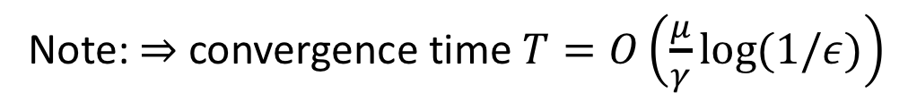

Gradient descent: linear convergence
Thm Suppose $f$ is a convex function such that $f$ is $μ$-smooth function on $X_{μ}$, and $f$ satisfies the $γ$-PL inequality on $X_{γ}$ Then, for GD with $η=1/μ,$ if $w^{(t)}∈X_{γ}$ and ${w^{(t+1)}∈X}_{μ}$, then $f\left(w^{\left(t+1\right)}\right)−f\left(w^{∗}\right)≤\left(1−\frac{γ}{μ}\right)\left(f\left(w^{\left(t\right)}\right)−f\left(w^{∗}\right)\right)$
Note: $⇒$ convergence time $T=O\left(\frac{μ}{γ}\log{(1/ε)}\right)$

Slide 28
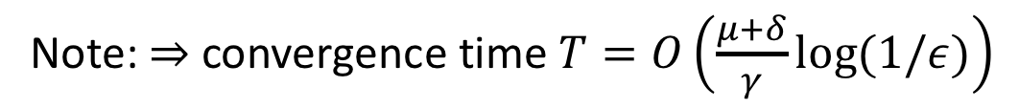

MM: linear convergence
Thm Suppose $f$ is a convex function that is $μ$-smooth function on $X_{μ}$ and that satisfies the $γ$-PL inequality on $X_{γ}⊆X_{μ}$ Let $g$ be a majorant surrogate function of $f$ such that for $δ>0$ $g\left(x;y\right)−f\left(x\right)≤\frac{δ}{2}{\left\|x−y\right\|}^{2}$ for all $x,y∈X_{μ}$ Then, if $w^{(t)}∈X_{γ}$ and $w^{\left(t\right)}−\frac{1}{μ+δ}∇f\left(w^{(t)}\right)∈X_{μ}$, we have $f\left(w^{\left(t+1\right)}\right)−f\left(w^{∗}\right)≤\left(1−\frac{γ}{μ+δ}\right)\left(f\left(w^{\left(t\right)}\right)−f\left(w^{∗}\right)\right)$
Note: $⇒$ convergence time $T=O\left(\frac{μ+δ}{γ}\log{(1/ε)}\right)$

Slide 29

Key lemma
Lem Suppose that $X$ is a convex set such that $f$ is $γ$-strongly convex on $X_{0}=X∩\left\{x∈R^{n}:1^{T}x=0\right\}$ Assume that $f$ is such that for every $x∈X$ (C1) $f\left(Π_{c}\left(x\right)\right)=f(x)$ (C2) $∇f\left(Π_{c}\left(x\right)\right)=∇f\left(x\right)$ where $Π_{c}\left(x\right)=x+c1$ Then, $f$ satisfies the $γ$-PL inequality on $X$

Slide 30
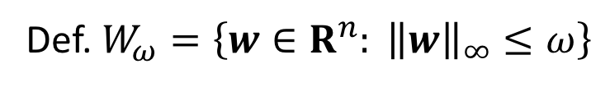

Bradley-Terry likelihood function properties
The negative log-likelihood of the Bradley-Terry model is $γ$-strongly convex on $W_{ω,0}=W_{ω}∩\left\{w∈R^{n}:1^{⊤}w=0\right\}$ and $μ$-smooth on $R^{n}$ with $γ=c_{ω}λ_{2}(L_{M})$ and $μ=\frac{1}{2}d(M)$ where $c_{ω}=1/{\left(e^{−ω}+e^{ω}\right)}^{2}$
Def. $W_{ω}=\left\{w∈R^{n}: {\left\|w\right\|}_{∞}≤ω\right\}$

Slide 31

MM: surrogate function smoothness
Lem For the Bradley-Terry model of paired comparisons, the surrogate majorant function satisfies $g\left(x;y\right)−f\left(x\right)≤\frac{δ}{2}{\left\|x−y\right\|}^{2}$with $δ=\frac{1}{2}e^{2ω}d(M)$
Recall $μ=\frac{1}{2}d\left(M\right)$ and the rate of convergence for MM is $1−γ/(μ+δ)$
$⇒$ MM and GD have the same the rate of convergence up to a constant factor

Slide 32

Bradley-Terry: a posteriori probability
Cor The negative log-a posteriori probability function with the Gamma ($α, β)$ prior is $γ$-strongly convex and $μ$-smooth on $W_{ω}$ with $γ=e^{−ω}β$ and $μ=\frac{1}{2}d\left(M\right)+e^{ω}β$
$⇒$ Slow convergence issue: the strong-convexity parameter scales proportionally to parameter $β$

Slide 33
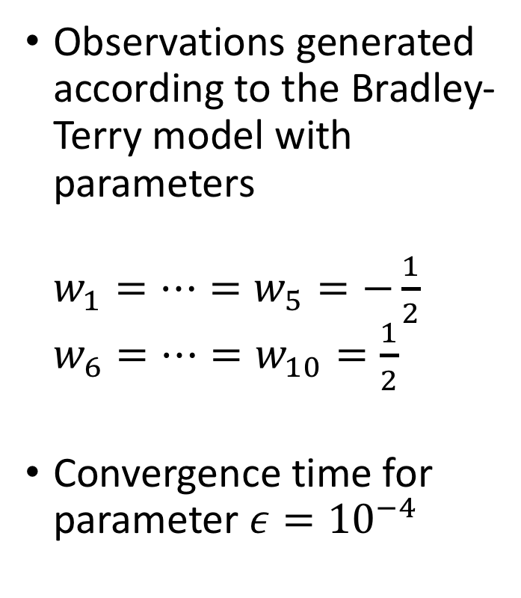
Example: ten items
Observations generated according to the Bradley-Terry model with parameters $w_{1}=⋯=w_{5}=−\frac{1}{2}$ $w_{6}=⋯=w_{10}=\frac{1}{2}$
Convergence time for parameter $ε={10}^{−4}$

Slide 34

Accelerated MAP inference
Approach: use the well-known first-order algorithms (GD and MM) but with $Π$-transformed iteration updates (GD) $w^{(t+1)}=Π\left(w^{\left(t\right)}−η∇f\left(w^{\left(t\right)}\right)\right)$ (MM) $w^{\left(t+1\right)}=Π\left(argmin_{w∈R^{n}}g\left(w;w^{\left(t\right)}\right)\right)$ where $Π:R^{n}→R^{n}$ is a suitably chosen mapping

Slide 35


Conditions on $f$ and $Π$
Function $f$ is a convex function satisfying (F1) $f$ is $μ$-smooth on $X$ (F2) $f$ satisfies the $γ$-PL inequality on $X_{0}=X∩\left\{x∈R^{n}:d^{⊤}∇f\left(x\right)=0\right\}$ for a given direction vector $d$
$Π$ is such that (P1) $f\left(Π\left(x\right)\right)≤f(x)$ for all $x∈R^{n}$ (P2) $d^{⊤}∇f\left(Π(x)\right)=0$ for all $x∈R^{n}$
(key condition)

Slide 36
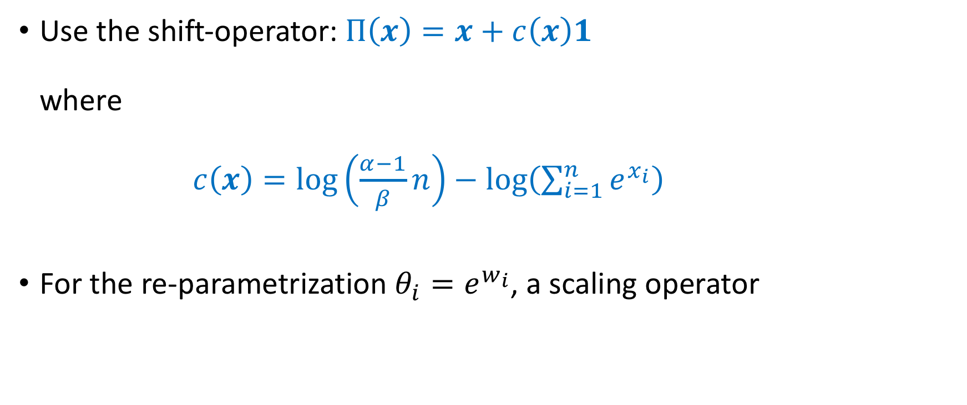
Acceleration for Bradley-Terry model
Use the shift-operator: $Π\left(x\right)=x+c\left(x\right)1$ where $c\left(x\right)=\log\left(\frac{α−1}{β}n\right)−\log\left(\sum_{i=1}^{n}{e^{x_{i}}}\right)$
For the re-parametrization $θ_{i}=e^{w_{i}}$, a scaling operator

Slide 37
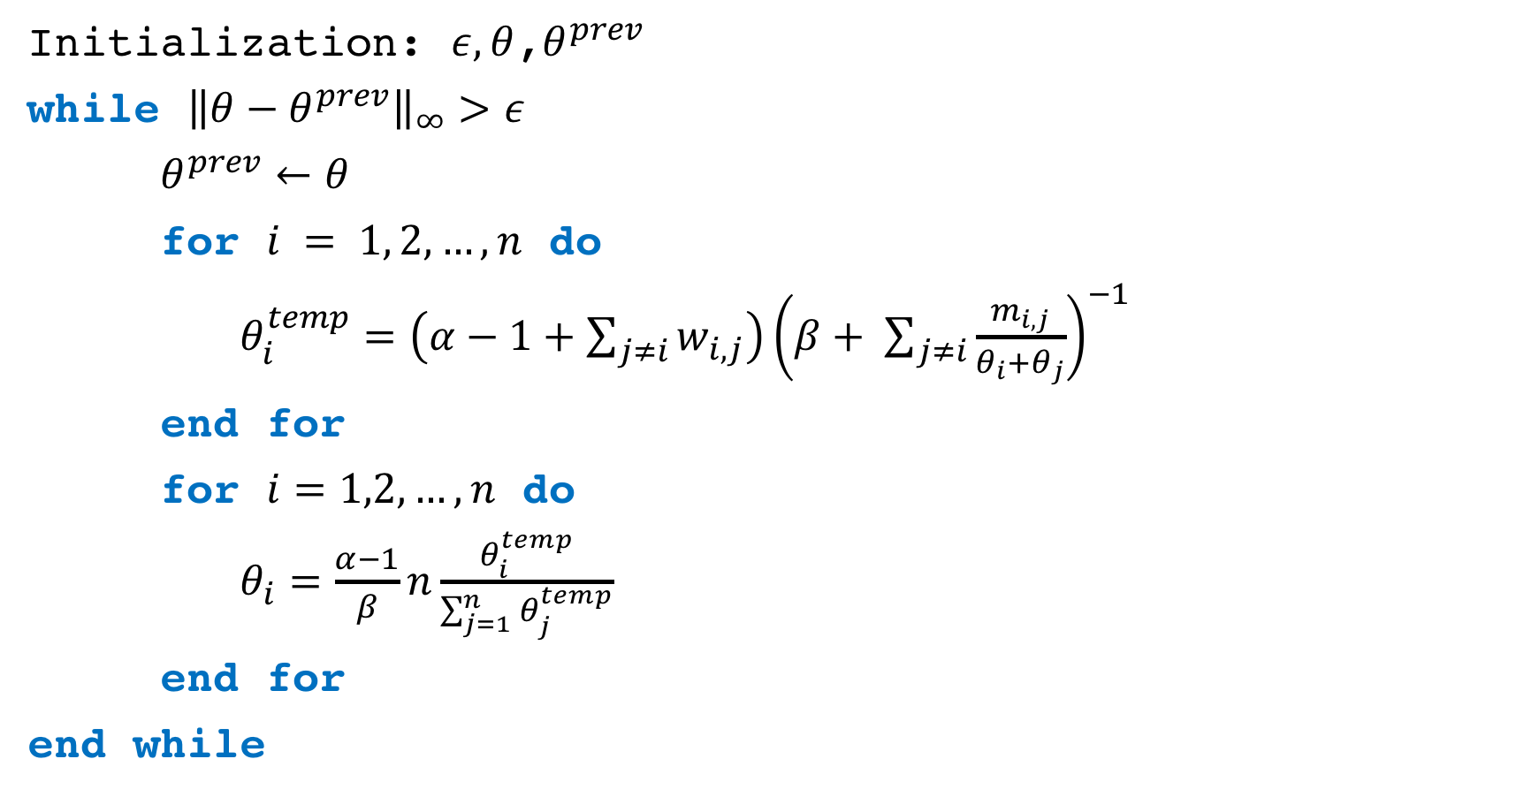
Accelerated MM algorithm
Initialization: $ε, θ$,$θ^{prev}$
while ${\left\|θ−θ^{prev}\right\|}_{∞}>ε$
$θ^{prev}←θ$
for $i = 1, 2,…, n$ do
$θ_{i}^{temp}=\left(α−1+\sum_{j≠i}{w_{i,j}}\right){\left(β+ \sum_{j≠i}{\frac{m_{i,j}}{θ_{i}+θ_{j}}}\right)}^{−1}$
end for
for $i=1,2,…, n$ do
$θ_{i}=\frac{α−1}{β}n\frac{θ_{i}^{temp}}{\sum_{j=1}^{n}{θ_{j}^{temp}}}$
end for
end while
// Standard MM update
// Acceleration rescaling

Slide 38


Acceleration for example ten items
$β$
$β$
no acceleration
with acceleration

Slide 39
Numerical results
Is this the real life? Is this just fantasy? Caught in a landslide …

Slide 40
GIFGIF example revisited
Mapping the emotional language of gifs
http://gifgif.media.mit.edu/

Slide 41
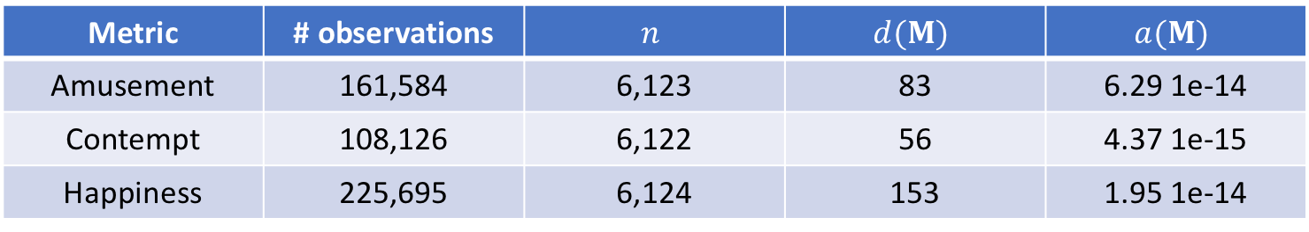

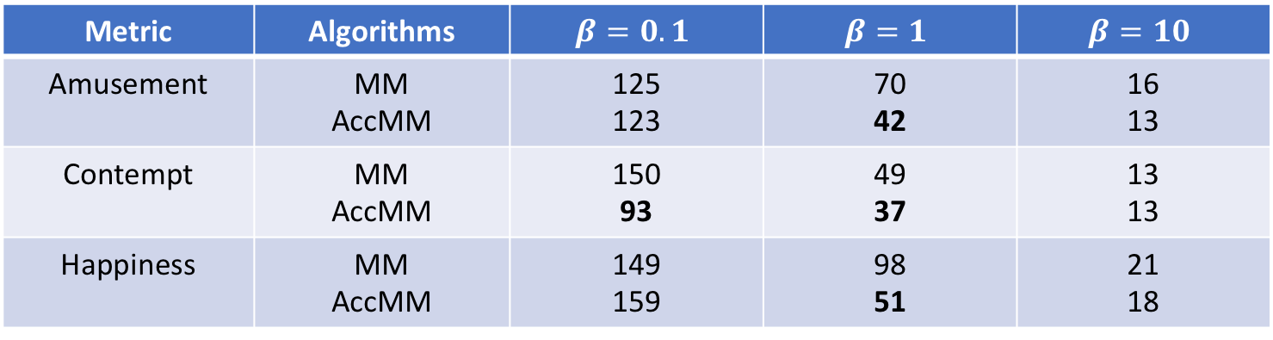
Convergence times: all items
Metric | # observations | $$n$$ | $$d(M)$$ | $$a(M)$$
Amusement | 161,584 | 6,123 | 83 | 6.29 1e-14
Contempt | 108,126 | 6,122 | 56 | 4.37 1e-15
Happiness | 225,695 | 6,124 | 153 | 1.95 1e-14
Metric | Algorithms | $$β=0.1$$ | $$β=1$$ | $$β=10$$
Amusement | MM AccMM | 125 123 | 70 42 | 16 13
Contempt | MM AccMM | 150 93 | 49 37 | 13 13
Happiness | MM AccMM | 149 159 | 98 51 | 21 18
Initial point $w^{(0)}$, $α−1=β$

Slide 42
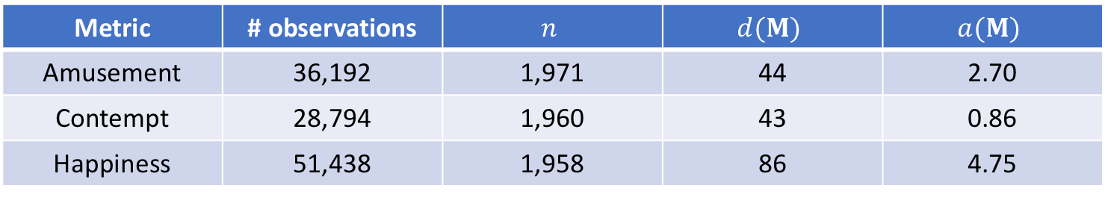
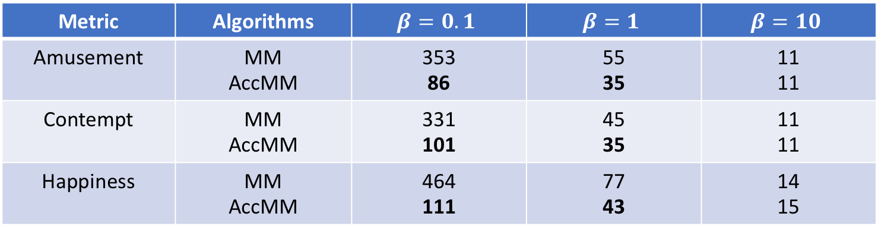
Convergence times: subsample of items
Metric | # observations | $$n$$ | $$d(M)$$ | $$a(M)$$
Amusement | 36,192 | 1,971 | 44 | 2.70
Contempt | 28,794 | 1,960 | 43 | 0.86
Happiness | 51,438 | 1,958 | 86 | 4.75
Metric | Algorithms | $$β=0.1$$ | $$β=1$$ | $$β=10$$
Amusement | MM AccMM | 353 86 | 55 35 | 11 11
Contempt | MM AccMM | 331 101 | 45 35 | 11 11
Happiness | MM AccMM | 464 111 | 77 43 | 14 15
A subsample of items chosen that form the largest connected component: ensures positive algebraic connectivity

Slide 43
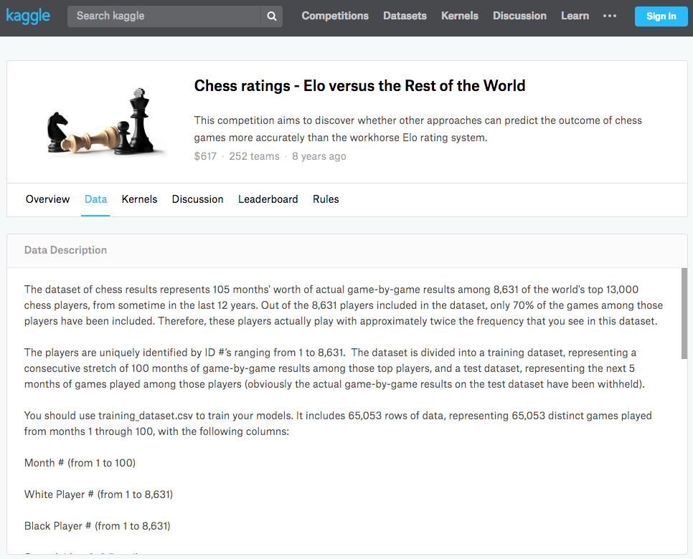

Slide 44
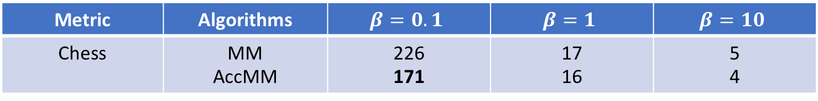
Convergence times: all items
Dataset | # observations | $$n$$ | $$d(M)$$ | $$a(M)$$
Chess | 7,809 | 8,629 | 3 | 0
Metric | Algorithms | $$β=0.1$$ | $$β=1$$ | $$β=10$$
Chess | MM AccMM | 226 171 | 17 16 | 5 4
Initial point $w^{(0)}$, $α−1=β$

Slide 45
Conclusion
Novel characterizations of the rate of convergence for generalized Bradley-Terry models
For MLE, the critical parameter is the algebraic connectivity of the observed matrix of pair co-occurrences
For MAP, the critical parameter is a parameter of the prior distribution, which can make convergence arbitrarily slow
Gradient descent and MM algorithms have the same (linear) convergence rate up to a constant factor
Novel accelerated iterative method: a transformation of iteration updates that resolves the slow convergence issue for MAP

Slide 46

Rao-Kupper model
The negative log-likelihood is $γ$-strongly convex on $W_{ω,0}=W_{ω}∩\left\{w∈R^{n}:1^{⊤}w=0\right\}$ and $μ$-smooth on $R^{n}$ with $γ=c_{a ω}λ_{2}(L_{M})$ and $μ=\frac{1}{2}d(M)$ where $c_{a,ω}=a/{\left(ae^{−ω}+e^{ω}\right)}^{2}$
Def. $a$ is the parameter of the Rao-Kupper model controls the probability of a tie

Slide 47

Luce choice model
The negative log-likelihood for the Luce choice model for comparison sets of cardinality $k≥2$ is $γ$-strongly convex on $W_{ω,0}=W_{ω}∩\left\{w∈R^{n}:1^{⊤}w=0\right\}$ and $μ$-smooth on $R^{n}$ with $γ=c_{ω,k}λ_{2}(L_{M})$ and $μ=d_{w,k}d(M)$ where
$c_{ω, k}=\left\{\begin{matrix}\frac{1}{{\left(e^{−ω}+e^{ω}\right)}^{2}}, & k=2 \\ \frac{1}{{\left(\left(k−2\right)e^{2ω}+2\right)}^{2}}, & k>2\end{matrix}\right.$ and $d_{ω, k}=\frac{1}{{\left(\left(k−2\right)e^{−2ω}+2\right)}^{2}}$

