Slide 1
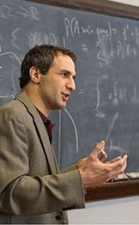
“Subjective Probabilities should be sharp”
Adam Elga

Slide 2
HEADS: This coin will land heads up if tossed.
1
0.5
0

Slide 3
FAKE COIN: There is a fake coin in Anna’s bag.
1
From 0.2 to 0.8
0

Slide 4
“Subjective Probabilities should be sharp”
Adam Elga

Slide 5
Bet A
If FAKE COIN, you lose £10. Otherwise, you win £15.
Bet B
If FAKE COIN, you win £15. Otherwise, you lose £10.
An agent who rejected both bets would be irrational
✓

Slide 6
Bet A
ACCEPT!
If FAKE COIN, you lose £10. Otherwise, you win £15.
1
Bet B
If FAKE COIN, you win £15. Otherwise, you lose £10.
Expected Utility of accepting bet A
(-10 X 0.2) + (15 X 0.8) = -2 + 12 = 10
Expected Utility of rejecting bet A
0
0.2
0

Slide 7
Bet A
If FAKE COIN, you lose £10. Otherwise, you win £15.
1
Reject A
Bet B
Accept B
If FAKE COIN, you win £15. Otherwise, you lose £10.
Accept A
Reject B
0

Slide 8
Bet A
If FAKE COIN, you lose £10. Otherwise, you win £15.
1
Reject A
Bet B
Accept B
If FAKE COIN, you win £15. Otherwise, you lose £10.
Accept A
Reject B
0

Slide 9
Bet A
ACCEPT!
or
REJECT!
If FAKE COIN, you lose £10. Otherwise, you win £15.
1
Reject A
Bet B
ACCEPT!
or
REJECT!
Accept B
If FAKE COIN, you win £15. Otherwise, you lose £10.
Q: How is rational action constrained?
Accept A
Reject B
✗
A: By the ‘permissive choice rules’
A: A rational agent will do the action that maximises expected utility
0

Slide 10
IMPRECISE: A rational agent can have imprecise credences
✗
Q: How is rational action constrained?
A: Rational choice is constrained just by ‘The Permissive choice Rules’
✗
You can rationally reject both bets

Slide 11
Bet A
ACCEPT!
or
REJECT!
If FAKE COIN, you lose £10. Otherwise, you win £15.
1
REJECT (but only if A was accepted)
Reject A
ACCEPT!
or
Bet B
Accept B
If FAKE COIN, you win £15. Otherwise, you lose £10.
Q: How is rational action constrained?
Accept A
Reject B
A: By the ‘sequence proposal’
0

Slide 12

Sally is offered A, and rejects it.
Sally is offered B
SHE IS RATIONALLY REQUIRED TO ACCEPT B

Slide 13
Bet A
ACCEPT!
or
REJECT!
If FAKE COIN, you lose £10. Otherwise, you win £15.
1
REJECT (but only if A was accepted)
Reject A
ACCEPT!
or
Bet B
Accept B
If FAKE COIN, you win £15. Otherwise, you lose £10.
Q: How is rational action constrained?
Accept A
Reject B
A: By the ‘sequence proposal’
0

Slide 14

Sally is offered A, and rejects it.
Sally is offered B
SHE IS RATIONALLY REQUIRED TO ACCEPT B
“In the two situations, when Sally is deciding whether to accept Bet B she faces choices that are exactly the same in every respect that she cares about. So it can’t be that rationality imposes different requirements on her in the two situations”
Elga, ‘Subjective Probabilities Should be Sharp’, p8

Sally is offered B
SHE IS NOT RATIONALLY REQUIRED TO ACCEPT B

Slide 15
Bet A
If FAKE COIN, you lose £10. Otherwise, you win £15.
1
Reject A and accept B
Reject A
Bet B
Accept B
If FAKE COIN, you win £15. Otherwise, you lose £10.
Accept both bets
Q: How is rational action constrained?
Accept A
Reject B
Accept A and reject B
A: By the ‘planning proposal’
0

Slide 16

Sally is told that she will be offered bets A and B, and makes a plan to reject A and accept B.
Sally is offered A, and rejects it.
Sally is offered B
SHE IS RATIONALLY REQUIRED TO ACCEPT B
“In the two situations, when Sally is deciding whether to accept Bet B she faces choices that are exactly the same in every respect that she cares about. So it can’t be that rationality imposes different requirements on her in the two situations”
Elga, ‘Subjective Probabilities Should be Sharp’, p8

Sally is offered B
SHE IS NOT RATIONALLY REQUIRED TO ACCEPT B

Slide 17
Bet A
If FAKE COIN, you lose £10. Otherwise, you win £15.
1
Bet B
If FAKE COIN, you win £15. Otherwise, you lose £10.
Q: How is rational action constrained?
A: There is no plausible answer to this question.
0

Slide 18


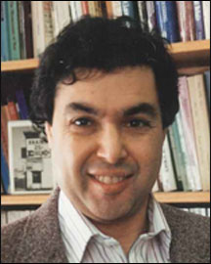

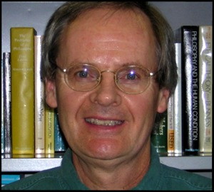

The Pile-in
Seamus Bradley
Katie Steele
Jake Chandler
Paul Weirich
Teddy Seidenfeld
Nils-Eric Sahlin

Slide 19
There are some ‘rules of rational action’ that Elga has not considered:
Maximin
Maximax
Hurwicz’ criterion
Ellsberg’s rule
We need to think about the problem like a game-theorist.
Together these points give us a response to Elga’s challenge.

Slide 20
Bet A
REJECT!
If FAKE COIN, you lose £10. Otherwise, you gain £15.
1
MINIMUM Expected Utility of accepting bet A
(-10 x 0.8) + (15 x 0.2) + = -8+3 = -5
MINIMUM Expected Utility of rejecting bet A
0
0

Slide 21
Bet B
REJECT!
If FAKE COIN, you gain £15. Otherwise, you lose £10.
1
MINIMUM Expected Utility of accepting bet B
(15x 0.2) + (-10 x 0.8) + = 3-8 = -5
MINIMUM Expected Utility of rejecting bet B
0
0

Slide 22
Accept bet B
Accept bet A
Reject bet B
Reject bet A
Accept bet B
Reject bet B

Slide 23
Bet B
REJECT!
If FAKE COIN, you gain £15. Otherwise, you lose £10.
1
MINIMUM Expected Utility of accepting bet B
(15x 0.2) + (-10 x 0.8) + = 3-8 = -5
MINIMUM Expected Utility of rejecting bet B
0
0

Slide 24
Accept bet B
Accept bet A
Reject bet B
Reject bet A
-5
Accept bet B
Reject bet B
0

Slide 25
Bet A
If FAKE COIN, you lose £10. Otherwise, you win £15.
1
Bet B
ACCEPT!
If FAKE COIN, you gain £15. Otherwise, you lose £10.
MINIMUM Expected Utility of accepting bet B once bet A has already been accepted
5
MINIMUM Expected Utility of rejecting bet B once bet A has already been accepted
0
(-10 x 0.8) + (15 x 0.2) = -8 + 3 = -5.

Slide 26
5
Accept bet B
Accept bet A
Reject bet B
-5
Reject bet A
-5
Accept bet B
Reject bet B
0

Slide 27
There are some ‘rules of rational action’ that Elga has not considered:
Maximin
Maximax
Hurwicz’ criterion
Ellsberg’s rule
We need to think about the problem like a game-theorist.
Together these points give us a response to Elga’s challenge.
A rational agent will accept both bets.

Slide 28
Commitments
There is a rule of rationality which (together with the fact about your probability range) determines how you will bet.
2. You can predict your own betting behaviour.
(2 follows from 1 if we make the assumption that you know what rule you are following, and what your probability range is. )

Slide 29
5
Accept bet B
Accept bet A
Reject bet B
-5
Reject bet A
-5
Accept bet B
Reject bet B
0

Slide 30
My Central Claim
In cases where we think subjective probabilities are imprecise, betting behaviour is typically unstable.

Slide 31
Will you take this bet?
1
Bet A
If FAKE COIN, you lose £10. Otherwise, you win £15.
“yes”
“no”
0
@
“yes”
Close possible worlds where you have the same relevant evidence as in the actual world

Slide 32
My central claim
In cases where we think your credences are imprecise, betting behaviour is typically unstable.
By this I mean that your betting behaviour will vary across close possible worlds where you have the same relevant evidence.
Even rational agents (at least, agents that are rational in an everyday-sense) display this sort of unstable betting behaviour.

Slide 33
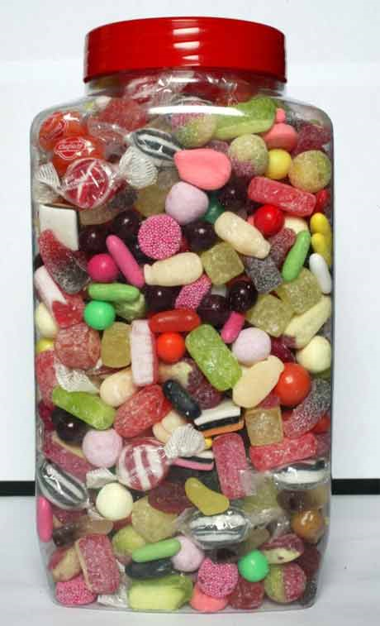
Are there over 500 sweets in this jar?
“yes”
“no”
@
“yes”

Slide 34
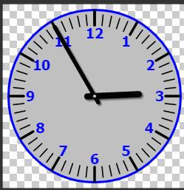
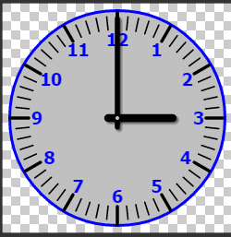
Are there over 500 sweets in this jar?
“no”
“yes”

Slide 35
Will you take this bet?
Bet A
If FAKE COIN, you lose £10. Otherwise, you win £15.
“yes”
“no”
@
“yes”
Close possible worlds where you have the same relevant evidence as in the actual world

Slide 36
Will you take this bet?
1
Bet A
If FAKE COIN, you lose £10. Otherwise, you win £15.
“no”
“yes”
0

Slide 37
Bet A
If FAKE COIN, you lose £10. Otherwise, you win £15.
1
Bet B
If FAKE COIN, you win £15. Otherwise, you lose £10.
0
Question: What are your intuitions here? If I don’t know that I will be offered both bets, would it be irrational to reject them both?

Slide 38
My central claim
In cases where we think your probabilities are imprecise, betting behaviour is typically unstable.
Even rational agents (at least, agents that are rational in an everyday-sense) display this sort of unstable betting behaviour.
Where betting behaviour is unstable, it is also unpredictable. You would not be able to predict your own betting behaviour.

Slide 39
The Pile-in
Seamus Bradley
Katie Steele
Jake Chandler
Paul Weirich
Teddy Seidenfeld
Nils-Eric Sahlin

Slide 40
5
Accept bet B
Accept bet A
Reject bet B
-5
Reject bet A
-5
Accept bet B
Reject bet B
0

Slide 41

There are cases where intuitively our subjective probabilities are not sharp.
The Dialectic (so far)
Sorry but they have to be! Otherwise you are irrational. See my argument.
Your argument is naive! See our sophisticated choice rules and game theory.
But your sophisticated choice rules misrepresent the phenomenon we began with.

Slide 42
Is Elga right then? Should subjective probabilities be sharp?
No – because saying that they are sharp would not solve the problem.

Slide 43
Spelling out the claim that subjective probabilities should be sharp
If an agent has sharp probabilties, (s)he has stable betting behaviour
An agent can have sharp probabilities, but still have unstable betting behaviour
OR
Rational agents always have stable betting behaviour
Mass irrationality

Slide 44
Bet A
If FAKE COIN, you lose £10. Otherwise, you win £15.
Bet B
If FAKE COIN, you win £15. Otherwise, you lose £10.
An agent who rejected both bets would be irrational
✓

Slide 45
Spelling out the claim that subjective probabilities should be sharp
If an agent has sharp probabilties, (s)he has stable betting behaviour
An agent can have sharp probabilities, but still have unstable betting behaviour
OR
Rational agents always have stable betting behaviour
Mass irrationality

Slide 46
The fact stating your precise probability in a claim
The fact stating your precise height in cm
supervenes on
supervenes on
Messy facts about your dispositions etc
Messy physical facts about you.

Slide 47
Spelling out the claim that subjective probabilities should be sharp
If an agent has sharp probabilties, (s)he has stable betting behaviour
An agent can have sharp probabilities, but still have unstable betting behaviour
OR
Rational agents always have stable betting behaviour
Mass irrationality

Slide 48
Bet A
If FAKE COIN, you lose £10. Otherwise, you win £15.
1
Bet B
If FAKE COIN, you win £15. Otherwise, you lose £10.
0

Slide 49
Spelling out the claim that subjective probabilities should be sharp
If an agent has sharp probabilties, (s)he has stable betting behaviour
An agent can have sharp probabilities, but still have unstable betting behaviour
OR
Rational agents always have stable betting behaviour
But then saying that probabilities should be sharp does not entail that a rational agent will not reject both bets!
Mass irrationality

Slide 50
 |  |  | Intuitively this is
You know you will be offered bet A and then bet B. | You reject A | You reject B | Irrational
You don’t know what bets you will be offered. | You accept A, and you reject B | You reject A, and you accept B. | Rational
The planning proposal is the solution that respects both of these intuitions.

