Slide 1

On a Portfolio Selection Problem using Individual Test Scores
Milan Vojnovic
Department of Statistics
Joint work with Shreyas Sekar and Se-Young Yun
LSE Risk & Stochastics Conference, April 20-21, 2017

Slide 2


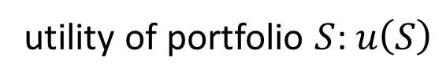







Single-portfolio utility maximisation
utility of portfolio $S$: $u\left(S\right)$
$$⋯$$
$$⋯$$
$$2$$
$$S$$
$$n$$
$$1$$
$$n$$
$$1$$
$$N$$
selected
options
Problem: find $S^{∗}$ of size $k$ that maximises $u(S)$ over $S⊆N:\left|S\right|=k$

Slide 3
Examples of portfolio options
Online workers in online labor platforms (e.g. TopCoder, Upwork)
Online gaming (e.g. TrueSkill)
Financial investments
Digital ads
…

Slide 4


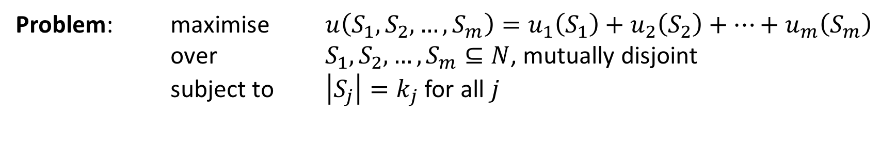






Multi-portfolio utility maximisation
$$1$$
$$2$$
$$m$$
$$⋯$$
$$⋯$$
$$1$$
$$2$$
$$n$$
Problem: maximise $u\left(S_{1},S_{2},…,S_{m}\right)=u_{1}\left(S_{1}\right)+u_{2}\left(S_{2}\right)+⋯+u_{m}\left(S_{m}\right)$ over $S_{1},S_{2},…, S_{m}⊆N$, mutually disjoint
subject to $\left|S_{j}\right|=k_{j}$ for all $j$

Slide 5





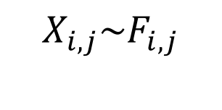


Stochastic reward system
$$j$$
Utility of portfolio $S_{j}$:
$$u_{j}\left(S_{j}\right)=E[g_{j}({(X}_{i,j}:i∈S_{j}))]$$
$$X_{i,j}\sim F_{i,j}$$
individual option performance
independent across options
(given distribution)
reward function
(given)
(see examples later)
$$⋯$$
$$⋯$$
$$⋯$$
$$i$$
$$S_{j}$$
Remark: we drop the portfolio index in the case of single portfolio (e.g. writing $X_{i}$ for individual performance)

Slide 6

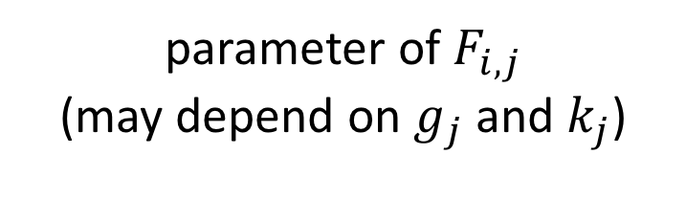

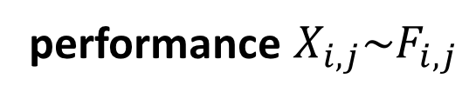
Test scores
parameter of $F_{i,j}$
(may depend on $g_{j}$and $k_{j}$)
test score
$$a_{i,j}^{k}$$
Ex 1 mean test score:
$a_{i,j}^{k}=E[X_{i,j}]$
Ex 2 quantile test score:
$a_{i,j}^{k}=E[X_{i,j}|F_{i,j}\left(X_{i,j}\right)≥θ_{k_{j}}]$
performance $X_{i,j}\sim F_{i,j}$
Test score algorithms: restricted to value
oracle calls (approximately) answered
by using test scores

Slide 7
A key question
Can test scores guarantee a constant-factor approximation of the optimum utility for “interesting classes” of reward functions?

Slide 8
Related work
Kleinberg, J. and Raghu, M., Team Performance with Test Scores, Proc. of ACM EC 2015:
First formulation of the problem for single portfolio
First constant-factor approximations by using test scores, for top-m reward function (defined shortly)
Negative results (e.g. for coverage set functions)
Hong L. and Page S. E., Groups of diverse problem solvers can outperform groups of high-ability problem solvers, PNAS, 101, 46, 2004
Page, S. E., The Difference: How the Power of Diversity Creates Better Groups, Firms, Schools, and Societies, Princeton University Press, 2008

Slide 9
Our work
Single portfolio: constant-factor approximations for a class of reward functions
Special test scores, so called replication test scores, guarantee a constant-factor approximation whenever this can be achieved by test scores
Results for more general multi-portfolio utility maximisation
Relations with sketching of set functions

Slide 10
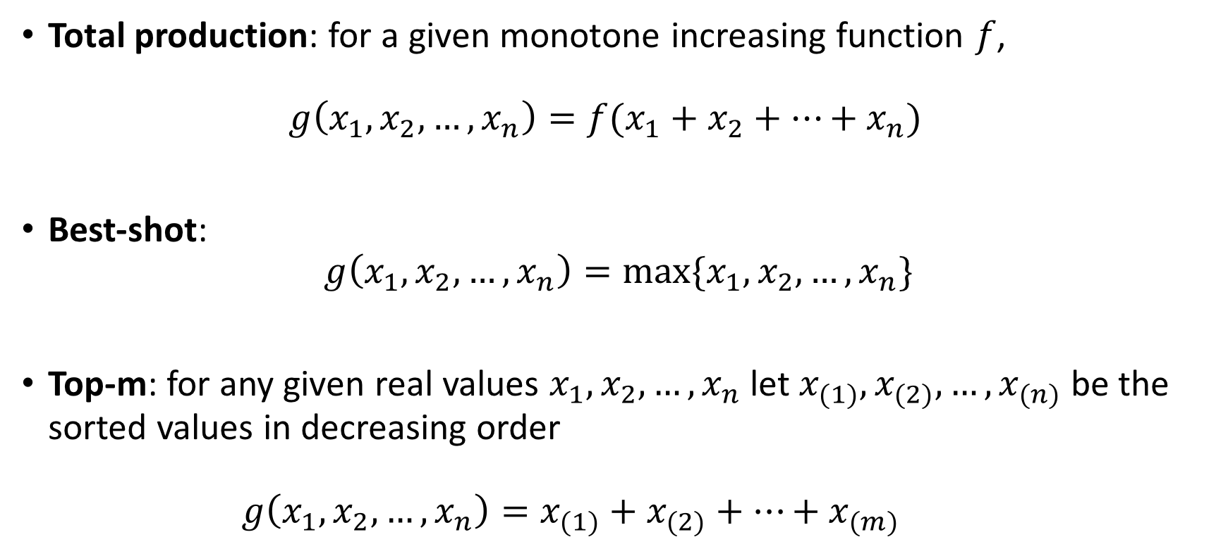
Classes of reward functions
Total production: for a given monotone increasing function $f$, $g\left(x_{1},x_{2},…, x_{n}\right)=f(x_{1}+x_{2}+…+x_{n})$
Best-shot: $g\left(x_{1},x_{2},…,x_{n}\right)=max⁡\{x_{1},x_{2},…,x_{n}\}$
Top-m: for any given real values $x_{1},x_{2},…,x_{n}$ let $x_{(1)},x_{(2)},…,x_{(n)}$ be the sorted values in decreasing order $g\left(x_{1},x_{2},…, x_{n}\right)=x_{(1)}+x_{(2)}+…+x_{(m)}$

Slide 11
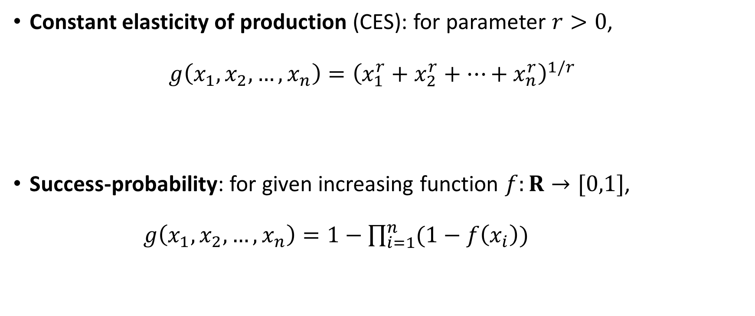
Classes of reward functions (cont’d)
Constant elasticity of production (CES): for parameter $r>0$, $g\left(x_{1},x_{2},…, x_{n}\right)={\left(x_{1}^{r}+x_{2}^{r}+…+x_{n}^{r}\right)}^{1/r}$
Success-probability: for given increasing function $f:R→[0,1]$, $g\left(x_{1},x_{2},…, x_{n}\right)=1−\prod_{i=1}^{n}{(1−f\left(x_{i}\right))}$

Slide 12
Some preliminary observations about mean and quantile test scores

Slide 13

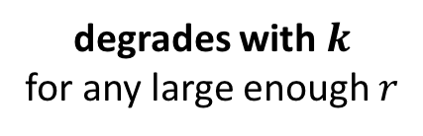
Mean test scores
Theorem: Suppose that $u$ is according to CES with parameter $r≥1$.
Let $M$ be a set of $k$ options with highest mean test scores. Then $u\left(M\right)≥\frac{1}{k^{1−\frac{1}{r}}}u(OPT)$. This bound is tight.
degrades with $k$
for any large enough $r$

Slide 14

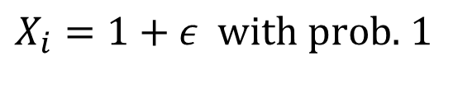

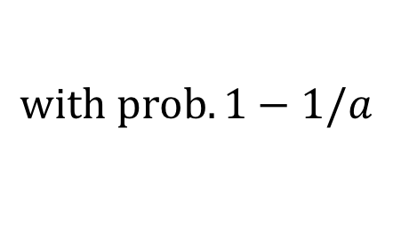

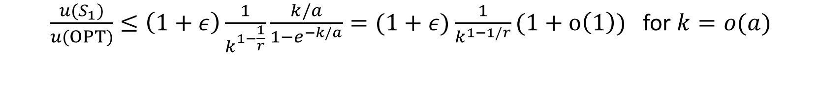
Tight example
Type 1 options:
$$u(S_{1})=k^{1/r}(1+ε)$$
$X_{i}=1+ε$ $with prob.$ $1$
Type 2 options:
$u\left(S_{2}\right)≥aP\left[\sum_{i∈S_{2}}{X_{i}}>0\right]≥a(1−e^{−k/a})$
$$X_{i}=\left\{\begin{matrix}0 \\ a\end{matrix}\right.$$
$$with prob. 1−1/a$$
$$with prob. 1/a$$
$\frac{u(S_{1})}{u(OPT)}≤\left(1+ε\right)\frac{1}{k^{1−\frac{1}{r}}}\frac{k/a}{1−e^{−k/a}}=(1+ε)\frac{1}{k^{1−1/r}}(1+o\left(1\right))$ for $k=o(a)$

Slide 15
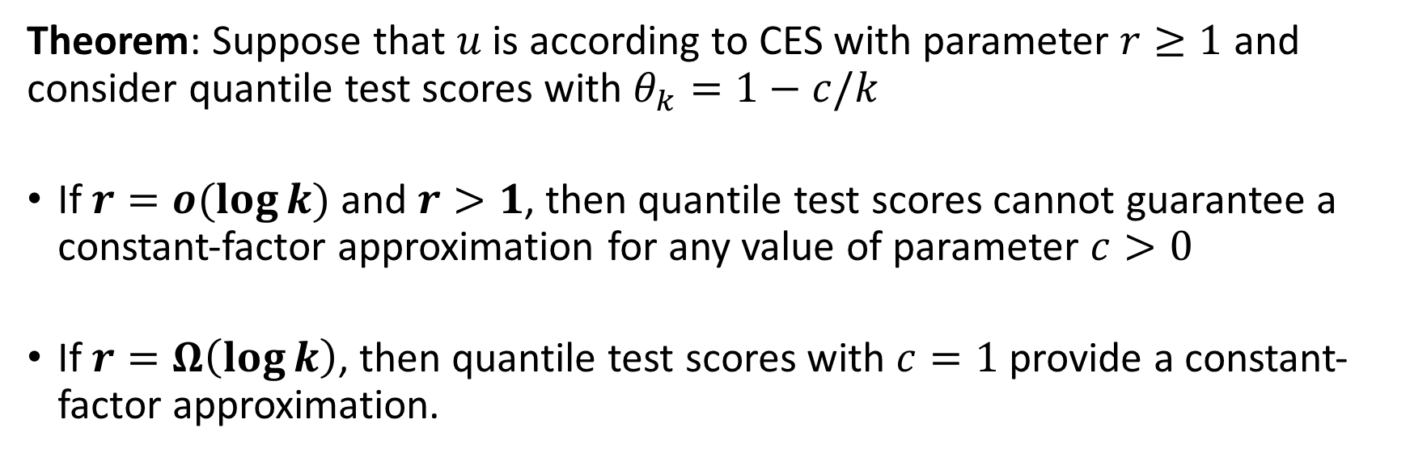



Quantile test scores
Theorem: Suppose that $u$ is according to CES with parameter $r≥1$ and consider quantile test scores with $θ_{k}=1−c/k$
If $r=o(\log{k)}$ and $r>1$, then quantile test scores cannot guarantee a constant-factor approximation for any value of parameter $c>0$
If $r=Ω\left(\log{k}\right)$, then quantile test scores with $c=1$ provide a constant-factor approximation.
Sharp threshold:
$$r$$
$$1$$
$$r^{∗}=Θ(\log{k})$$

Slide 16
Single-portfolio utility maximisation

Slide 17
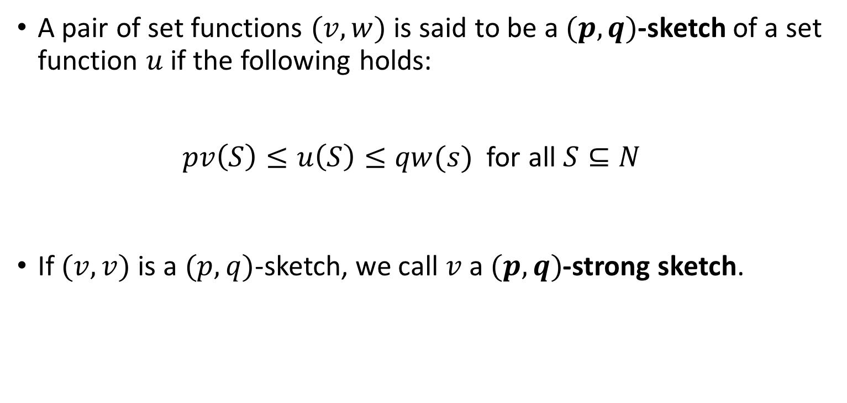
Sketch of a set function
A pair of set functions $(v,w)$ is said to be a $(p,q)$-sketch of a set function $u$ if the following holds: $pv\left(S\right)≤u\left(S\right)≤qw(s)$ for all $S⊆N$
If $(v,v)$ is a $(p,q)$-sketch, we call $v$ a $(p,q)$-strong sketch.

Slide 18
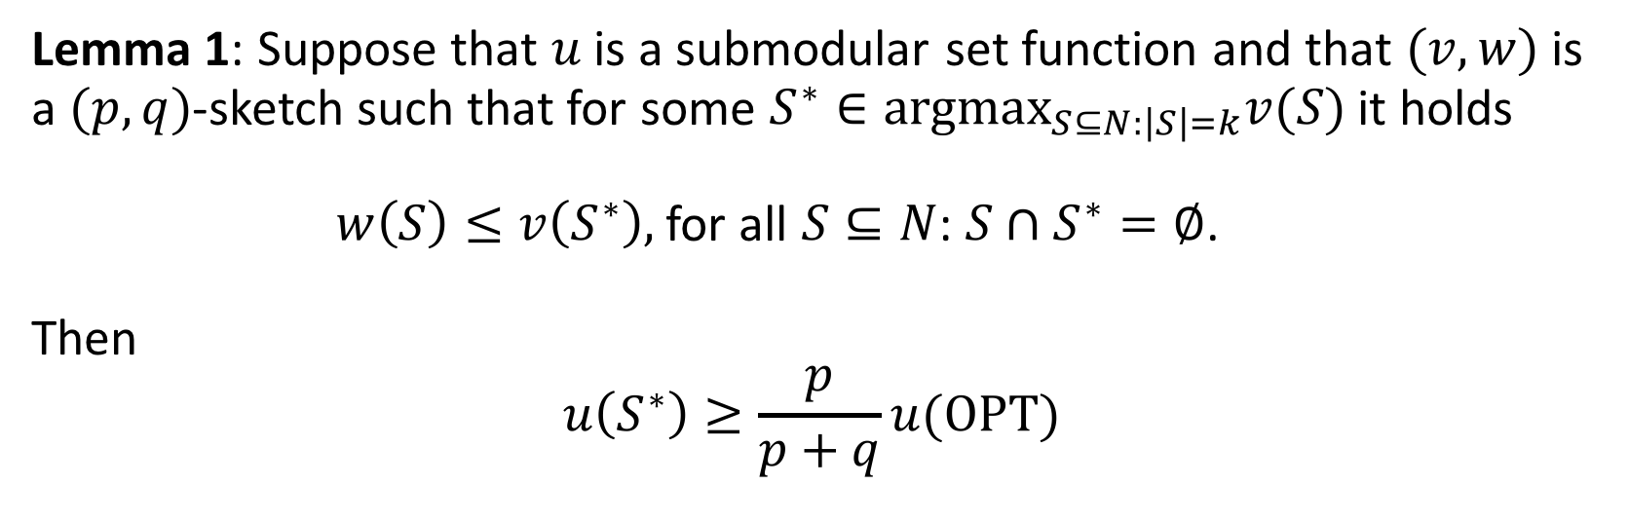
Sketching and submodular utility
Lemma 1: Suppose that $u$ is a submodular set function and that $(v,w)$ is a $(p,q)$-sketch such that for some $S^{∗}∈argmax_{S⊆N:\left|S\right|=k}v(S)$ it holds $w\left(S\right)≤v\left(S^{∗}\right),$for all $S⊆N$: $S∩S^{∗}=∅$. Then $$u\left(S^{∗}\right)≥\frac{p}{p+q}u(OPT)$$

Slide 19
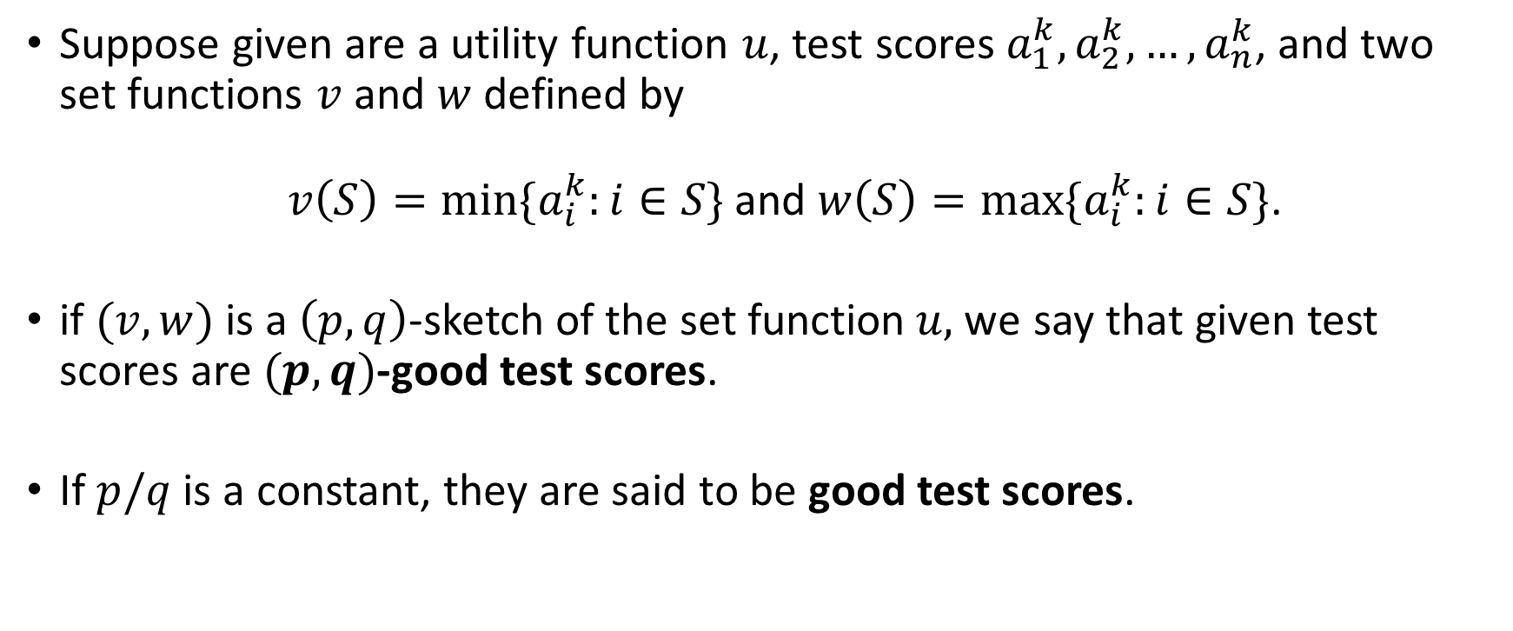
Good test scores
Suppose given are a utility function $u$, test scores$a_{1}^{k}, a_{2}^{k},…, a_{n}^{k}$, and two set functions $v$ and $w$ defined by $v\left(S\right)=\min{\{a_{i}^{k}:i∈S\}}$ and $w\left(S\right)=\max{\{a_{i}^{k}:i∈S\}}$.
if $(v,w)$ is a $\left(p,q\right)$-sketch of the set function$u,$we say that given test scores are $(p,q)$-good test scores.
If $p/q$ is a constant, they are said to be good test scores.

Slide 20
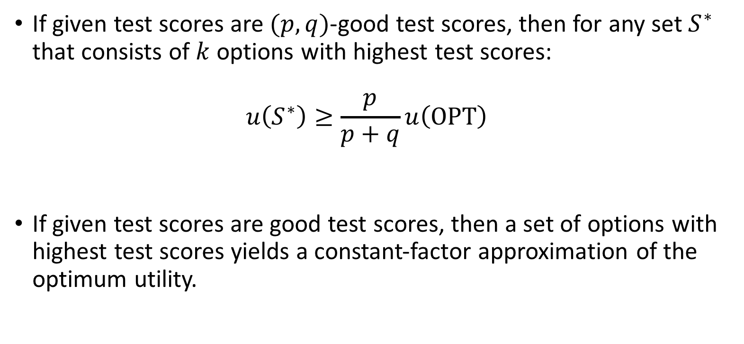
Good test scores (cont’d)
If given test scores are$(p,q)$-good test scores, then for any set $S^{∗}$ that consists of $k$ options with highest test scores: $u\left(S^{∗}\right)≥\frac{p}{p+q}u\left(OPT\right)$
If given test scores are good test scores, then a set of options with highest test scores yields a constant-factor approximation of the optimum utility.
Lemma 1

Slide 21
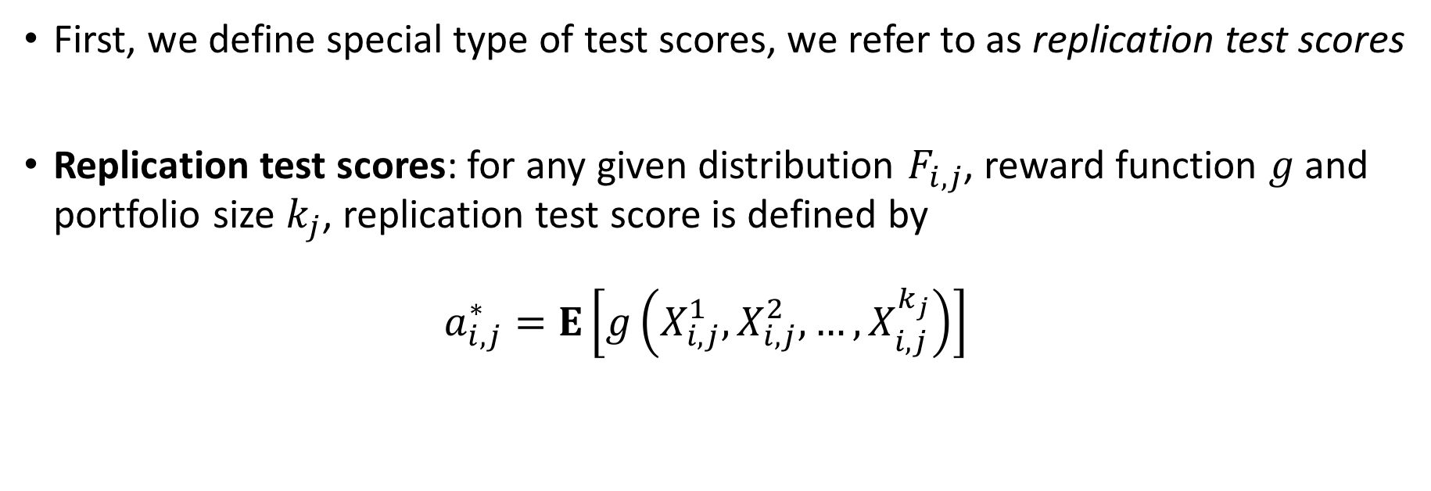
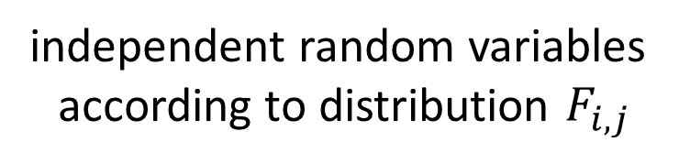
When do good test scores exist?
First, we define special type of test scores, we refer to as replication test scores
Replication test scores: for any given distribution $F_{i,j}$, reward function $g$ and portfolio size $k_{j}$, replication test score is defined by $a_{i,j}^{∗}=E\left[g\left(X_{i,j}^{1},X_{i,j}^{2},…,X_{i,j}^{k_{j}}\right)\right]$
independent random variables
according to distribution $F_{i,j}$

Slide 22
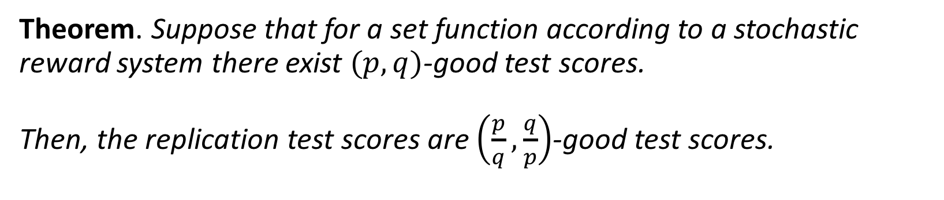
When do good test scores exist? (cont’d)
Theorem. Suppose that for a set function according to a stochastic reward system there exist $(p,q)$-good test scores. Then, the replication test scores are $\left(\frac{p}{q},\frac{q}{p}\right)$-good test scores.
In order to check whether good test scores exist, it suffices to check whether replication test scores are good test scores.

Slide 23
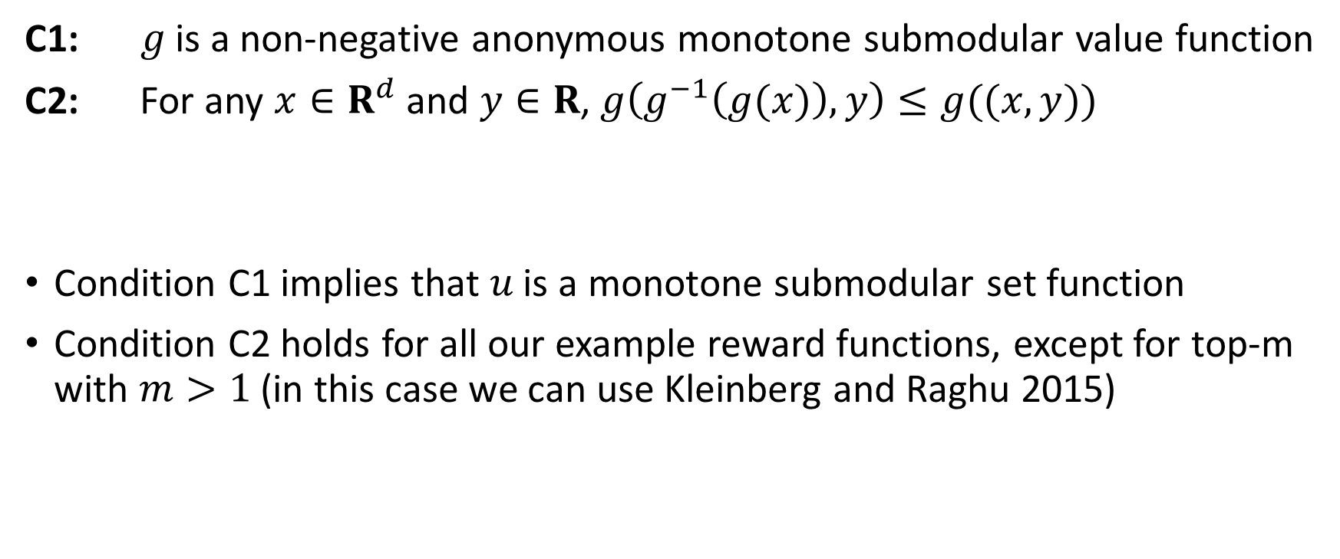
Existence of good replication test scores
C1: $g$ is a non-negative anonymous monotone submodular value function
C2: For any $x∈R^{d}$ and $y∈R$, $g\left(g^{−1}\left(g(x)\right),y\right)≤g((x,y))$
Condition C1 implies that $u$ is a monotone submodular set function
Condition C2 holds for all our example reward functions, except for top-m with $m>1$ (in this case we can use Kleinberg and Raghu 2015)
* $g^{−1}$ is the inverse of the production function for a team of size $1$

Slide 24
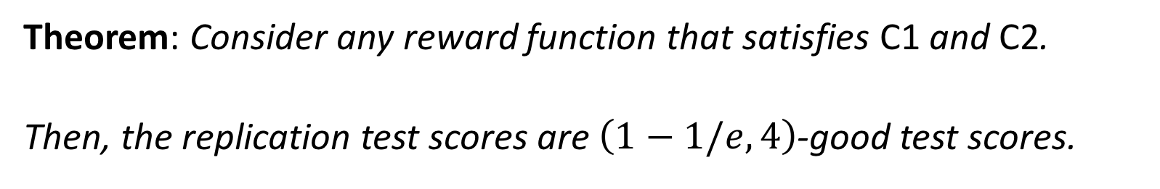
Existence of good replication test scores (cont’d)
Theorem: Consider any reward function that satisfies C1 and C2.
Then, the replication test scores are $\left(1−1/e,4\right)$-good test scores.
constant-factor approximation for submodular maximisation problem

Slide 25
Multi-portfolio utility maximisation

Slide 26

Sketching and submodular utility
Lemma 2: Consider a utility maximisation problem with utility functions $u_{1},u_{2},…, u_{m}$ and cardinality parameters $k_{1},k_{2},…, k_{m}$. Suppose that
each $u_{j}$ has a set function $v_{j}$ that is a $(p,q)$-strong sketch, and
$S_{1},S_{2},…, S_{m}$ is an $α$-approximation for the same optimisation problem, but with utility functions $v_{1},v_{2},…, v_{m}$.
Then $$u_{1}\left(S_{1}\right)+u_{2}\left(S_{2}\right)+…+u_{m}\left(S_{m}\right)≥α\frac{p}{q}u(OPT)$$

Slide 27
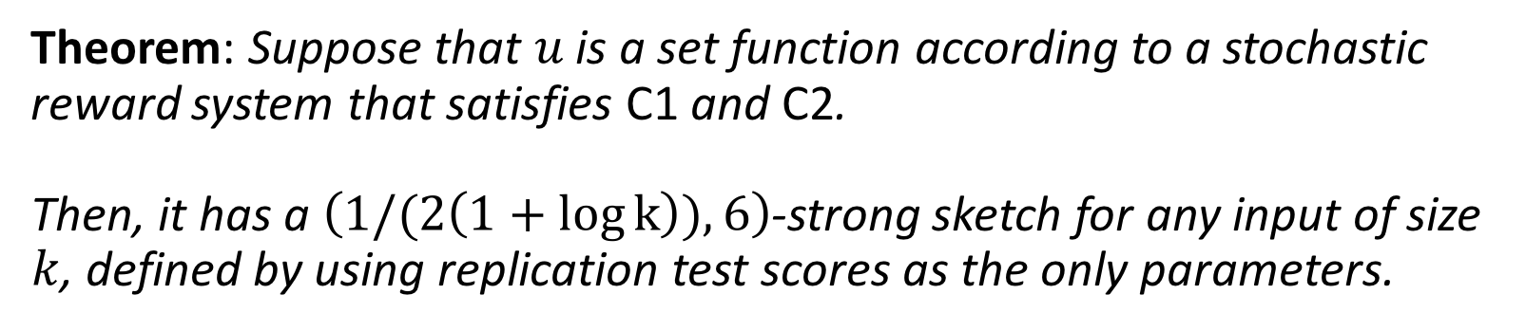
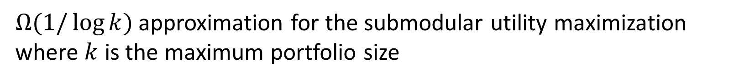
Strong sketch using replication test scores
Theorem: Suppose that $u$ is a set function according to a stochastic reward system that satisfies C1 and C2. Then, it has a $\left(1/(2\left(1+\log{k}\right)),6\right)$-strong sketch for any input of size $k$, defined by using replication test scores as the only parameters.
$Ω(1/\log{k})$ approximation for the submodular utility maximization where $k$ is the maximum portfolio size
+ Lemma 2
+ a ½ approximation

Slide 28
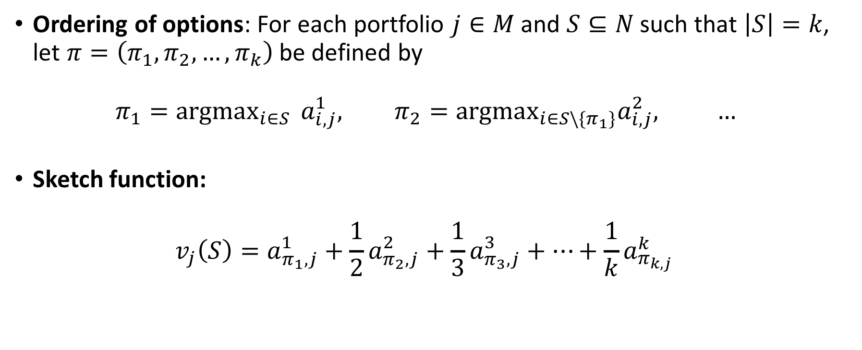
Our strong sketch
Ordering of options: For each portfolio $j∈M$ and $S⊆N$ such that $\left|S\right|=k$, let $π=\left(π_{1},π_{2},…,π_{k}\right)$ be defined by $π_{1}=argmax_{i∈S } a_{i,j}^{1}, π_{2}=argmax_{i∈S\backslash \{π_{1}\}}a_{i,j}^{2}, …$
Sketch function: $v_{j}\left(S\right)=a_{π_{1},j}^{1}+\frac{1}{2}a_{π_{2},j}^{2}+\frac{1}{3}a_{π_{3},j}^{3}+…+\frac{1}{k}a_{π_{k,j }}^{k}$

Slide 29
Greedy algorithm
Ç√

Slide 30
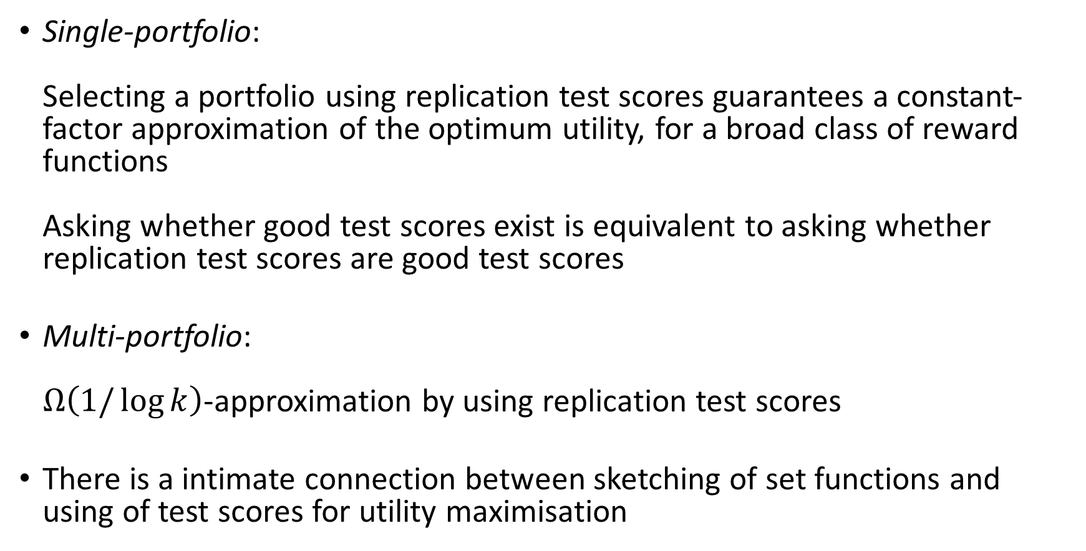
Conclusion
Single-portfolio: Selecting a portfolio using replication test scores guarantees a constant-factor approximation of the optimum utility, for a broad class of reward functions Asking whether good test scores exist is equivalent to asking whether replication test scores are good test scores
Multi-portfolio: $Ω\left(1/\log{k}\right)$-approximation by using replication test scores
There is a intimate connection between sketching of set functions and using of test scores for utility maximisation

Slide 31
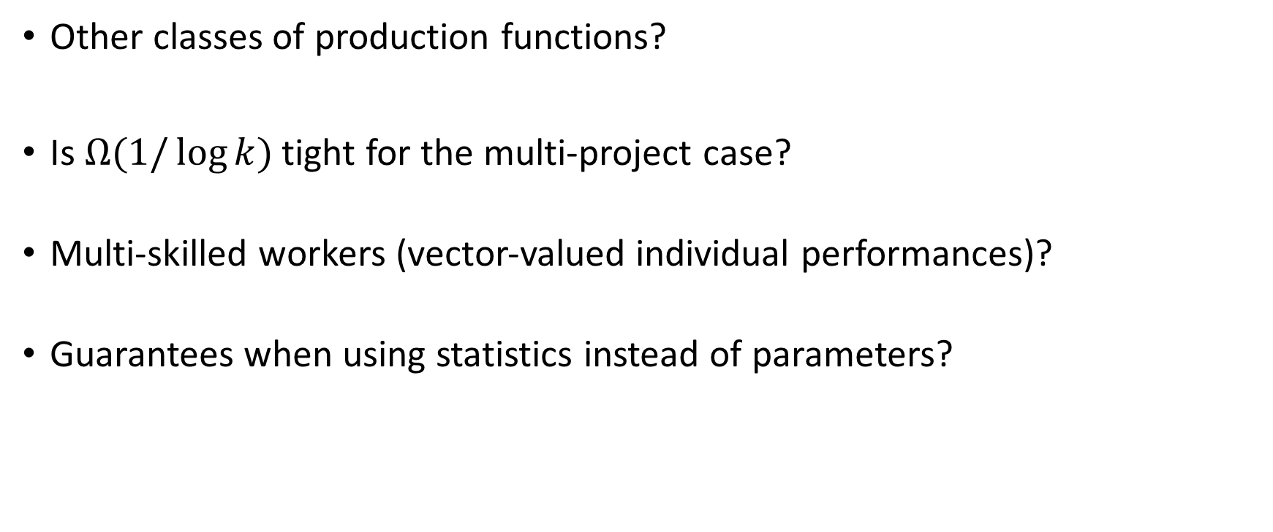
Future work
Other classes of production functions?
Is $Ω(1/\log{k)}$ tight for the multi-project case?
Multi-skilled workers (vector-valued individual performances)?
Guarantees when using statistics instead of parameters?

Slide 32
To probe further
Working paper:
Sekar, S., Vojnovic, M. and Yun, S., Sketching with Test Scores and Submodular Maximization, https://arxiv.org/abs/1605.07172, May 2016

