Slide 1

How to hire a team using individual test scores?
Milan Vojnovic
Department of Statistics
Joint work with Shreyas Sekar and Se-Young Yun
LSE Math Seminar on Combinatorics, Games and Optimisation, LSE, London, UK, January 12th, 2017

Slide 2


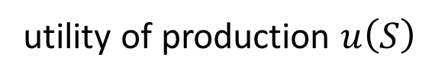







Single-project utility maximisation
project
utility of production $u\left(S\right)$
$$⋯$$
$$⋯$$
$$2$$
$$S$$
$$n$$
$$1$$
$$n$$
$$1$$
$$N$$
hired
candidates
Problem: find $S^{∗}$ of size $k$ that maximises $u(S)$ over $S⊆N:\left|S\right|=k$

Slide 3


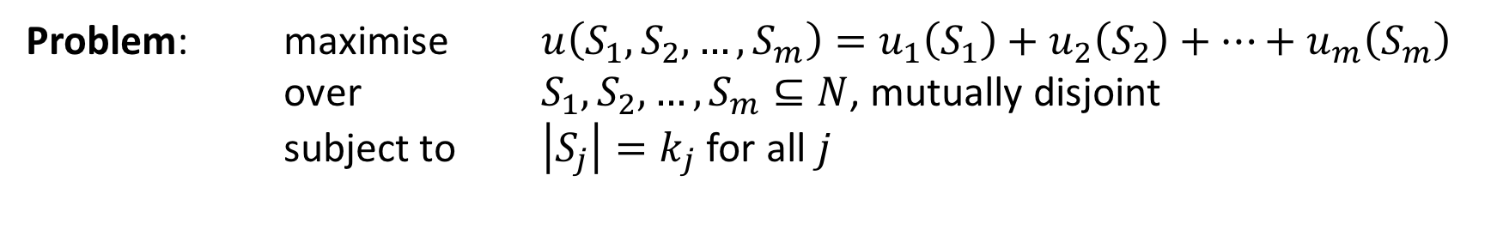






Multi-project utility maximisation
$$1$$
$$2$$
$$m$$
$$⋯$$
$$⋯$$
$$1$$
$$2$$
$$n$$
Problem: maximise $u\left(S_{1},S_{2},…,S_{m}\right)=u_{1}\left(S_{1}\right)+u_{2}\left(S_{2}\right)+⋯+u_{m}\left(S_{m}\right)$
over $S_{1},S_{2},…, S_{m}⊆N$, mutually disjoint
subject to $\left|S_{j}\right|=k_{j}$ for all $j$

Slide 4



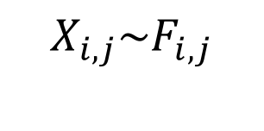



Stochastic productivity system
$$j$$
Utility of production:
$$u_{j}\left(S_{j}\right)=E[g_{j}({(X}_{i,j}:i∈S_{j}))]$$
$$X_{i,j}\sim F_{i,j}$$
individual performance
independent across individuals
(given distribution)
production function
(given)
(see examples later)
$$⋯$$
$$⋯$$
$$⋯$$
$$i$$
$$S_{j}$$
Remark: we drop the project index in the case of single project (e.g. writing $X_{i}$ for individual performance)

Slide 5

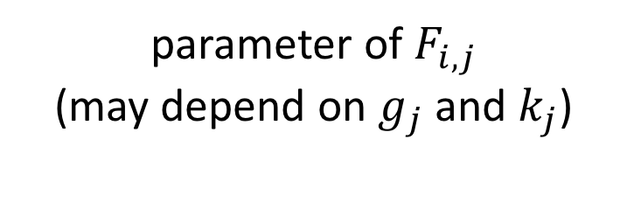

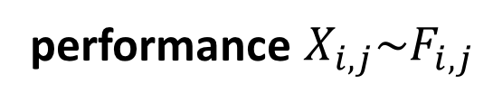
Test scores
parameter of $F_{i,j}$
(may depend on $g_{j}$and $k_{j}$)
test score
$$a_{i,j}^{k}$$
Ex 1 mean test score:
$a_{i,j}^{k}=E[X_{i,j}]$
Ex 2 quantile test score:
$a_{i,j}^{k}=E[X_{i,j}|F_{i,j}\left(X_{i,j}\right)≥θ_{k_{j}}]$
performance $X_{i,j}\sim F_{i,j}$
Test score algorithms: restricted to value
oracle calls computed by using test scores

Slide 6
A key question
Can test scores guarantee a constant-factor approximation of the optimum utility of production, for “interesting classes” of production functions?

Slide 7
Motivating applications
Hiring workers in online labour platforms (e.g. TopCoder, Upwork, …)
Online gaming (e.g. TrueSkill)
…

Slide 8
Related work
Kleinberg, J. and Raghu, M., Team Performance with Test Scores, Proc. of ACM EC 2015:
First formulation of the problem for single project, as described earlier
First constant-factor approximations by using test scores, for top-m production function (see later)
Negative results (e.g. for coverage set functions)
Hong L. and Page S. E., Groups of diverse problem solvers can outperform groups of high-ability problem solvers, PNAS, 101, 46, 2004
Page, S. E., The Difference: How the Power of Diversity Creates Better Groups, Firms, Schools, and Societies, Princeton University Press, 2008

Slide 9
Our work
Single project: constant-factor approximations for a class of production functions
Special types of test scores, so called replication test scores, showed to guarantee a constant-factor approximation whenever this is possible to achieve by test scores
Results for more general multi-project utility maximisation
Relations with sketching of set functions

Slide 10
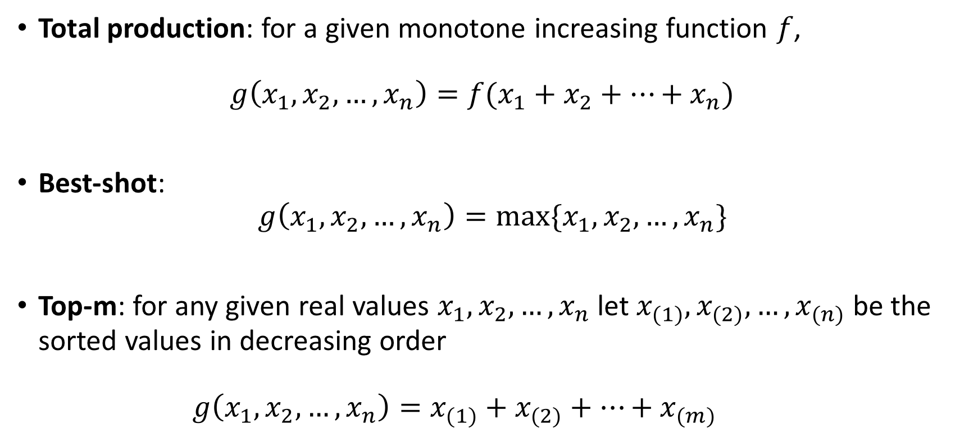
Classes of production functions
Total production: for a given monotone increasing function $f$,
$g\left(x_{1},x_{2},…, x_{n}\right)=f(x_{1}+x_{2}+…+x_{n})$
Best-shot:
$g\left(x_{1},x_{2},…,x_{n}\right)=max⁡\{x_{1},x_{2},…,x_{n}\}$
Top-m: for any given real values $x_{1},x_{2},…,x_{n}$ let $x_{(1)},x_{(2)},…,x_{(n)}$ be the sorted values in decreasing order
$g\left(x_{1},x_{2},…, x_{n}\right)=x_{(1)}+x_{(2)}+…+x_{(m)}$

Slide 11
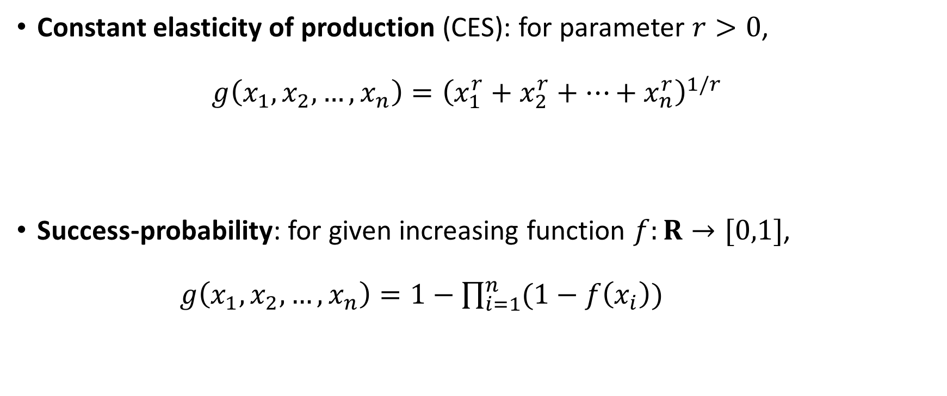
Classes of production functions (cont’d)
Constant elasticity of production (CES): for parameter $r>0$,
$g\left(x_{1},x_{2},…, x_{n}\right)={\left(x_{1}^{r}+x_{2}^{r}+…+x_{n}^{r}\right)}^{1/r}$
Success-probability: for given increasing function $f:R→[0,1]$,
$g\left(x_{1},x_{2},…, x_{n}\right)=1−\prod_{i=1}^{n}{(1−f\left(x_{i}\right))}$

Slide 12
Some preliminary observations about mean and quantile test scores

Slide 13

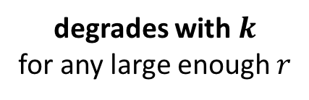
Mean test scores
Theorem: Suppose that $u$ is according to CES with parameter $r≥1$.
Let $M$ be a set of $k$ individuals with highest mean test scores.
Then
$u\left(M\right)≥\frac{1}{k^{1−\frac{1}{r}}}u(OPT)$.
This bound is tight.
degrades with $k$
for any large enough $r$

Slide 14
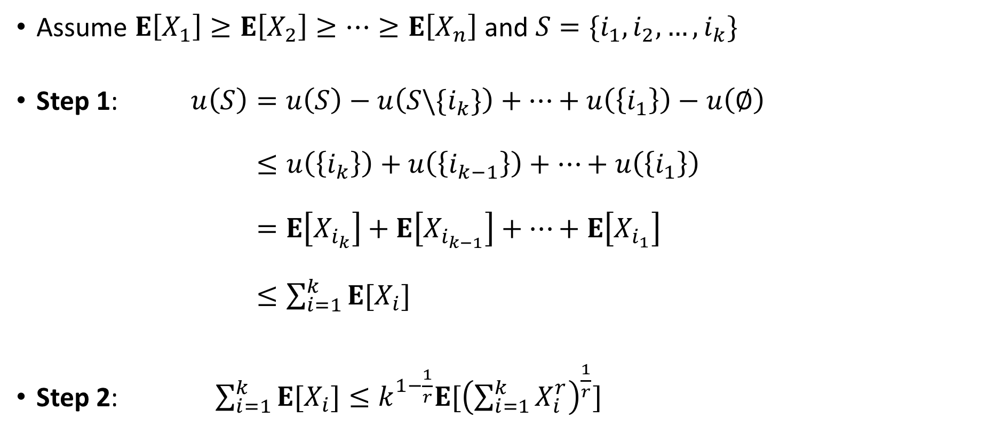
Proof sketch
Assume $E\left[X_{1}\right]≥E\left[X_{2}\right]≥⋯≥E\left[X_{n}\right]$ and $S=\{i_{1},i_{2},…,i_{k}\}$
Step 1: $u\left(S\right)=u\left(S\right)−u\left(S\backslash \{i_{k}\}\right)+⋯+u\left(\left\{i_{1}\right\}\right)−u\left(∅\right)$
$≤u\left(\left\{i_{k}\right\}\right)+u\left(\left\{i_{k−1}\right\}\right)+…+u\left(\left\{i_{1}\right\}\right)$
$=E\left[X_{i_{k}}\right]+E\left[X_{i_{k−1}}\right]+…+E\left[X_{i_{1}}\right]$
$≤\sum_{i=1}^{k}{E[X_{i}]}$
Step 2: $\sum_{i=1}^{k}{E[X_{i}]}≤k^{1−\frac{1}{r}}E[{\left(\sum_{i=1}^{k}{X_{i}^{r}}\right)}^{\frac{1}{r}}]$
(submodular)
(CES)
(Jensen)

Slide 15

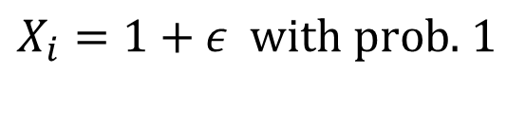

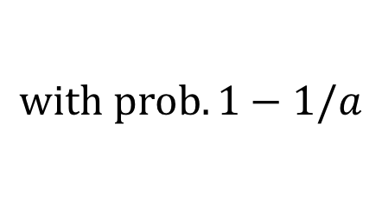

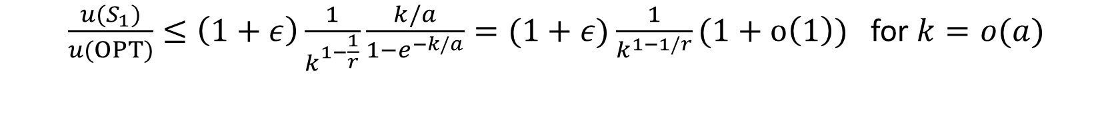
Tight instances
Type 1 individuals:
$$u(S_{1})=k^{1/r}(1+ε)$$
$X_{i}=1+ε$ $with prob.$ $1$
Type 2 individuals:
$u\left(S_{2}\right)≥aP\left[\sum_{i∈S_{2}}{X_{i}}>0\right]≥a(1−e^{−k/a})$
$$X_{i}=\left\{\begin{matrix}0 \\ a\end{matrix}\right.$$
$$with prob. 1−1/a$$
$$with prob. 1/a$$
$\frac{u(S_{1})}{u(OPT)}≤\left(1+ε\right)\frac{1}{k^{1−\frac{1}{r}}}\frac{k/a}{1−e^{−k/a}}=(1+ε)\frac{1}{k^{1−1/r}}(1+o\left(1\right))$ for $k=o(a)$

Slide 16
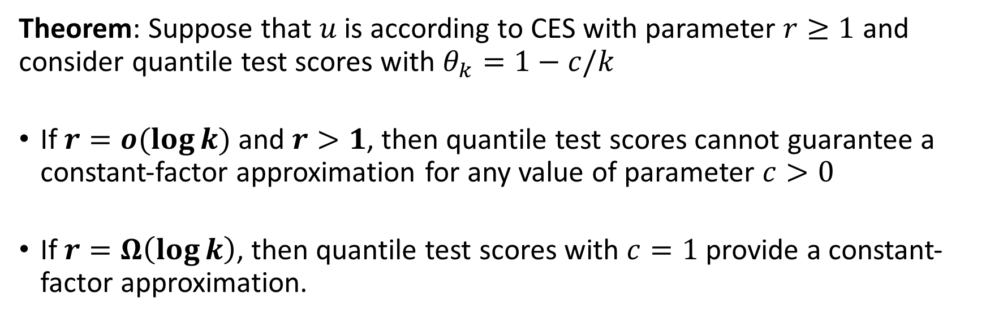



Quantile test scores
Theorem: Suppose that $u$ is according to CES with parameter $r≥1$ and consider quantile test scores with $θ_{k}=1−c/k$
If $r=o(\log{k)}$ and $r>1$, then quantile test scores cannot guarantee a constant-factor approximation for any value of parameter $c>0$
If $r=Ω\left(\log{k}\right)$, then quantile test scores with $c=1$ provide a constant-factor approximation.
Sharp threshold:
$$r$$
$$1$$
$$r^{∗}=Θ(\log{k})$$

Slide 17
Single-project utility maximisation

Slide 18
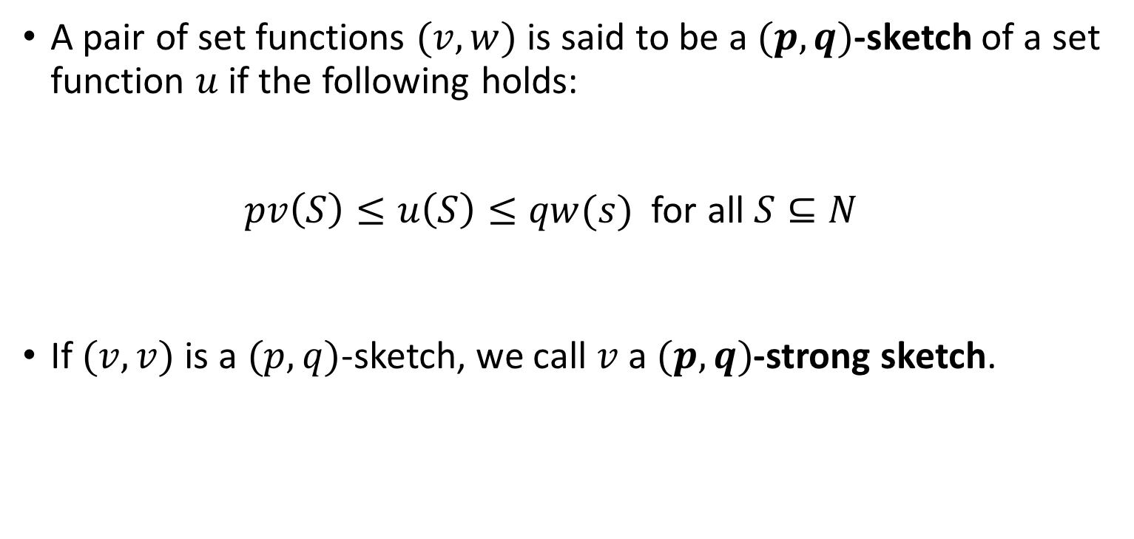
Sketch of a set function
A pair of set functions $(v,w)$ is said to be a $(p,q)$-sketch of a set function $u$ if the following holds:
$pv\left(S\right)≤u\left(S\right)≤qw(s)$ for all $S⊆N$
If $(v,v)$ is a $(p,q)$-sketch, we call $v$ a $(p,q)$-strong sketch.

Slide 19
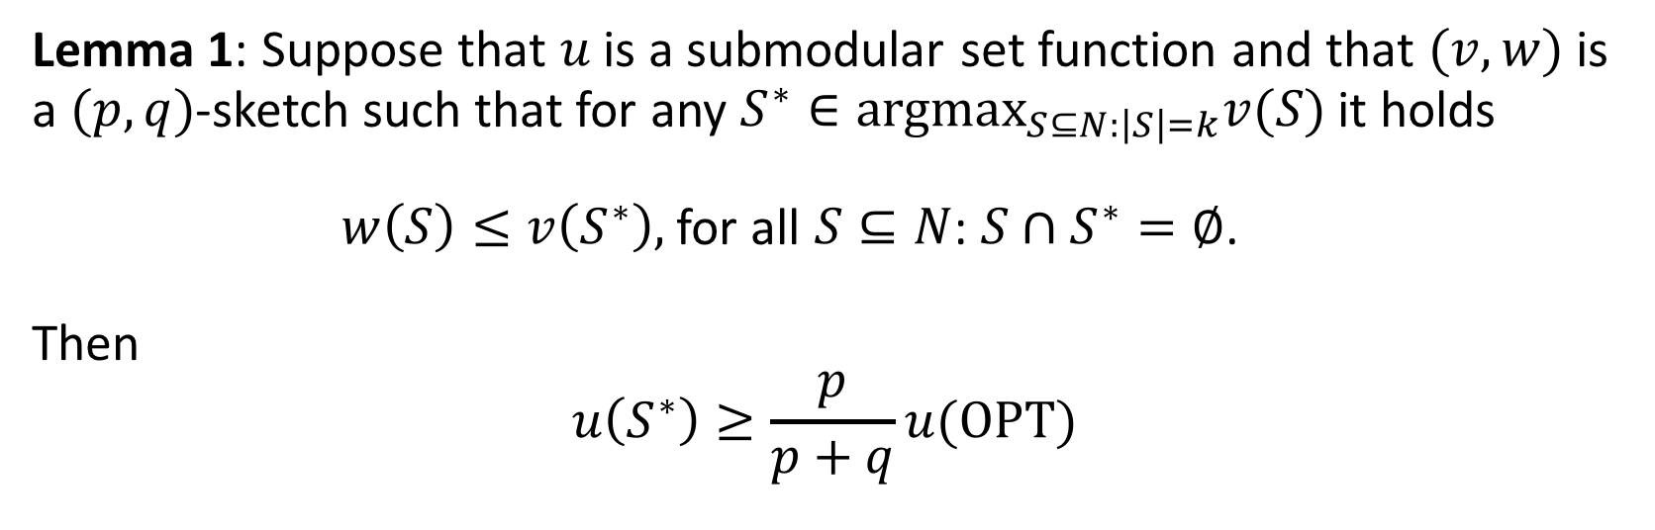
Sketching and submodular utility
Lemma 1: Suppose that $u$ is a submodular set function and that $(v,w)$ is a $(p,q)$-sketch such that for any $S^{∗}∈argmax_{S⊆N:\left|S\right|=k}v(S)$ it holds
$w\left(S\right)≤v\left(S^{∗}\right),$for all $S⊆N$: $S∩S^{∗}=∅$.
Then
$$u\left(S^{∗}\right)≥\frac{p}{p+q}u(OPT)$$

Slide 20
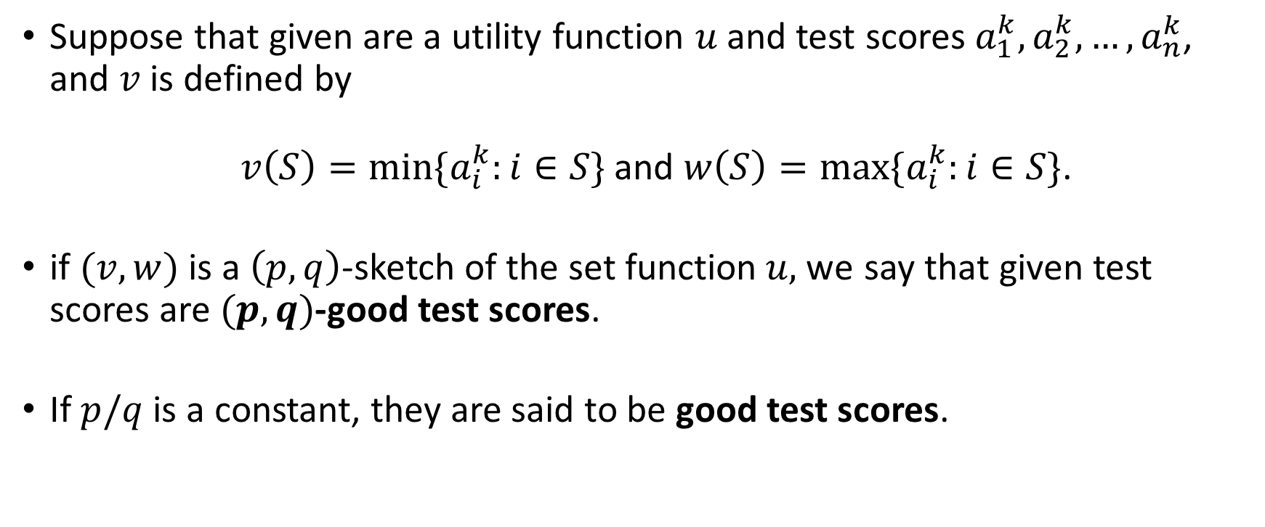
Good test scores
Suppose that given are a utility function $u$ and test scores$a_{1}^{k}, a_{2}^{k},…, a_{n}^{k}$, and $v$ is defined by
$v\left(S\right)=\min{\{a_{i}^{k}:i∈S\}}$ and $w\left(S\right)=\max{\{a_{i}^{k}:i∈S\}}$.
if $(v,w)$ is a $\left(p,q\right)$-sketch of the set function$u,$we say that given test scores are $(p,q)$-good test scores.
If $p/q$ is a constant, they are said to be good test scores.

Slide 21
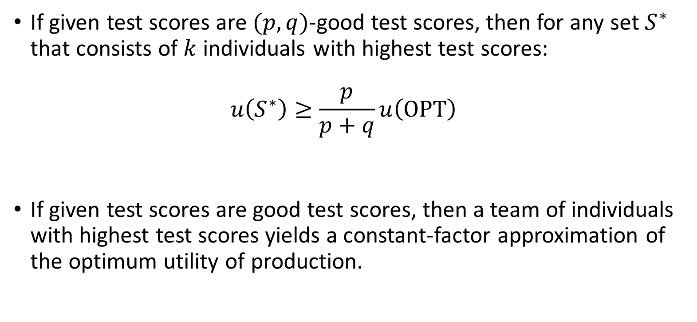
Good test scores (cont’d)
If given test scores are$(p,q)$-good test scores, then for any set $S^{∗}$ that consists of $k$ individuals with highest test scores:
$u\left(S^{∗}\right)≥\frac{p}{p+q}u\left(OPT\right)$
If given test scores are good test scores, then a team of individuals with highest test scores yields a constant-factor approximation of the optimum utility of production.
Lemma 1

Slide 22
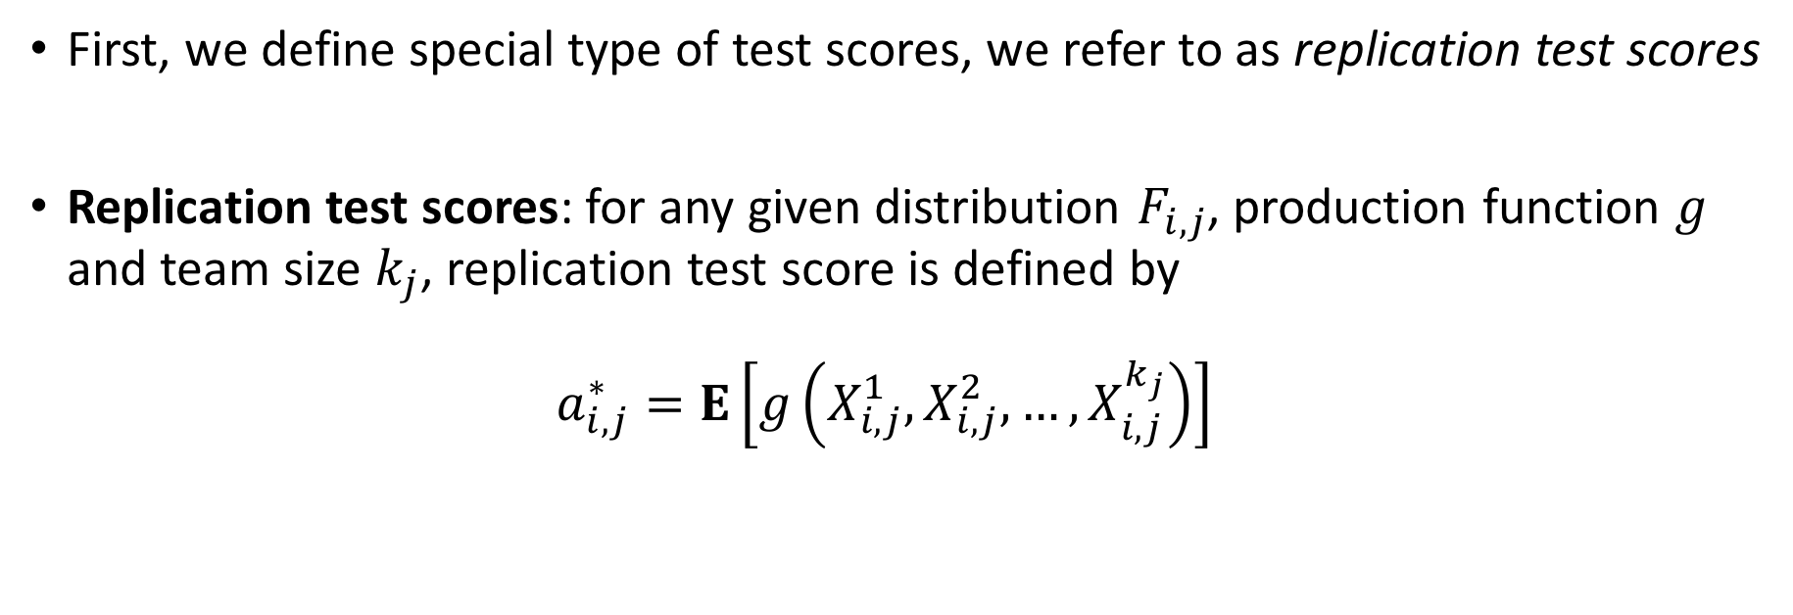
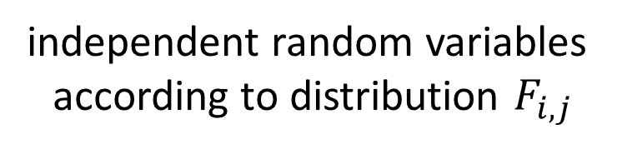
When do good test scores exist?
First, we define special type of test scores, we refer to as replication test scores
Replication test scores: for any given distribution $F_{i,j}$, production function $g$ and team size $k_{j}$, replication test score is defined by
$a_{i,j}^{∗}=E\left[g\left(X_{i,j}^{1},X_{i,j}^{2},…,X_{i,j}^{k_{j}}\right)\right]$
independent random variables
according to distribution $F_{i,j}$

Slide 23
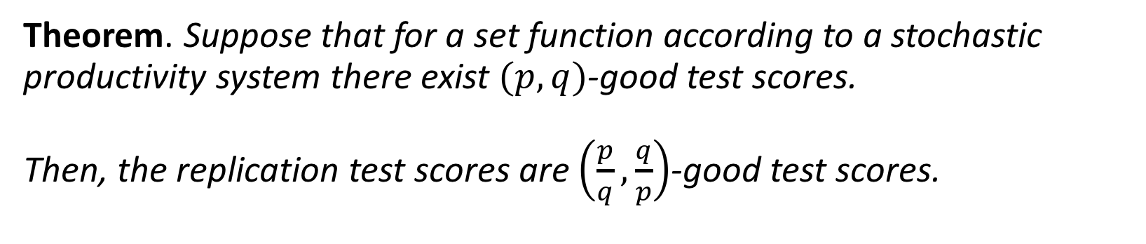
When do good test scores exist? (cont’d)
Theorem. Suppose that for a set function according to a stochastic productivity system there exist $(p,q)$-good test scores.
Then, the replication test scores are $\left(\frac{p}{q},\frac{q}{p}\right)$-good test scores.
In order to check whether good test scores exist, it suffices to check whether replication test scores are good test scores.

Slide 24
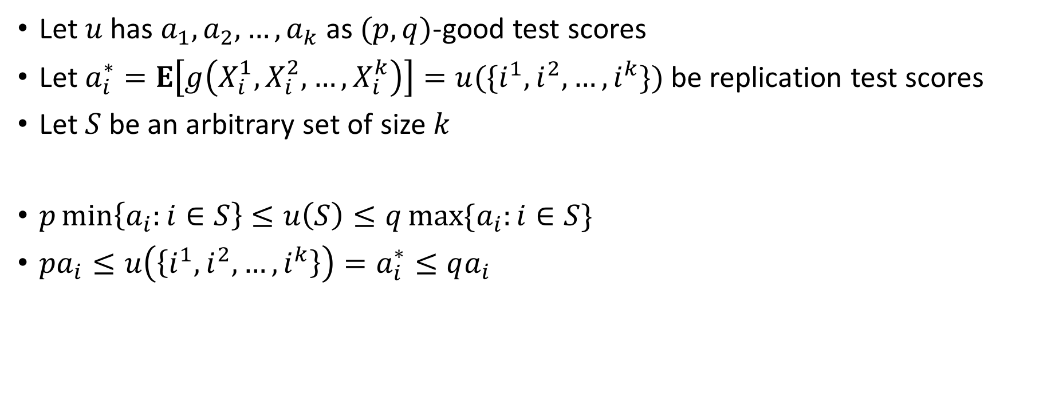
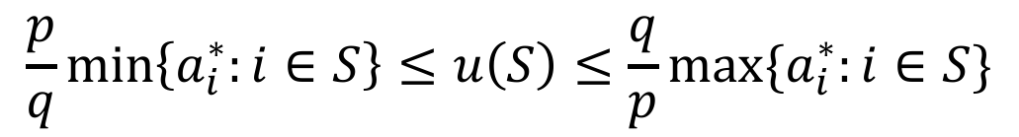
Proof sketch
Let $u$ has $a_{1},a_{2},…,a_{k}$ as $(p,q)$-good test scores
Let $a_{i}^{∗}=E\left[g\left(X_{i}^{1},X_{i}^{2},…,X_{i}^{k}\right)\right]=u({\{i}^{1},i^{2},…,i^{k}\})$ be replication test scores
Let $S$ be an arbitrary set of size $k$
$p\min\left\{a_{i}:i∈S\right\}≤u\left(S\right)≤q\max{\{a_{i}:i∈S\}}$
$pa_{i}≤u\left(\left\{i^{1},i^{2},…, i^{k}\right\}\right)=a_{i}^{∗}≤qa_{i}$
$$\frac{p}{q}\min\left\{a_{i}^{∗}:i∈S\right\}≤u\left(S\right)≤\frac{q}{p}\max{\{a_{i}^{∗}:i∈S\}}$$

Slide 25
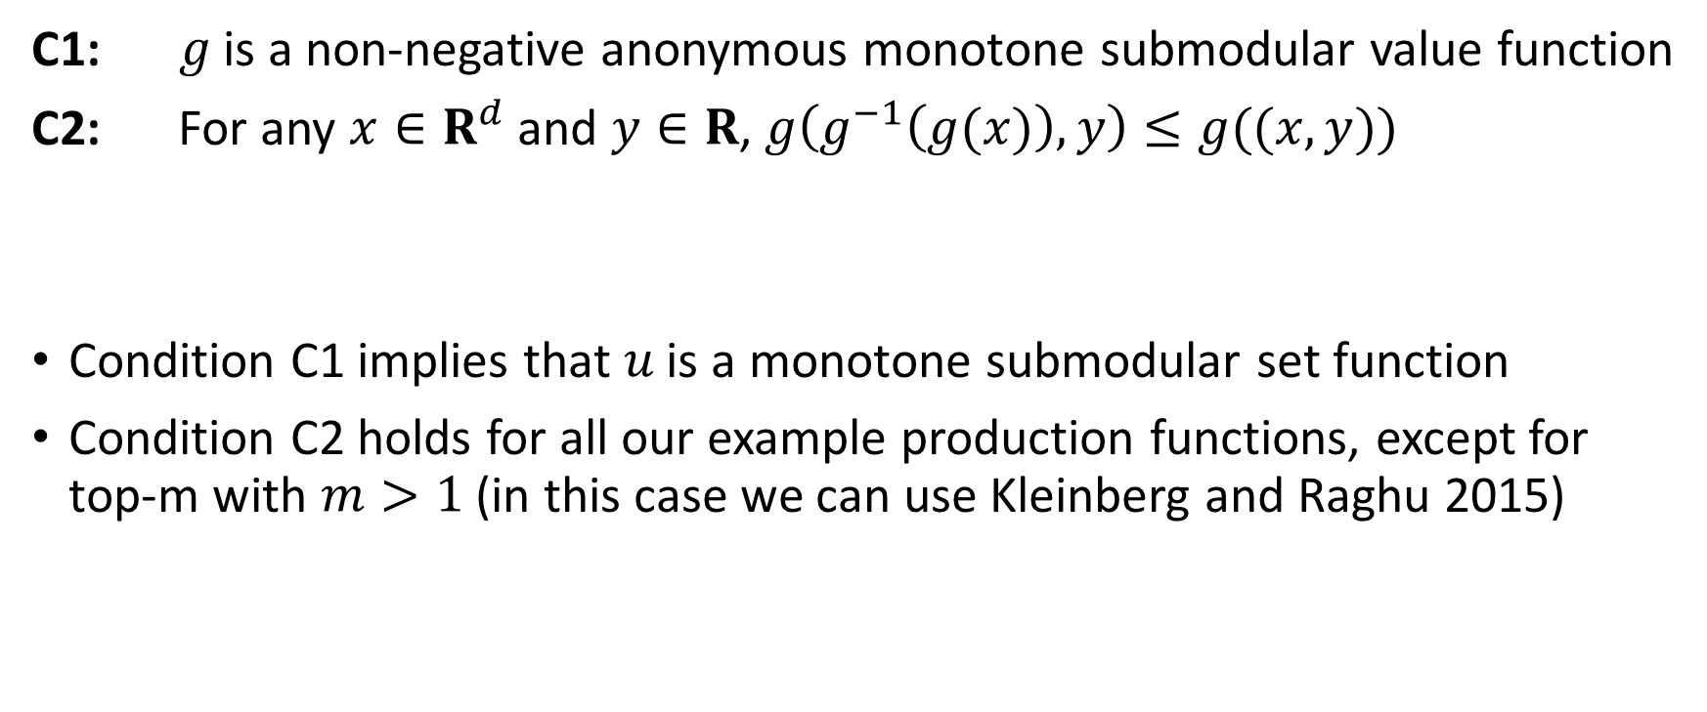
Existence of good replication test scores
C1: $g$ is a non-negative anonymous monotone submodular value function
C2: For any $x∈R^{d}$ and $y∈R$, $g\left(g^{−1}\left(g(x)\right),y\right)≤g((x,y))$
Condition C1 implies that $u$ is a monotone submodular set function
Condition C2 holds for all our example production functions, except for top-m with $m>1$ (in this case we can use Kleinberg and Raghu 2015)
* $g^{−1}$ is the inverse of the production function for a team of size $1$

Slide 26
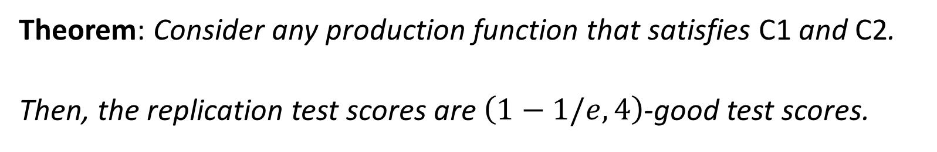
Existence of good replication test scores (cont’d)
Theorem: Consider any production function that satisfies C1 and C2.
Then, the replication test scores are $\left(1−1/e,4\right)$-good test scores.
constant-factor approximation for submodular maximisation problem

Slide 27
Multi-project utility maximisation

Slide 28

Sketching and submodular utility (cont’d)
Lemma 2: Consider a utility maximisation problem with utility functions $u_{1},u_{2},…, u_{m}$ and cardinality parameters $k_{1},k_{2},…, k_{m}$.
Suppose that
each $u_{j}$ has a set function $v_{j}$ that is a $(p,q)$-strong sketch, and
$S_{1},S_{2},…, S_{m}$ is an $α$-approximation for the same optimisation problem, but with utility functions $v_{1},v_{2},…, v_{m}$.
Then
$$u_{1}\left(S_{1}\right)+u_{2}\left(S_{2}\right)+…+u_{m}\left(S_{m}\right)≥α\frac{p}{q}u(OPT)$$

Slide 29
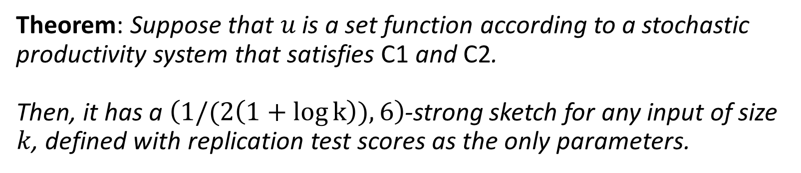
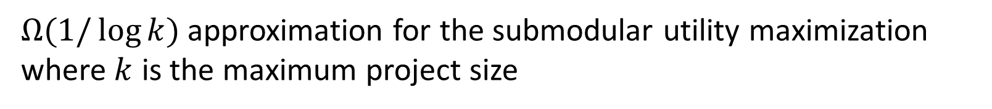
Strong sketch using replication test scores
Theorem: Suppose that $u$ is a set function according to a stochastic productivity system that satisfies C1 and C2.
Then, it has a $\left(1/(2\left(1+\log{k}\right)),6\right)$-strong sketch for any input of size $k$, defined with replication test scores as the only parameters.
$Ω(1/\log{k})$ approximation for the submodular utility maximization where $k$ is the maximum project size
+ Lemma 2
+ a ½ approximation

Slide 30
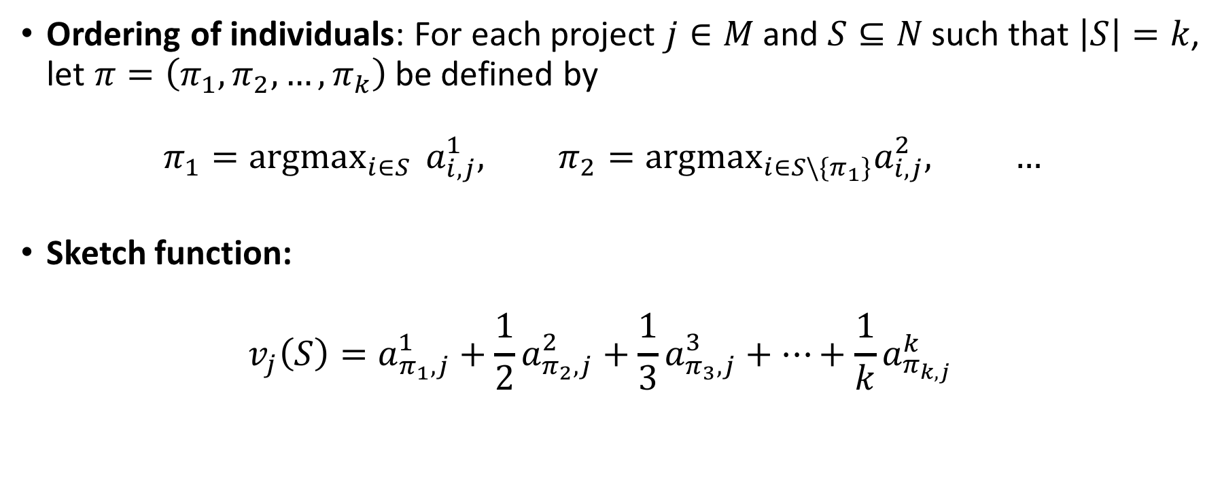
Our strong sketch
Ordering of individuals: For each project $j∈M$ and $S⊆N$ such that $\left|S\right|=k$, let $π=\left(π_{1},π_{2},…,π_{k}\right)$ be defined by
$π_{1}=argmax_{i∈S } a_{i,j}^{1}, π_{2}=argmax_{i∈S\backslash \{π_{1}\}}a_{i,j}^{2}, …$
Sketch function:
$v_{j}\left(S\right)=a_{π_{1},j}^{1}+\frac{1}{2}a_{π_{2},j}^{2}+\frac{1}{3}a_{π_{3},j}^{3}+…+\frac{1}{k}a_{π_{k,j }}^{k}$

Slide 31
Greedy algorithm

Slide 32
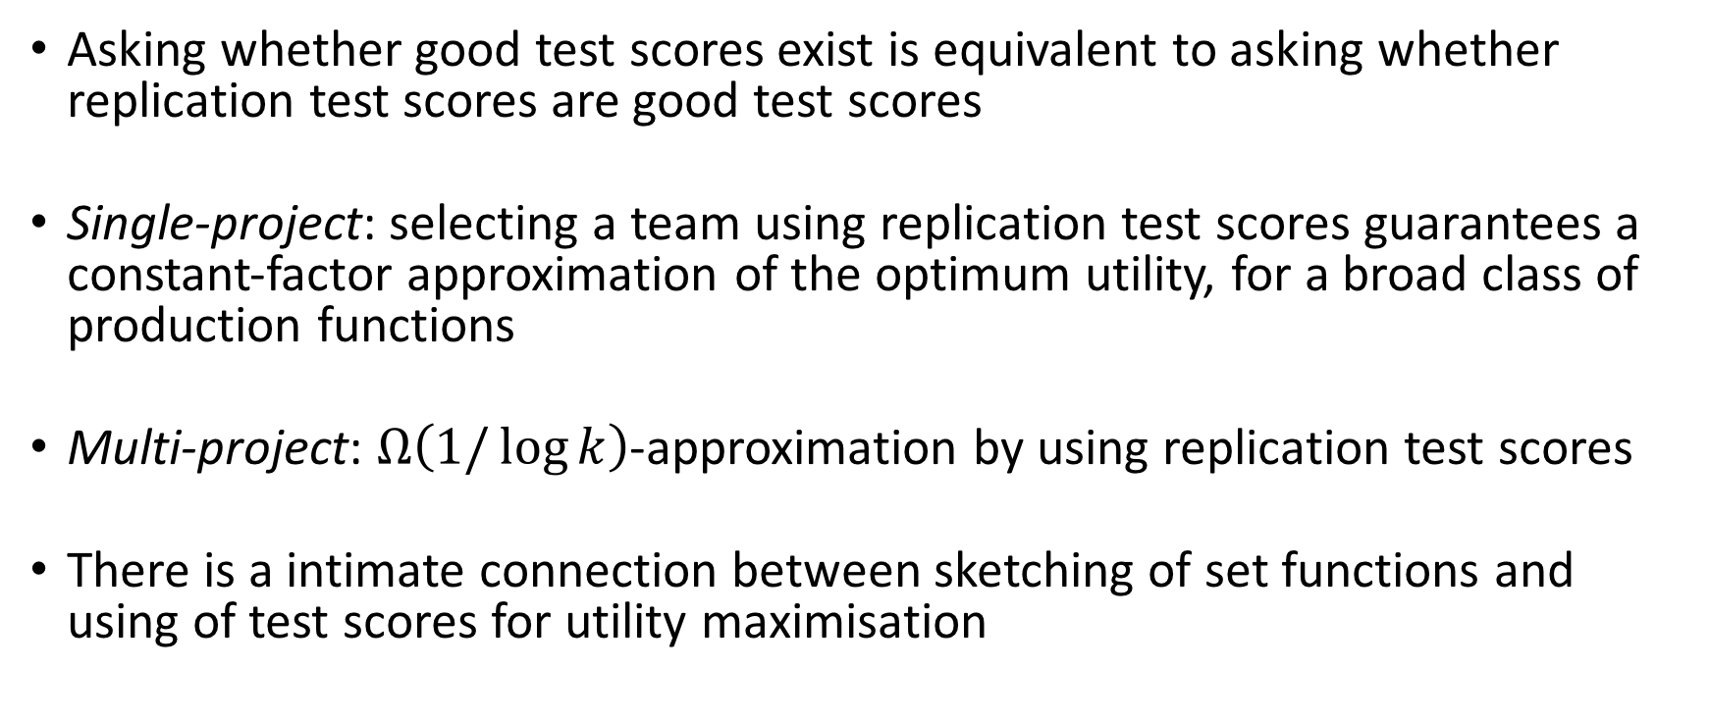
Conclusion
Asking whether good test scores exist is equivalent to asking whether replication test scores are good test scores
Single-project: selecting a team using replication test scores guarantees a constant-factor approximation of the optimum utility, for a broad class of production functions
Multi-project: $Ω\left(1/\log{k}\right)$-approximation by using replication test scores
There is a intimate connection between sketching of set functions and using of test scores for utility maximisation

Slide 33
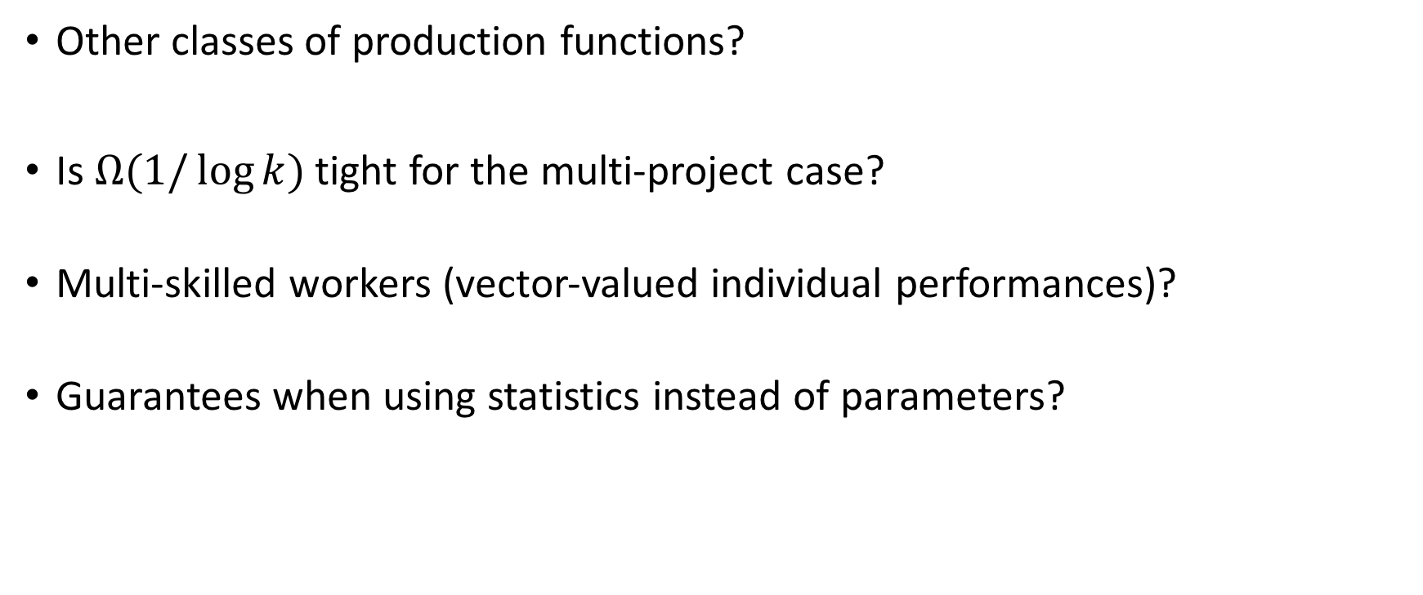
Future work
Other classes of production functions?
Is $Ω(1/\log{k)}$ tight for the multi-project case?
Multi-skilled workers (vector-valued individual performances)?
Guarantees when using statistics instead of parameters?

Slide 34
To probe further
Working paper:
Sekar, S., Vojnovic, M. and Yun, S., Sketching with Test Scores and Submodular Maximization, https://arxiv.org/abs/1605.07172, May 2016

